Slide 1

OVERVIEW OF TREASURER FUNCTIONS
Notes:
We designed this template so that each member of the project team has a set of slides with its own theme. Members, here’s how you add a new slide to just your set:
Mark where you want to add the slide: Select an existing one in the Thumbnails pane, click the New Slide button, then choose a layout. The new slide gets the same theme as the other slides in your set.
Careful! Don’t annoy your fellow presenters by accidentally changing their themes. That can happen if you choose a different theme from the Design tab, which changes all of the slides in the presentation to that look.

Slide 2
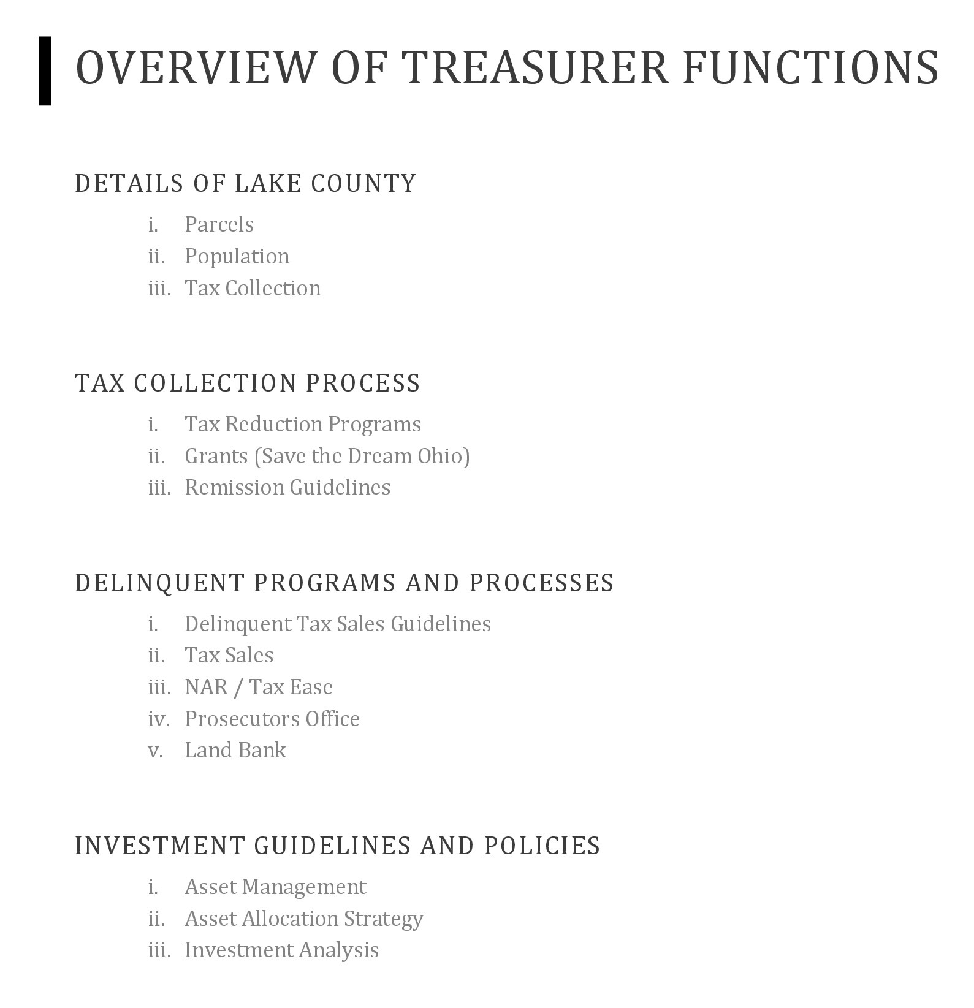


Slide 3
DETAILS OF LAKE COUNTY
Parcels
Population
Tax Collection

Slide 4

PARCELS
113,000 as of Jan. 1, 2021
Add your results here

Slide 5
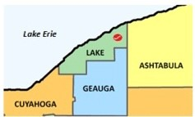
POPULATION
AS OF THE 2020 CENSUS, THE POPULATION OF LAKE COUNTY WAS 232,603

Slide 6
TAX COLLECTION
Approximately $250,000,000 total for February 2022 collection
Taxes are paid one full year in arrears in Ohio
Due dates are always Mid-Feb & Mid-July

Slide 7
REAL ESTATE TAXES
This is a tax levied on land and buildings located within the school district. Individuals and businesses pay this tax on the property they own. Two key components in calculating real estate taxes are the taxable or assessed value (market value x 35%) of the property and the millage rate.

Slide 8
MARKET VALUE
The market value is the estimated sales value of the property. For purposes of real estate taxes, the county auditor determines the market value of all of the property in the county. The county auditor then calculates the taxable/assessed value for each property.

Slide 9
TAXABLE / ASSESSED VALUE
Taxable value and assessed value are different terminologies for the same thing.
The taxable value is determined by taking 35% of the market value of the property. For example, a home that would have a market value of $100,000 would have a taxable value of $35,000.

Slide 10
HOUSE BILL 920
During the 1970s property values were increasing at a very high rate. In 1976 the Ohio Legislature enacted House Bill 920. This bill effectively freezes all voted real estate millage at the dollar amount collected the first year the millage went into effect. As property values rise through reappraisal or triennial update, the outside millage is reduced. In simple terms, the amount of money a school district collects from a levy does not increase as property values increase.

Slide 11
MILLS
Property tax rates are computed in mills. A mill is 1/1000 or .001
One mill cost a property owner $1.00 for every $1,000 of taxable value

Slide 12
INSIDE MILLAGE
In Ohio, millage is referred to as "inside" millage and "outside" millage. Inside millage is millage provided by the Constitution of the State of Ohio and is levied without a vote of the people. It is called inside millage because it is "inside" the law. Another name would be un-voted millage. The Constitution allows for 10 mills of inside millage in each political subdivision (1% without any prior approval or restrictions). Public schools, counties, townships, and other local governments are allocated a portion of the 10 inside mills.

Slide 13
OUTSIDE MILLAGE
Outside millage is any millage "outside" the 10 mills that is provided by the Constitution of the State of Ohio. This millage is voted in by the public. Another name for outside millage is voted millage.

Slide 14
TAX BILLS – LAKE COUNTY FINANCING
DISTRICTS 1 & 2 (MADISON SCHOOLS)
Madison Fire Dept.
Lake County Financing
DISTRICTS 3,4,& 5 (PERRY SCHOOLS)
Perry Fire Dept.
Lake County Financing
DISTRICT 15 (PAINESVILLE CITY SCHOOLS)
Lake County Financing
DISTRICTS 7,8,11,13,&35 (RIVERSIDE SCHOOLS)
Lake County Financing
Lake County Financing District was created (1990) by the above 4 school districts to share in revenue of the Perry Power Plant

Slide 15
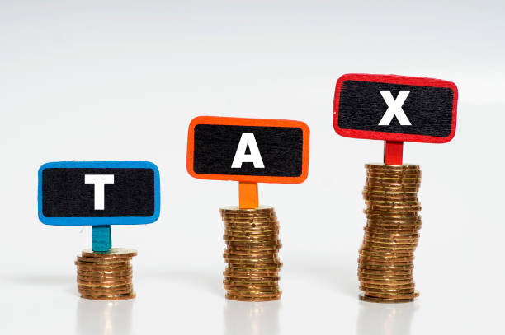
TAX COLLECTION PROCESS
Tax Reduction Programs
Grants (Save the Dream Ohio)
Remission Guidelines

Slide 16
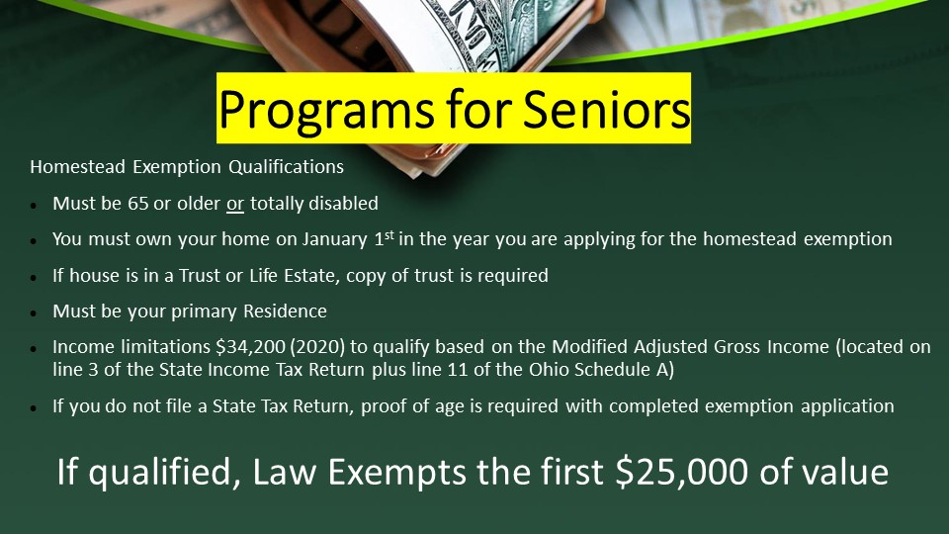
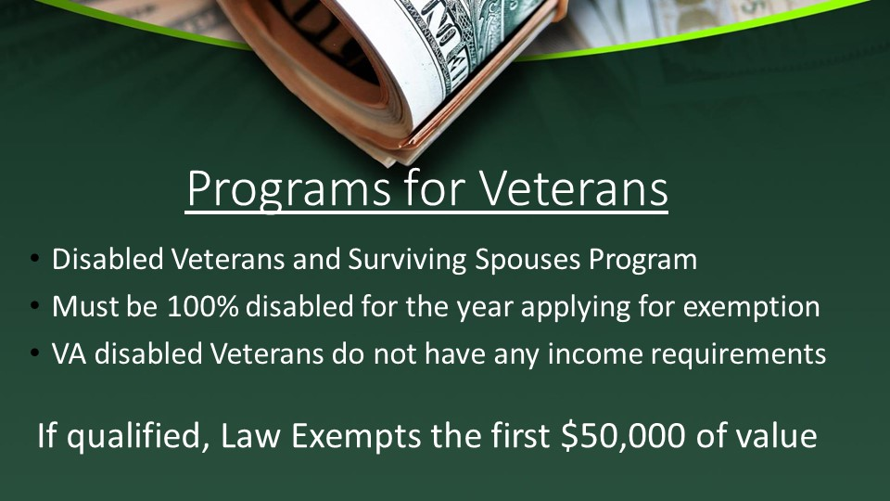
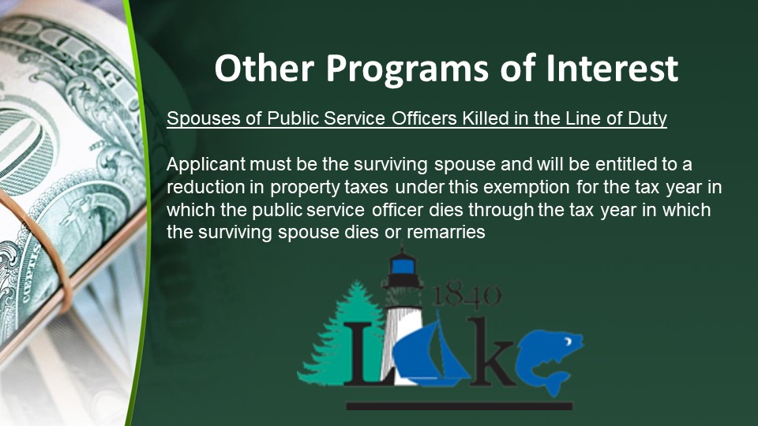
TAX REDUCTION PROGRAMS

Slide 17


GRANTS

Slide 18
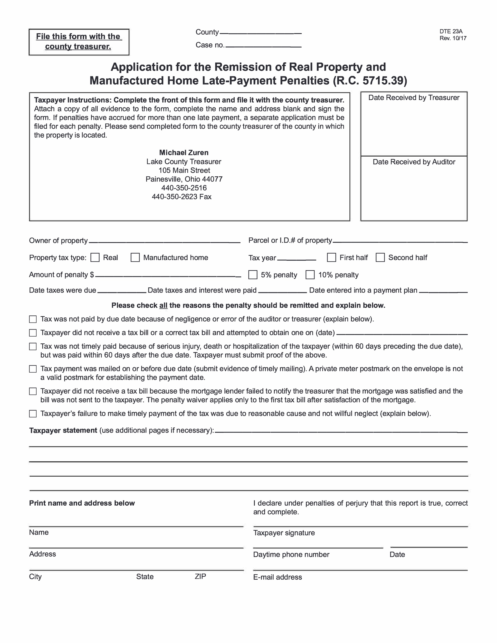

REMISSION GUIDELINES

Slide 19
DELINQUENT TAX
A number of delinquencies are created due to incorrect or lack of information on the conveyance forms
at transfer!
** Correct tax mailing address and phone numbers should be included on the form **
Sales/Transfers within 3 months of collection due dates sometimes create delinquencies or overpayments
Who is paying? Buyer/Seller/Lender/Title Co?

Slide 20
DELINQUENT TAX SALES GUIDELINES
Have delinquent property taxes for a minimum of 3 tax billing cycles
Not on a payment plan with the Treasurer
Parcels with the aforementioned criteria will:
Be able to enter into a payment plan
Go to tax lien sale
Be referred to the Prosecutor’s office for collection / foreclosure

Slide 21
TAX SALES
TAX
SALES
Lien sales are handled in office
Tax/sheriff sales are conducted by the Sheriff’s department in conjunction with the Prosecutor’s office or the purchaser of the tax lien

Slide 22

NAR / TAX EASE
Liens placed 2021 and after:
For information regarding how to resolve your Tax Lien,
Please contact us ASAP at:
Our Toll-Free Number : 1 (866)960-0067
If you have any issues or need additional information, you may also contact our Chief Director of Government Relations:
Dawn Hoosier
Email: dhoosier@narsolutions.net
Cell Phone: 1(513)236-5487
NAR Ohio is here and happy to assist you in resolving this matter.
Liens placed before 2021:
Tax Ease Ohio, LLC
Call Center: 1-866-907-2626 Call Center Hours: 7am – 6pm EST (M-F) Live Answering
Email: OHinfo@taxease.com Customer Service: www.TaxEaseOhio.com
Checks made payable to:
US Bank, as CF for Tax Ease Ohio

Slide 23
PROSECUTORS OFFICE
Tax Collection
The Prosecutor’s Civil Division attorneys are charged with representing the County Treasurer in enforcing the collection of all delinquent real and personal property taxes in Lake County.
Your Lake County Prosecutor’s Office is a full service law firm representing all of the County’s boards and offices, certain other political subdivisions and the State of Ohio. Unlike other law firms, the Prosecuting Attorney is vested with personal discretion entrusted to him as a minister of justice, and not merely as an advocate. The Prosecuting Attorney acts as the chief law enforcement official for the County.

Slide 24
LAND BANK
Mission
The mission of the Land Bank is to help stabilize and/or increase property values, strengthen communities and help to enhance the overall quality of life for Lake County residents. We accomplish this goal by revitalizing abandoned and/or blighted residential or commercial structures, either by acquisition for rehabilitation and/or demolition. Further collaborative efforts keep an eye towards economic development, creating green space when appropriate, and when possible – making permanent neighborhood improvements.
Board
A land reutilization corporation is a creature of Ohio Statute, which also defines the makeup of the board of directors. A board must consist of the county’s treasurer, two of the three sitting county commissioners, a director/representative from the county’s largest city and an individual chosen by the townships having a population in excess of 10,000 residents. At the discretion of the Board, four additional voting directors have been added including one required by law to have a background in real estate. Appointments are subject to a required unanimous approval of the treasurer and two commissioners. The current four voting directors were solicited by advertisement in the News-Herald and selected after an interview process. Appointments consist of staggered three year terms.

Slide 25
INVESTMENT GUIDELINES AND POLICIES
Asset Management
Asset Allocation Strategy
Investment Analysis

Slide 26
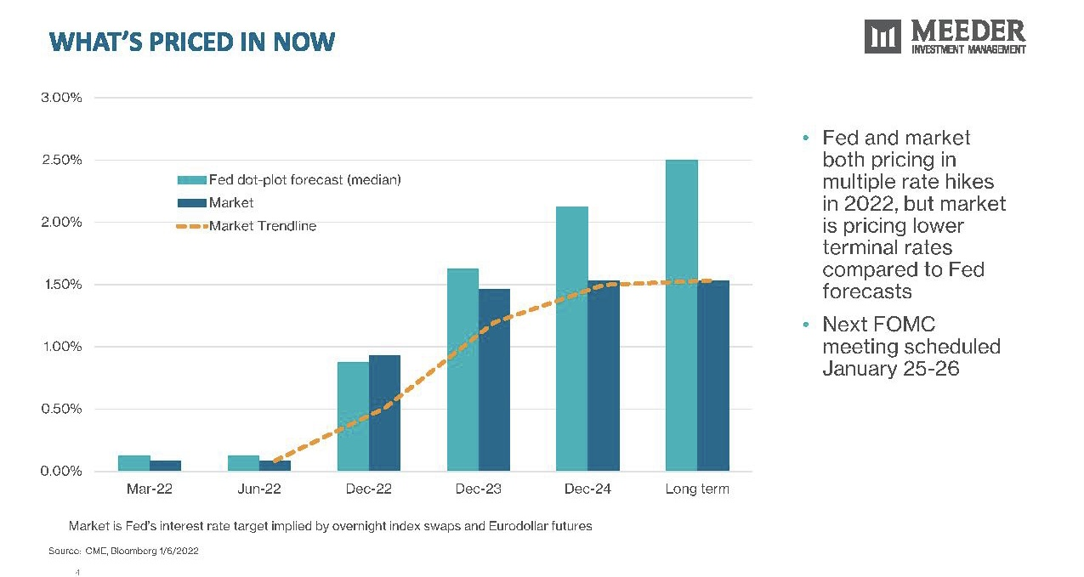
ASSET MANAGEMENT

Slide 27
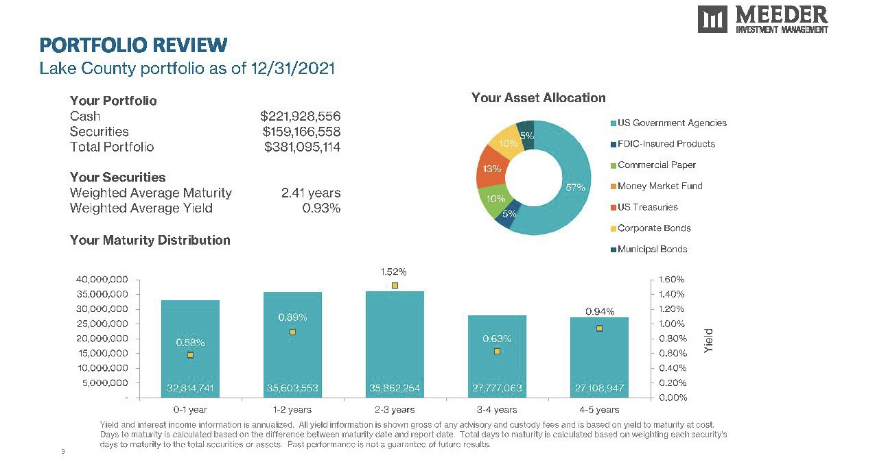
ASSET ALLOCATION STRATEGY

Slide 28
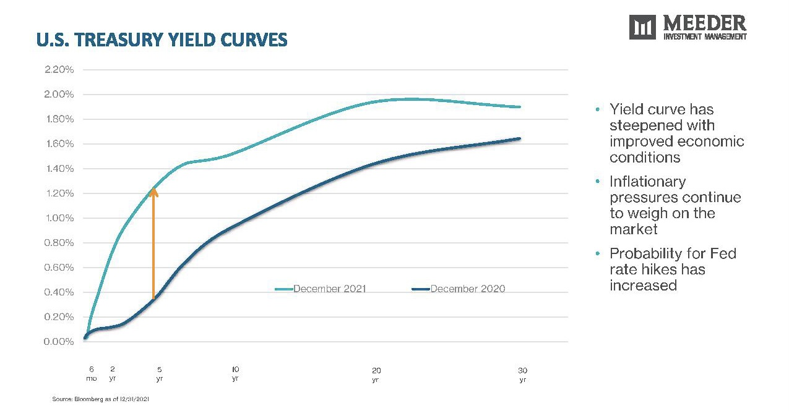
INVESTMENT ANALYSIS

Slide 29
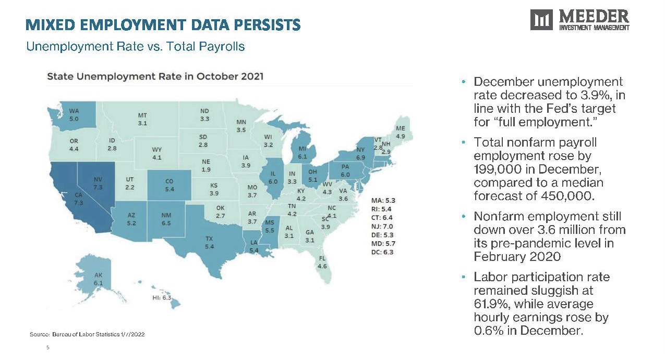

Slide 30
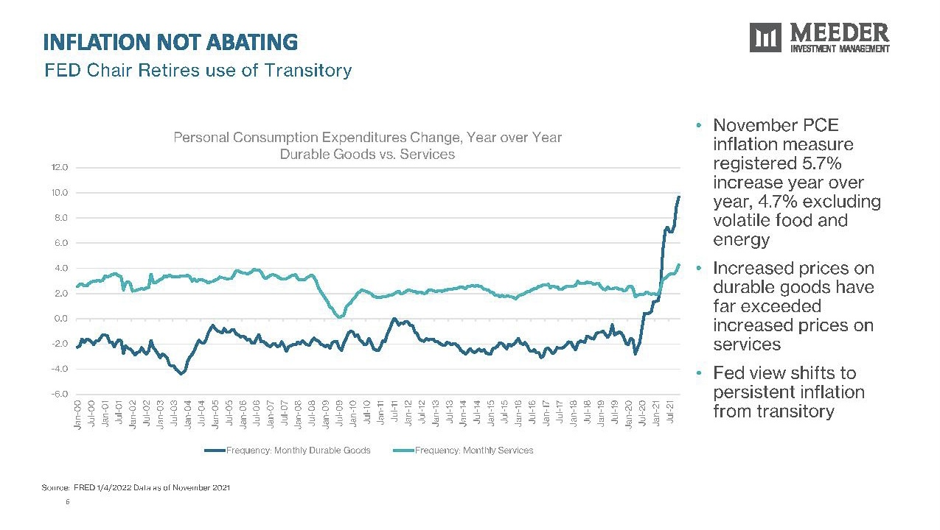

Slide 31

QUESTIONS
AND
ANSWERS

