Slide 1


Identity Theft
AND FRAUD

Slide 2
Identity Theft Explained
Identity theft occurs when a criminal steals your personal information and uses it without your permission, looking to steal your money, data and other personal assets.

Slide 3
What is Identity Fraud? Identity fraud and identity theft are similar, and the terms can be used interchangeably. However, identity fraud is different in that it specifically refers to using the stolen information, while identity theft may only involve stealing your personal information.

Slide 4
What kind of personal information do they steal? It can be your: * Name and address * Credit card or bank account numbers * Social security number * Medical insurance account numbers * Driver’s license * Mortgage

Slide 5
What is the effects of identity theft?
There are several ways identity thieves can use your personal information to their advantage:
Steal money or benefits, identity sold on the dark web, or impersonate you on social media or to get a job or apartment.

Slide 6
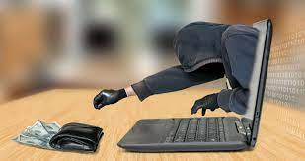
What can a thief do with your information? * Empty your bank account * Buy things with your credit cards * Get new credit cards * Open cell phone, electricity or gas account * Steal your tax refund * Get medical care * Pretend to be you if they are arrested

Slide 7
Common Types of Scams
Threatening Calls
Request for a specific type of payment
(like a gift card)
Unusual
Emails
Online Account
Scams
Offers to collect tax payment in person
IRS or Government
Imposter

Slide 8
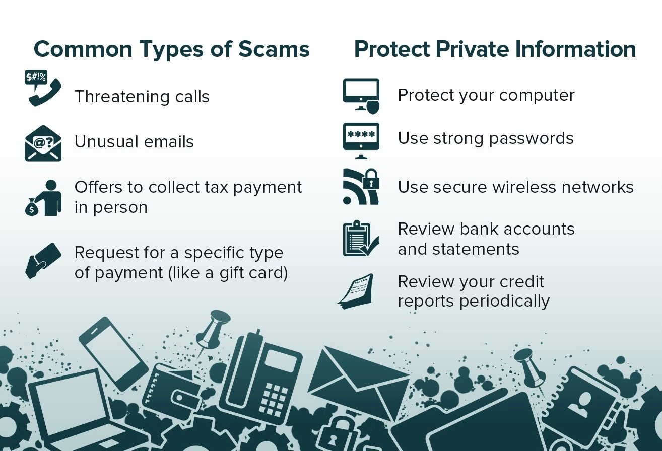

Slide 9
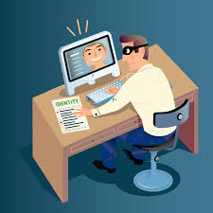
Protect Private Information
Protect your computer
Use strong passwords on computer or tablet
Use secure wireless networks
Review bank accounts and statements
Review your credit reports periodically

Slide 10
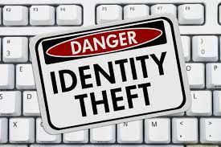
Has anyone had their identity stolen? How did you know? What did you do?

Slide 11
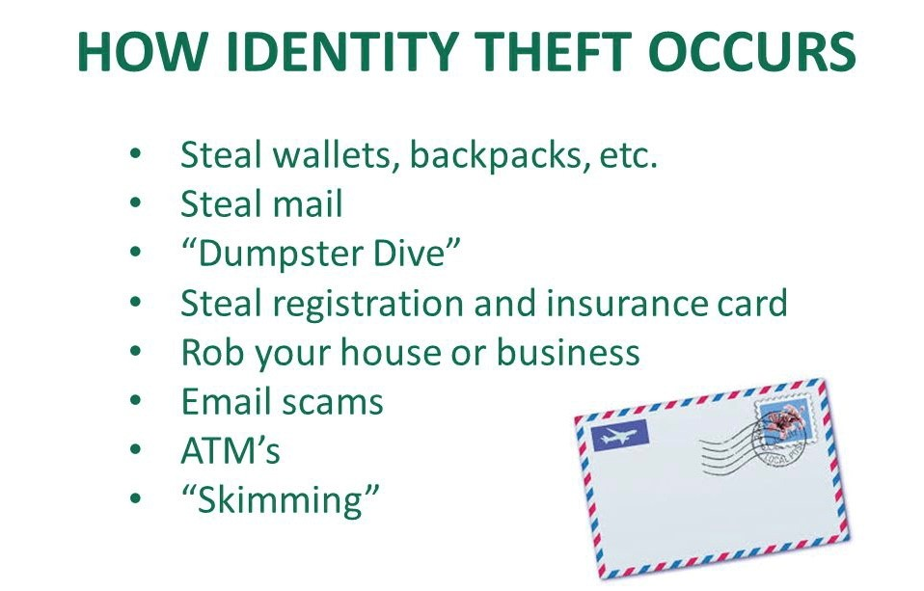

Slide 13
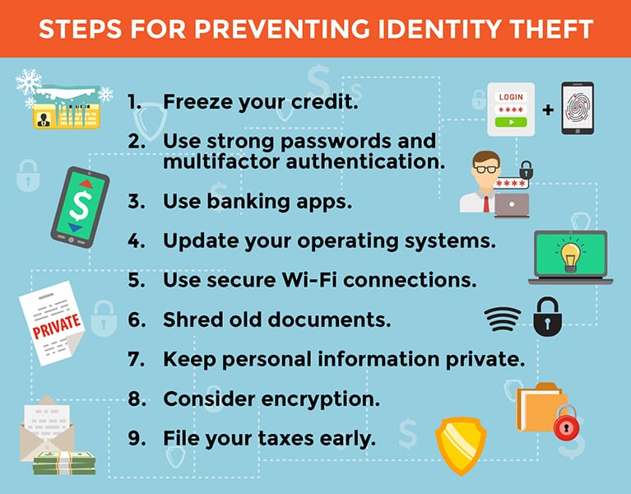

Slide 14
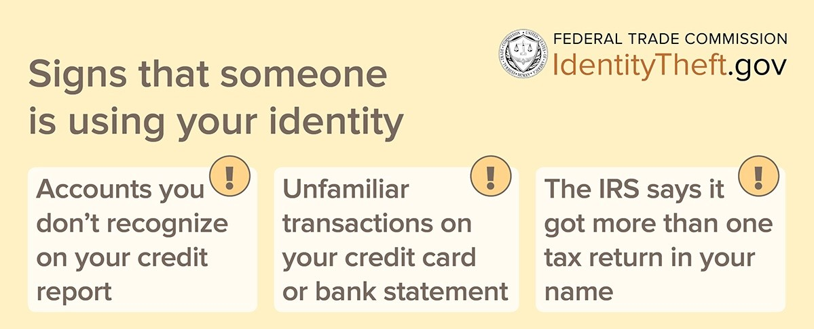

Slide 15
Freeze Your Credit
If you’ve noticed some unusual activity on your credit report, then you might need to initiate a credit freeze for identity protection. It will prevent fraudsters from causing further damage while giving you time to sort things out. Follow these steps to freeze your credit.

Slide 16
How Do You Put a Credit Freeze on Yourself?
A credit freeze is essentially a lockdown of your credit file. Once you request to have your credit frozen, no one can open any new credit accounts under your name. Additionally, people and businesses are unable to access your credit report or history. Many people opt to freeze credit if they’re worried about identity theft. It’s an extreme move and it’s usually the last resort for most people. In order to initiate a credit freeze, you’ll need to contact each credit bureau individually.

Slide 17
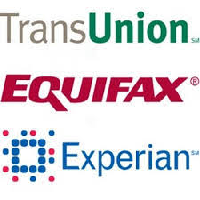
How Do You Put a Credit Freeze on Yourself?
A credit freeze is essentially a lockdown of your credit file. Once you request to have your credit frozen, no one can open any new credit accounts under your name. Additionally, people and businesses are unable to access your credit report or history. Many people opt to freeze credit if they’re worried about identity theft. It’s an extreme move and it’s usually the last resort for most people. In order to initiate a credit freeze, you’ll need to contact each credit bureau individually.

Slide 18
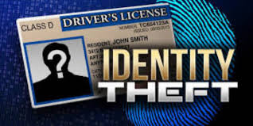
Because there are so many ways someone can steal your identity, it is virtually impossible to prevent becoming a target altogether. Even if you do not have a lot of liquid assets, an impressive credit score, or access to valuable targets, such as people or secured systems, a thief can still make a profit off your identity.

Slide 19
In many cases, what happens after your identity has been stolen may have a minimal financial impact. However, a thief can make anywhere from a few to hundreds of dollars by selling your identity. Therefore, identity thieves typically go after anyone because each identity has an intrinsic value on the black market. In other situations, the thief aims to personally exploit your identity. If this is the case, they may be more surgical regarding who they choose to target.

Slide 20
In either case, you can minimize your chances of falling victim to identity thieves by learning how it happens, the different kinds of identity theft, signs you have been targeted, and how to protect yourself from these kinds of attacks.

Slide 21
How Identity Theft Happens
The term “identity theft” encompasses a broad range of methods of stealing other people’s information. However, it is common for a thief to target high-value information, such as a Social Security number, and use it to buy something, open an account, or commit fraud that involves impersonating the individual, particularly online.
There are several ways this happens.

Slide 22
Data Breaches
A data breach is when a thief or hacker is able to access the data of an organization without receiving the proper authorization. The company may have sensitive information stored in a central location. The thief targets the database or file holding that information and tries to penetrate any cyber defenses in place. In many cases, the thief will focus on getting credit card or Social Security numbers, as well as the complete names of the owners.

Slide 23
Files containing other information can be highly sought-after targets as well, particularly because that information can be used to correlate the identity of each person. For example, where the individual lives, has lived in the past, their phone number, old phone numbers, or maiden names can all be the targets of a data breach.

Slide 24
In 2019, there were 1,506 data breaches in the United States, resulting in the exposure of 164.68 million sensitive records. It is difficult to avoid having some of your information included in one of the many data breaches that occur each year. This is because most people have their personal data stored within the databases and files of multiple companies with whom they do business.

Slide 25
Unsecure Browsing
In most cases, the websites you visit are safe. They are protected by security measures that prevent hackers from gaining access to the information you enter. The protection often involves encrypting the data that gets entered. This way, if a thief were to intercept data, they would only get a jumbled arrangement of letters, numbers, and symbols instead of your Social Security number, name, address, etc.

Slide 26
However, if you use websites that are not as well-known, you may be putting yourself at risk. Even if the website’s designer had good intentions, the website itself may have been compromised by a hacker.

Slide 27
In other cases, a hacker can design a fake website that looks like a real one. When you enter your information, it goes straight to the hacker instead of the company you thought you were sending it to.

Slide 28
Dark Web Marketplaces
The dark web consists of a network of websites hidden from regular internet users. When someone visits the dark web, they can use software to hide who they are, as well as what they are doing while connected. This makes the dark web an ideal place for thieves, hackers, and others looking to defraud users.

Slide 29
Often, your browser can detect fraudulent websites and alert you to the danger. If you get an alert, it is best to take action by leaving the website and closing your browser.

Slide 30
As a result, the dark web is a prime selling ground for your personal information. Hackers recognize the elevated risk associated with trying to exploit personal information themselves, so they often head to the dark web to sell it off to someone else.

Slide 31
Malware Activity
With malware, or malicious software, a hacker can accomplish any number of things—from taking over a computer system to controlling a network, to providing backdoor access and more. Malware can also be used specifically to steal personal information.
The most common way malware is used to execute identity theft or fraud is when it is programmed to spy on the target’s computer activity. The attack may begin with a phishing email or other trap designed to get the user to click on a link or image that automatically installs the malware.

Slide 32
The initial buyer may use it or sell it to another malicious actor to make a quick profit. Therefore, if your information goes to the dark web, it is virtually impossible to say how it will be used.

Slide 33
An attack can be performed using a number of methods, such as keyloggers, which can keep track of which keys a user strikes. When the user accesses a particular website or logs in to their computer, the keylogger can record their keystrokes and report them back to the thief.

Slide 34
Credit Card Theft
Credit card theft is one of the most simple ways a thief can steal your identity. Once they have access to your credit card, they often do not need any other aspect of your identity—the card itself is enough to make purchases under the target’s identity.

Slide 35
A thief may even make relatively large purchases the user could not possibly pay off. They could then sell the item to someone else at a steep discount, banking a profit along the way.
Credit card theft can also be used to grab card numbers for resale on the dark web. A credit card number may go for a few dollars or far more.

Slide 36
The thief gets your credit card information and then sells it to someone else. It is important to instantly cancel any credit cards that have been lost or stolen, but often, a data breach is used to get ahold of your card information.

Slide 37
Mail Theft
Even before the internet, identity thieves were busy taking people’s personal information and using it for their benefit. A common method was mail theft. In this kind of attack, the thief grabs the target’s credit card or other information from their mailbox. They then try to use it to make purchases—or sell it to another thief for a quick profit.

Slide 38
Companies store long lists of credit card information to help their customers make quicker purchases. When the customer first does business with the company, the credit card information is obtained and kept in a secure location. When the customer returns, because their card information is already in the company’s system, their next purchase is quicker and easier. This convenience comes at a cost, however, because if someone is able to penetrate the defenses protecting customers’ card information, they can get a storehouse of account numbers.

Slide 39
Phishing and Spam Attacks
An attacker may send an email or text message that looks like it is coming from a legitimate source. When the target clicks on a link, they are taken to a fake website that asks you for your username, password, or other personal information like your Social Security or credit card number. The hacker can then use that information to assume your identity or make purchases.

Slide 40
A thief does not have to go into your mailbox to take your credit card or gather personal information. It is just as easy to go through your trash. Often, people throw out letters, notices, or account statements that contain sensitive information. Even if the information in the trashed document is not enough to execute a complete theft of your identity, it can be used by the thief to confirm who you are. It is best to shred your old mail instead of just throwing it in the garbage.

Slide 41
Wi-Fi Hacking
Anytime you use your computer or mobile device on a public network, you may be vulnerable to a hacker that can eavesdrop on your communications with the network. This is a particularly prevalent issue at places like coffee shops, department stores, or airports where anybody can get onto the network, often without a password.

Slide 42
Mobile Phone Theft
Some people use their mobile phones to log in to sites automatically, without having to enter their username or password. If someone gets ahold of your mobile phone, they may be able to access these same sites, especially if they do not need to enter a password or use biometric verification, such as a fingerprint or facial scan.
Mobile phone theft is also popular because people often store their personal information, including passwords and account numbers, in applications on their phones.

Slide 43
This may include an app where you can manage and edit notes or email and text apps. If a thief can take your phone and get into it, they can easily navigate to your emails and text messages to steal information.
Further, if they want to execute a more sophisticated attack, they can use your phone to fulfill the second stage of a two-factor authentication (2FA) access procedure. When the site or application sends a text to you, the thief receives it and can then enter a verification number to gain access to the application or site.

Slide 44
Once the hacker has started spying on your communications, they watch to see if you enter your personal information. They may specifically be after your Social Security, credit card, or bank account number. Once they have it, they can use it to make purchases, masquerade as you online while opening accounts, or sell the information to someone on the dark web.

Slide 45
Card Skimming
Credit card theft may also involve skimming. In a skimming attack, a fake credit card machine is installed on a gas pump or another point-of-sale (POS) device. It is then used to collect the card information of customers as they swipe their cards. A skimming attack often uses a hidden camera to record the target’s password, particularly if they are using a debit card.

Slide 46
Child ID Theft
With child ID theft, the child’s personal information is used to execute the attack. This may include the child’s Social Security number, which can be mailed to you soon after they are born. The attacker may not use the information for many years, waiting until the child is old enough to get a credit card. When they reach the right age, the thief then uses the information to open an account or obtain credit in the name of the child.

Slide 47
It is important to keep an eye out for any credit card machine that looks out of the ordinary. For example, the card-swiping device may protrude excessively from the machine or the device may be loose when you shake it. If anything seems suspicious, stop using the machine, check around for small cameras pointed toward it, then alert the proper authorities. Letting them know the reasons why you suspected a skimming machine, as well as the exact location, can help them track down the perpetrator and protect your information and that of others.

Slide 48
Tax ID Theft
With tax ID theft, the attacker uses your social security number and other necessary information to file taxes and then collect your refund. They may also alter the tax information they enter to inflate the refund they get. If this happens to you, there is a chance you will not know until you try to file your taxes. The Internal Revenue Service (IRS) will then alert you that someone has already filed a tax return in your name. After an investigation, you should be able to file your taxes and get the refund you are entitled to.

Slide 49
Keep an eye out for the following signs that may indicate your identity has been stolen:
Discrepancies in your financial statements
Unauthorized purchases in your bank statements
You get calls from debt collectors about charges you did not initiate
You get a letter from the IRS about multiple tax returns
You get medical bills for services you never used
You see strange charges on your credit card statement
You are not getting bills in the mail, which could be because the thief has changed your address, resulting in your mail getting routed somewhere else
You get rejected for a loan even though you usually have good credit, which could mean a thief was borrowing money in your name and not repaying it

Slide 50
To protect yourself from identity theft, you can implement the following measures:
Use complex passwords for all your accounts and devices. This should include multiple, non-sequential or logical letters, numbers, and symbols
Enable multi-factor authentication (MFA)
Never provide personal information, especially over the phone, to someone who calls unexpectedly
Shred all documents prior to putting them in the trash
Use paperless billing to prevent account numbers from getting to your mailbox or trash
Store your debit, credit, Social Security, Medicare, and other cards in a secure area in your home
Frequently check your bank and credit card accounts for unusual activity
Never click suspicious links
Arrange for your bank or credit card company to alert you every time a withdrawal has been made from your account

Slide 51
What To Do if You Think You Are a Victim
If you think you have been targeted, you should immediately cancel your credit and debit cards. Also, reach out to the credit bureaus Experian, Equifax, and TransUnion. If you report the situation to one, it is required by law to pass the information on to the others. This way, your credit score can be protected if unauthorized transactions are performed in your name.
You should then alert the authorities. You can use the website of the Federal Trade Commission (FTC) to figure out how to proceed.

Slide 52
Steps to Repair Identity Theft 1. Contact the three main credit agencies and request fraud alerts and credit freezes. This will make it more difficult for identity thieves to open new credit in your name. 2. Dispute fraudulent accounts with the three main credit bureaus. 3. Dispute fraudulent charges directly with the affected creditors. 4. For lost or stolen credit and debit cards, federal law limits your liability if your credit or debit card is lost or stolen, but you have a limited amount of time to report the loss or theft.

Slide 53
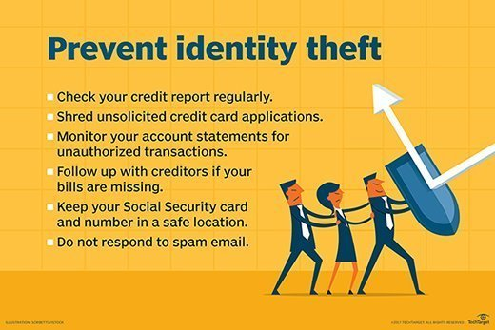

Slide 54
If you’re a victim: Contact Federal Trade Commission IdentityTheft.gov

Slide 55



