Slide 1

New 12 month payment plan | Homestead & tax credits
Medicare Options | Identity Theft
CHRISTOPHER GALLOWAY,
Lake County Auditor

Slide 2
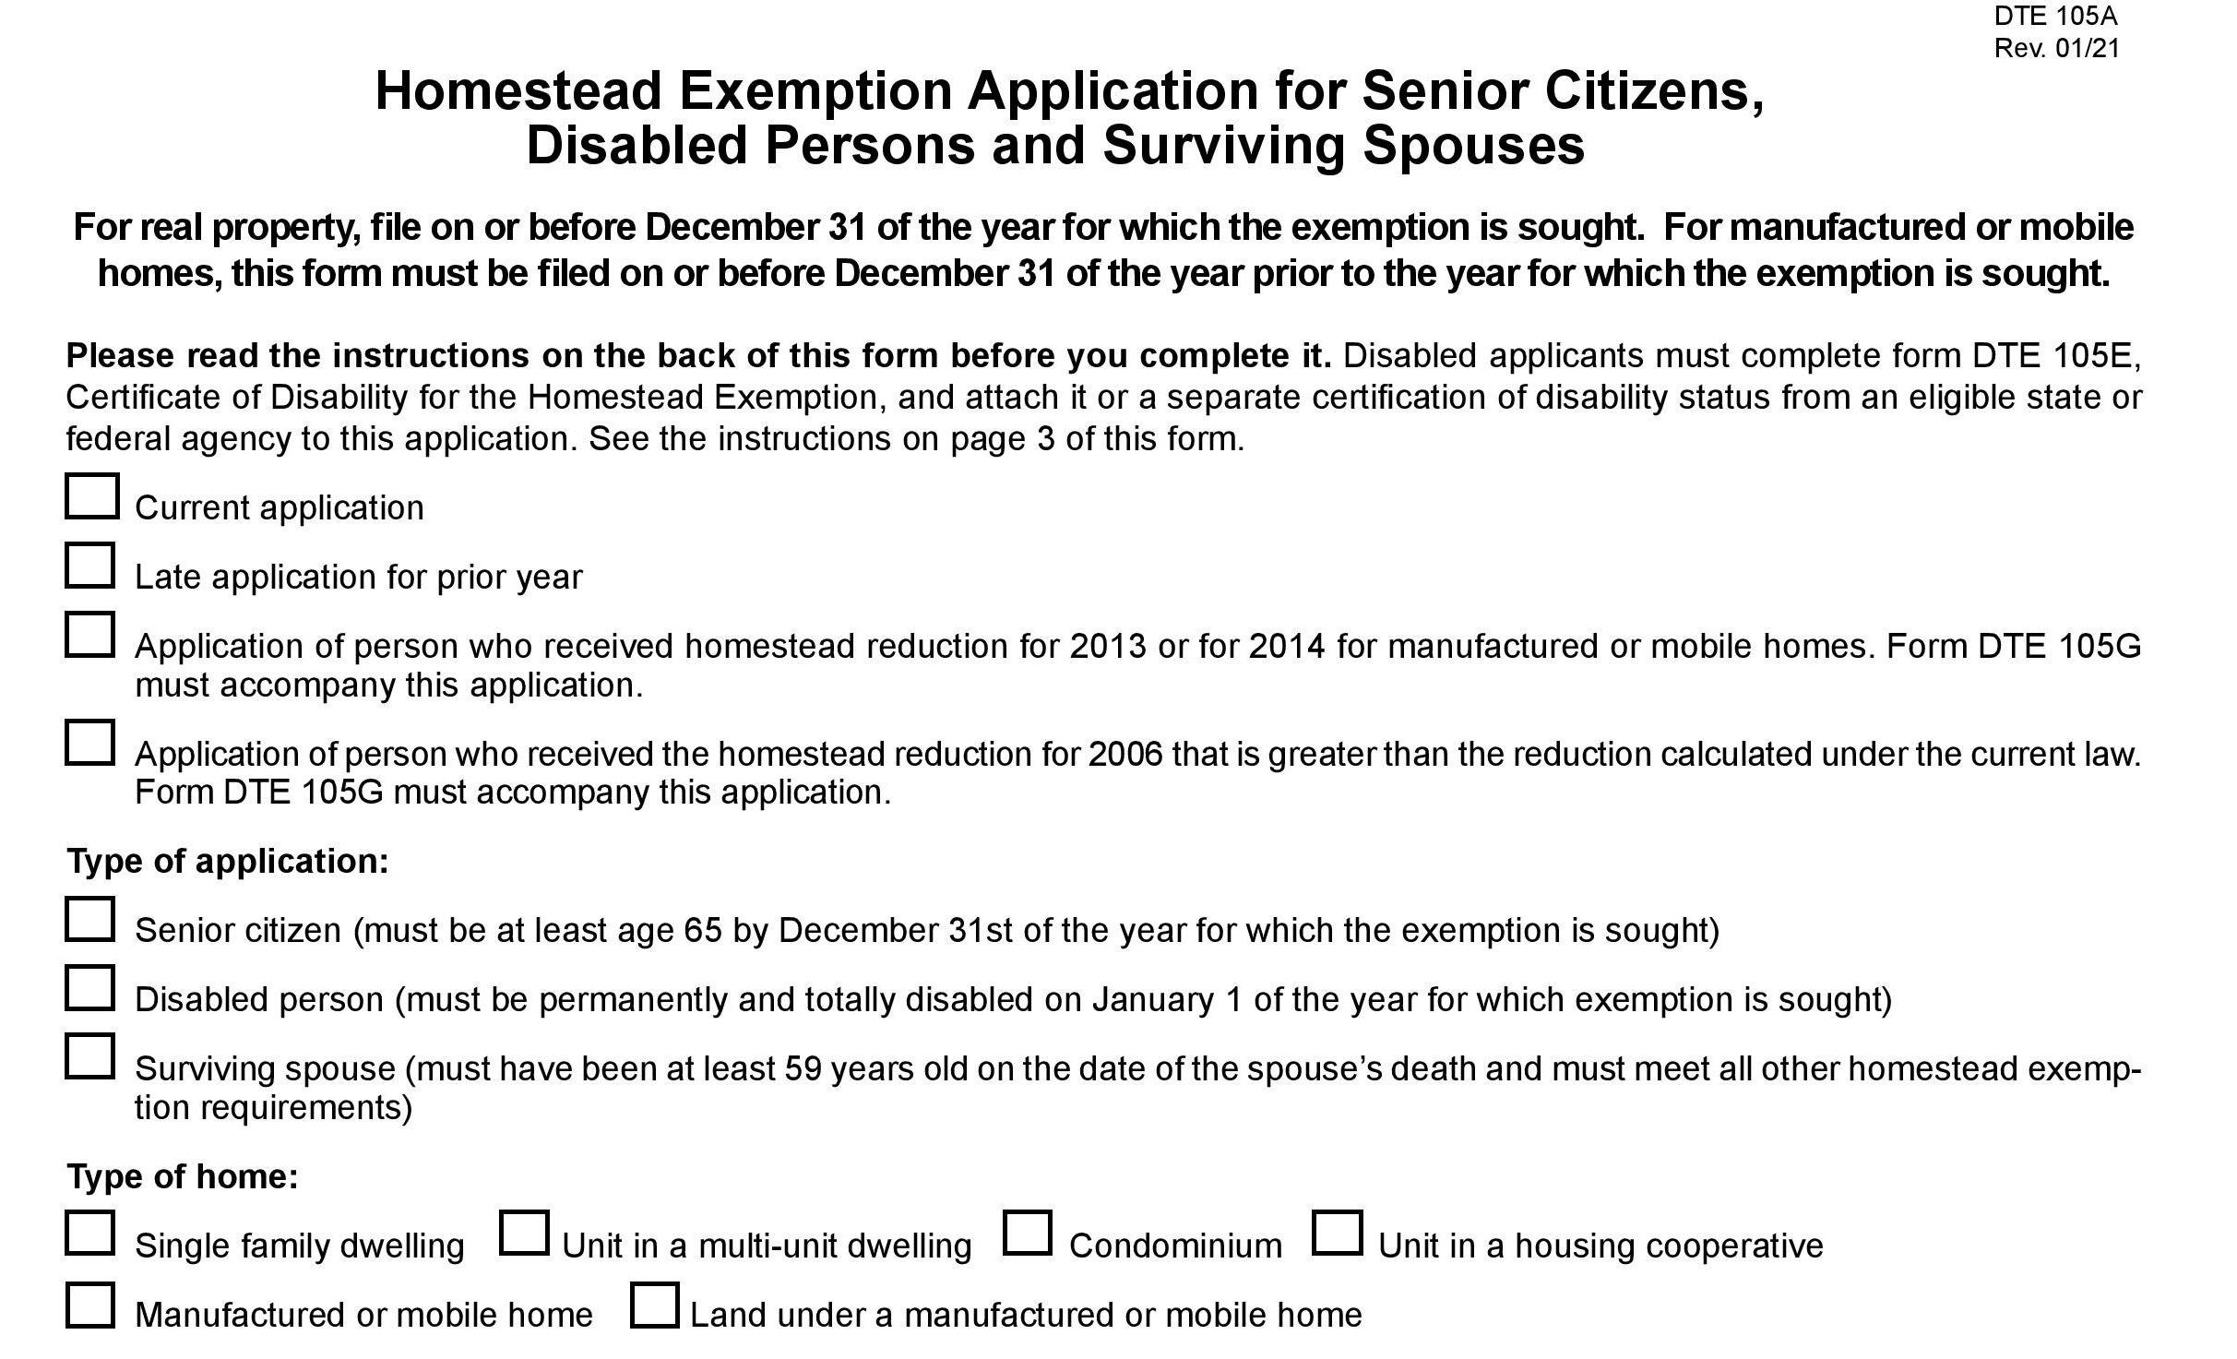

Slide 3
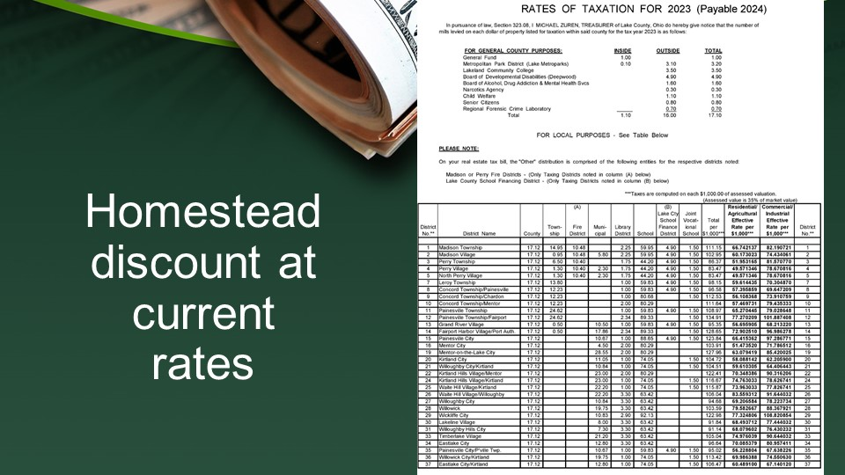

Slide 4
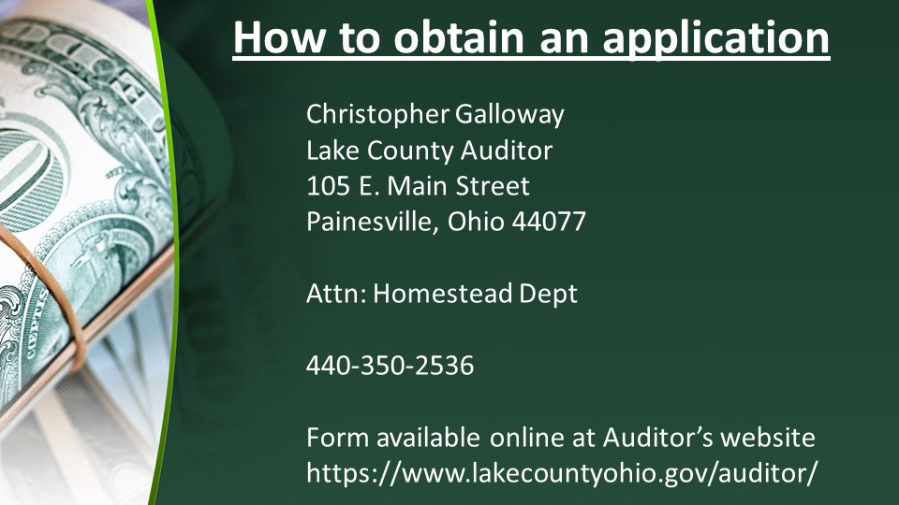

Slide 5


Slide 6
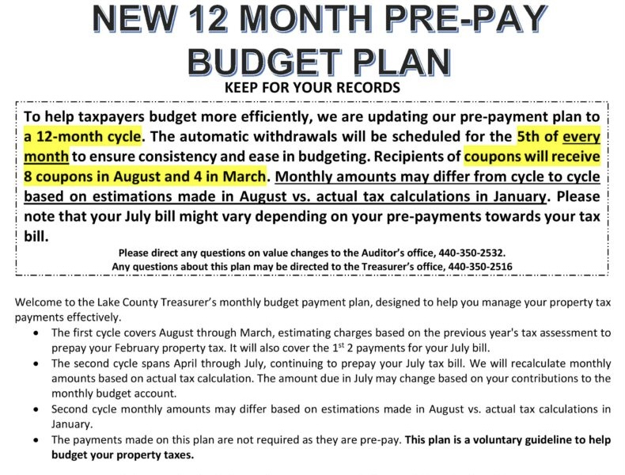
CHRISTOPHER GALLOWAY,
Lake County Auditor

Slide 7

IDENTITY THEFT PROTECTION FOR SENIORS

Slide 8

Identity Theft Explained
Identity theft occurs when a criminal steals your personal information and uses it without your permission, looking to steal your money, data and other personal assets.

Slide 9
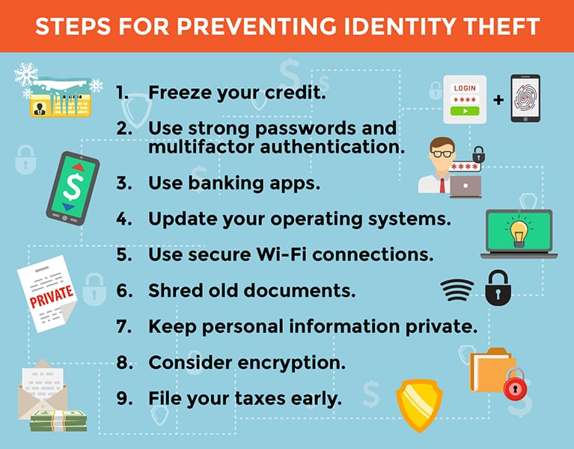

Slide 10
Report identity theft and get a recovery plan.
If you’re a victim:
Contact Federal Trade Commission
IdentityTheft.gov

Slide 11


Slide 12

HOME TITLE THEFT

Slide 13

Call
800-728-3858
It’s simple:
Just give them your name and you will be notified when a document is recorded with your name match.

Slide 14


