Slide 1
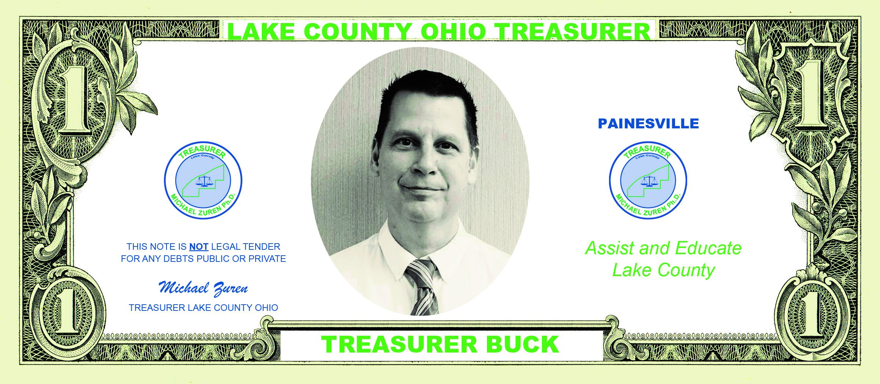

OVERVIEW OF TREASURER FUNCTIONS
Notes:
We designed this template so that each member of the project team has a set of slides with its own theme. Members, here’s how you add a new slide to just your set:
Mark where you want to add the slide: Select an existing one in the Thumbnails pane, click the New Slide button, then choose a layout. The new slide gets the same theme as the other slides in your set.
Careful! Don’t annoy your fellow presenters by accidentally changing their themes. That can happen if you choose a different theme from the Design tab, which changes all of the slides in the presentation to that look.

Slide 2
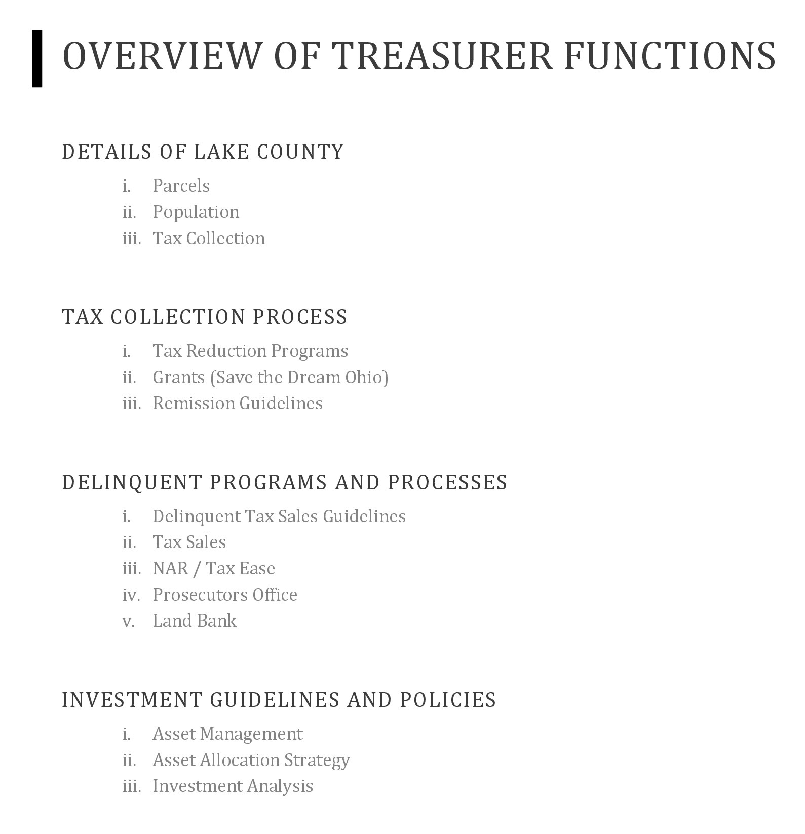


Slide 3
Agenda
Technology
Investment Return
Return Taxpayer Money
Community Outreach

Slide 4
Technology
Introducing Text to Pay, Apple & Google Pay, Venmo, Paypal, and Retail Locations
Already added Auto Pay, Recurring Payments, and 12 month pre-pay payment plan
Use of email addresses and phone numbers
Additional notifications via email and mail
Resulting in higher collection rates, friendlier payment options, and costs savings

Slide 5

Real estate collection methods & stats:
By mail: down 10%
Online bill pay: 42%
E-check: 11%
In-person: 2%
Automatic payments: 6%

Slide 6
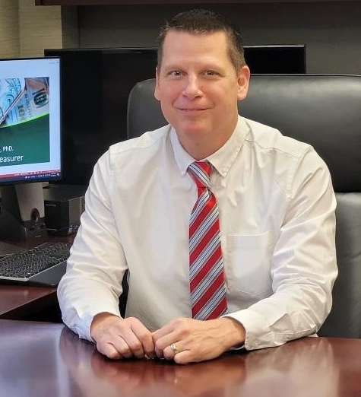
Investment Return
1.3 million 2021 to
19 million 2024
Utilizing corporate bonds, CD’s and
maximum return based on maturity rates

Slide 7
Returning Taxpayer Money
$5.3 Million
Investigated overpayments or duplicate payments
From 2021 to 1983
Resulting in 17,000 refunds

Slide 8
Community Outreach
Financial Literacy, Identity Theft & Fraud Presentations at local schools, libraries, senior centers, Council on Aging, and more
Financial Literacy Sessions for Graduates of AWT in Mentor
Student Treasurer for a Day Program
The Lake County Opioid Alliance

Slide 9
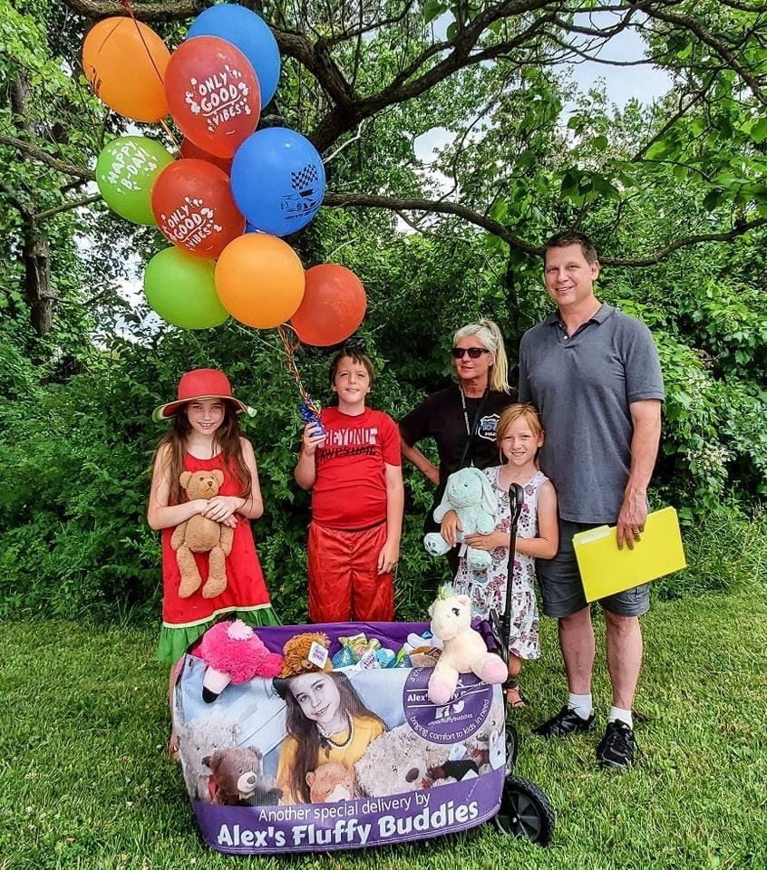
The Lake County Birthday Club celebrates special needs & milestone birthdays

Slide 10
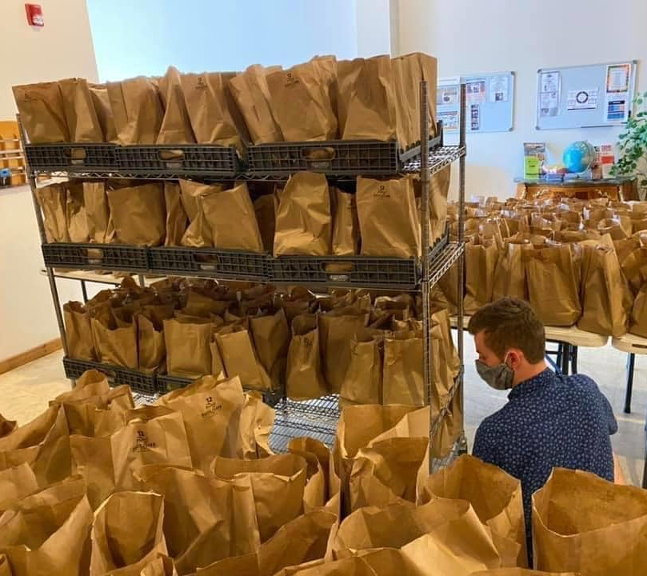
Free Kids
Lunch Program
Willow Praise Church in Willowick
Served over 35k meals since it began
Provides backpacks with school supplies, winter coats, and
Celebrates holidays like Easter and Halloween

Slide 11
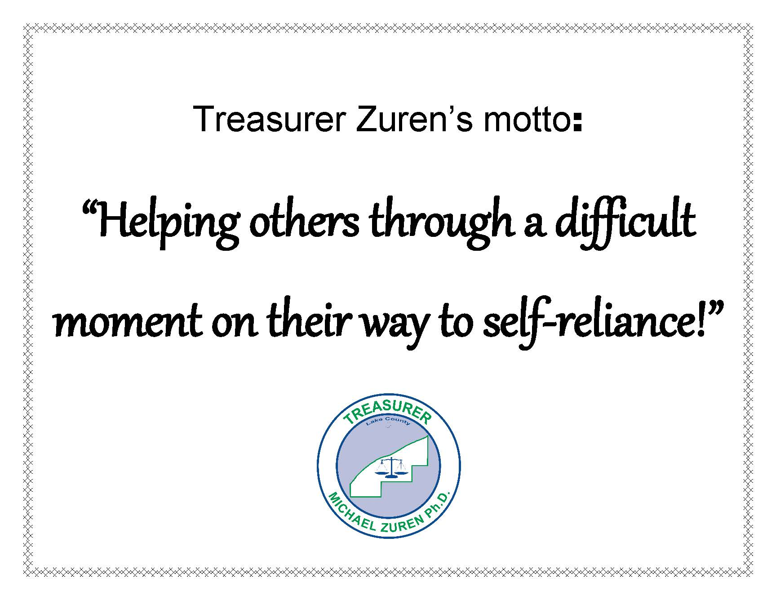

Slide 12
Q&A

Slide 13
Thank you
Michael Zuren PhD
440-350-2480
michael.zuren@lakecountyohio.gov
www.lakecountyohio.gov/treasurer

