Slide 1


Slide 2

Ohio Property Tax – Deep Dive
The Impact on Ohio’s Future for All Ages
Presented by:
Michael Zuren, PhD
Lake County Treasurer

Slide 3
Lake County Doubles the Homestead Exemption and Owner-Occupancy Credit (2026 only)
Owner-Occupancy
2.5% reduction doubled to 5% on qualifying levies on certain property taxes for anyone who owns and lives in their home as their primary residence
Using local county funds (no state reimbursement for the extra amount)
Homestead Exemption
For qualifying seniors (65+), permanently disabled people, or surviving spouses

Slide 4
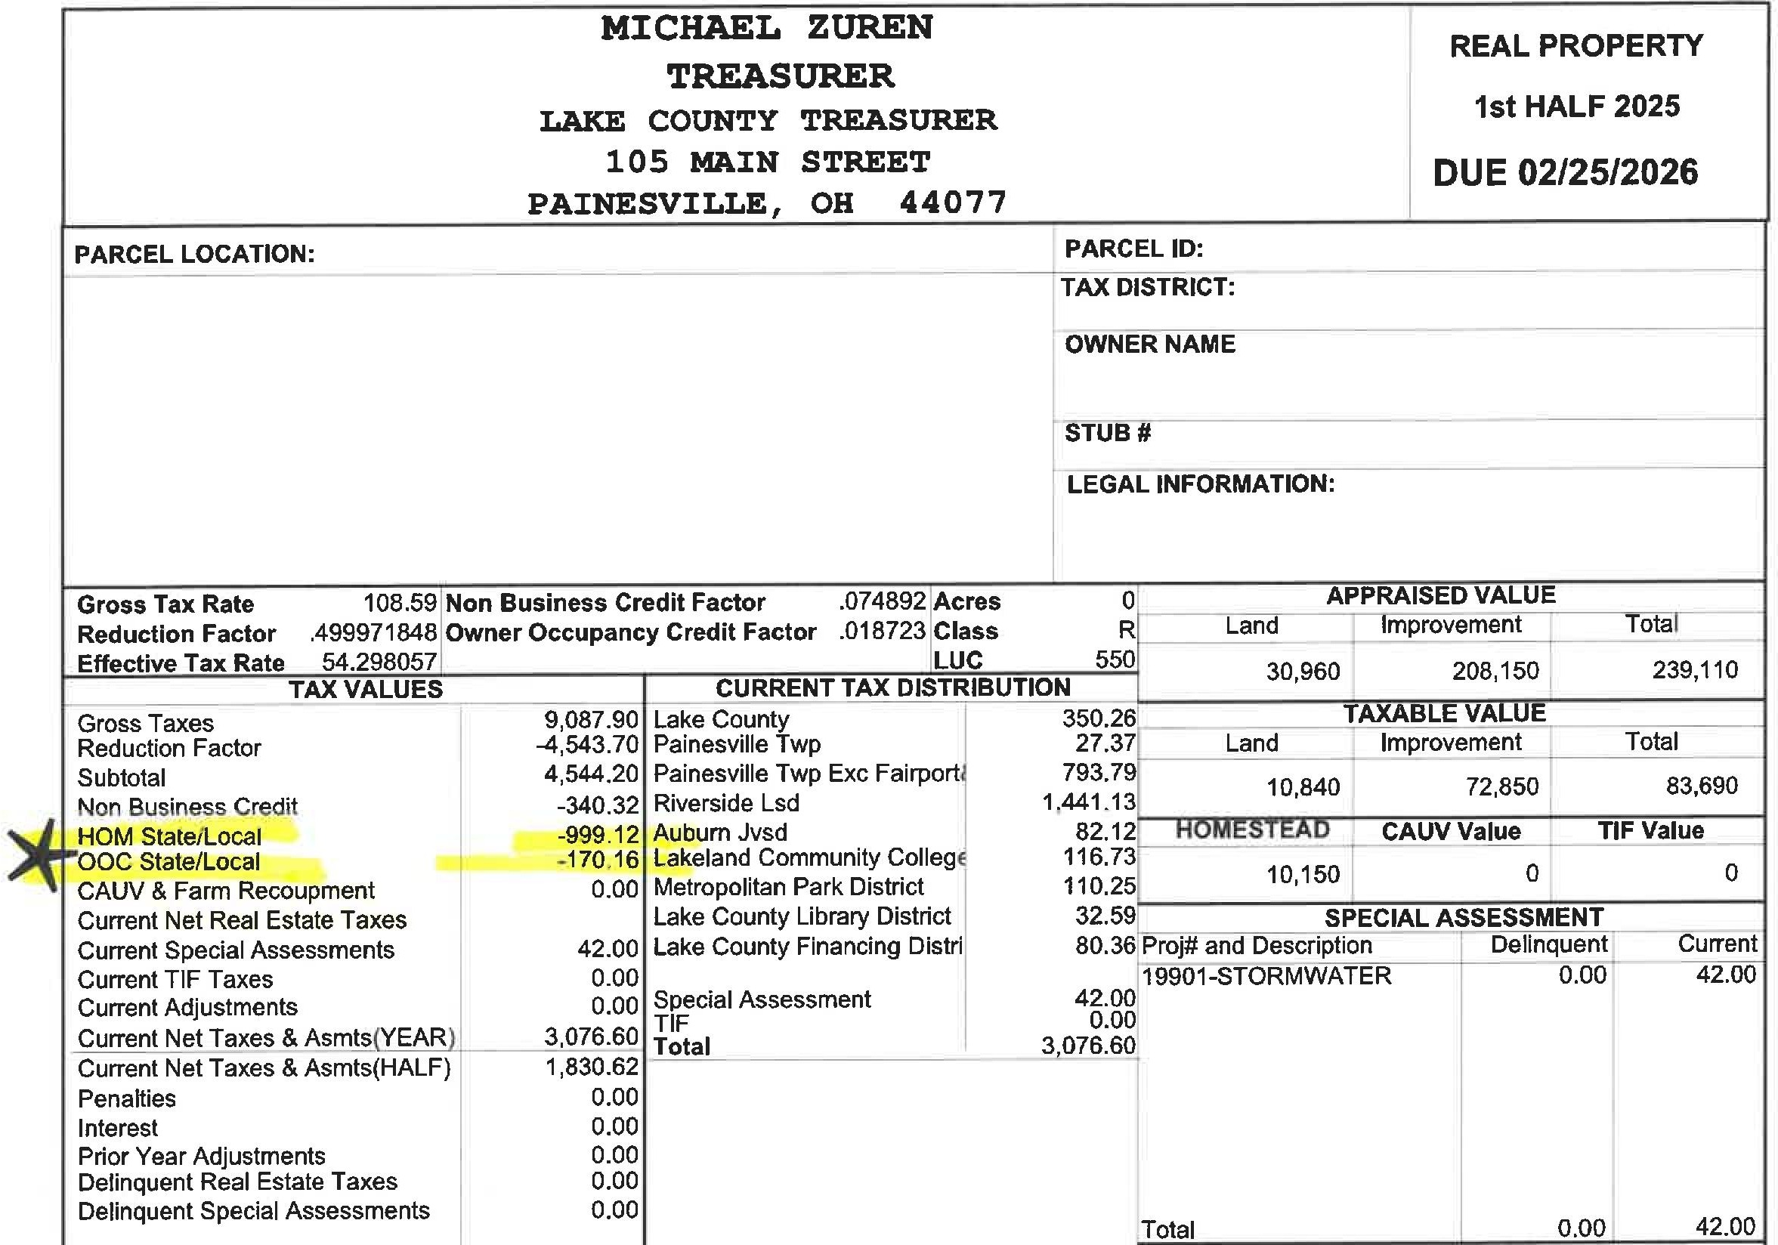

Slide 5
5 New Property Tax Laws:
HB 124: Gives county auditors more oversight in determining property valuations and modifies the process for sales-assessment ratio studies.

Slide 6
Ohio House Bill 124
Control over sales data selection:
Gives auditors the primary role in deciding which recent home sales data is included to track market trends and set new values.

Slide 7
HB 129: Requires fixed-sum levies (like many school emergency levies)
to be included in the calculation of a school district's 20-mill floor, which can help lower tax rates.

Slide 8
HB 129 Primarily lowers property taxes by curbing unvoted tax increases:
Under prior law, certain levies (like emergency, substitute, incremental growth, conversion levies, and the property tax portion of combined levies) did NOT count toward this floor. This allowed districts to collect additional revenue from rising property values without new levies.

Slide 9
HB 186: Establishes an "Inflation Cap Credit" for school district property taxes, linking growth to the rate of inflation. It also phases out the general 10% non-business credit and gradually increases the owner-occupied credit for homeowners living in their homes.

Slide 10
HB 186
In short: Your school taxes can’t rise more than inflation without a vote of the people (for the parts affected by this floor).
If they would, you get a credit to bring it back down.

Slide 11
HB 309: Expands the authority of county budget commissions to allow them to review and potentially reduce property tax rates if they determine collections are "unnecessary" or "excessive," even for voter-approved levies.

Slide 12
HB 309
County Budget Commission (usually the county auditor, treasurer, and prosecutor or a tax official).
HB 309 expands their authority: They can now review and reduce the tax rate (millage) on voted levies if the money collected is seen as “unnecessary” (more than really needed after accounting for reserves and other income) or “excessive” (higher rate than required for normal services).

Slide 13
HB 335: Limits revenue increases from "inside millage" (taxes local governments collect without voter approval) due to reappraisals or updates, capping the growth to the rate of inflation.

Slide 14
What is “Inside Millage” in Simple Terms?
Ohio’s constitution allows local governments (like counties, cities, schools, libraries, townships, etc.) to collect up to 10 mills (that’s 1% of a property’s accessed value) in property taxes without needing voter approval. This is called inside millage (or “unvoted” or “inside” mills).

Slide 15
How much will the average homeowner save from the 2025 Property tax reforms in 2025
For the typical Ohio homeowner in an owner-occupied property, the reforms translate to an average savings of about $128 in 2026 property taxes, with cumulative benefits growing over time through capped increased and expanded credits.

Slide 17
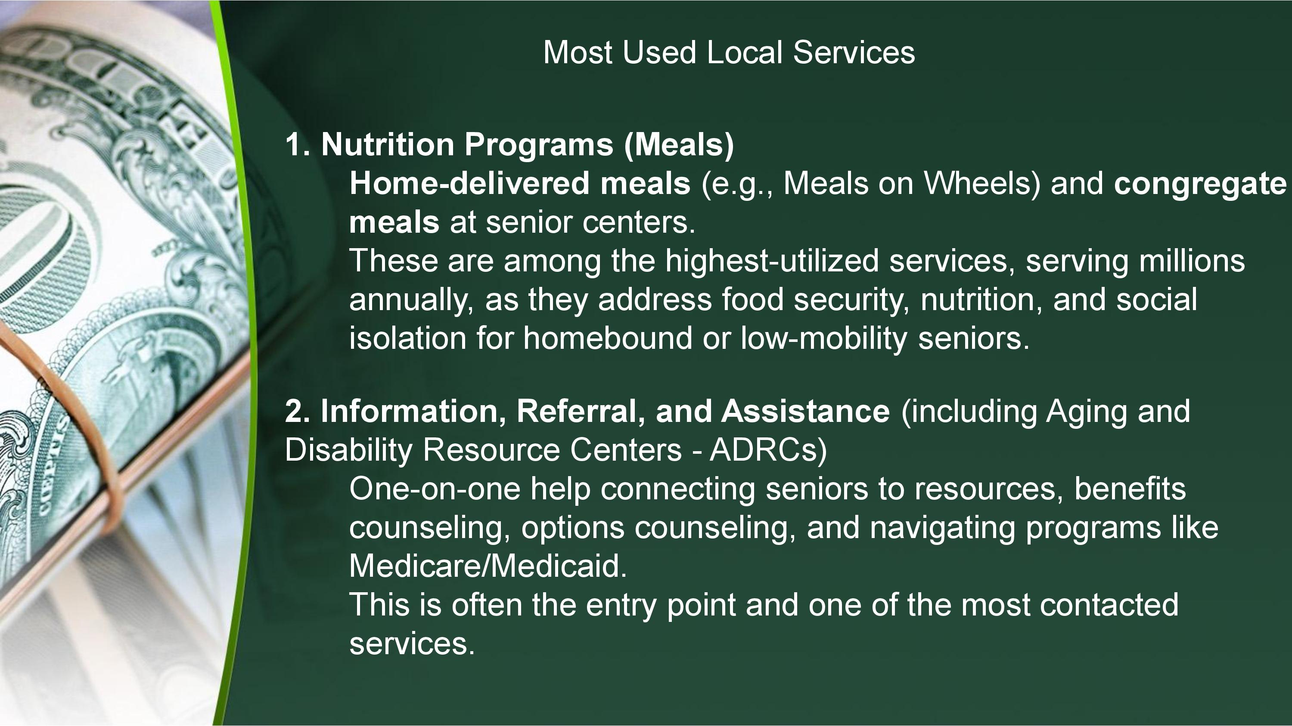

Slide 18
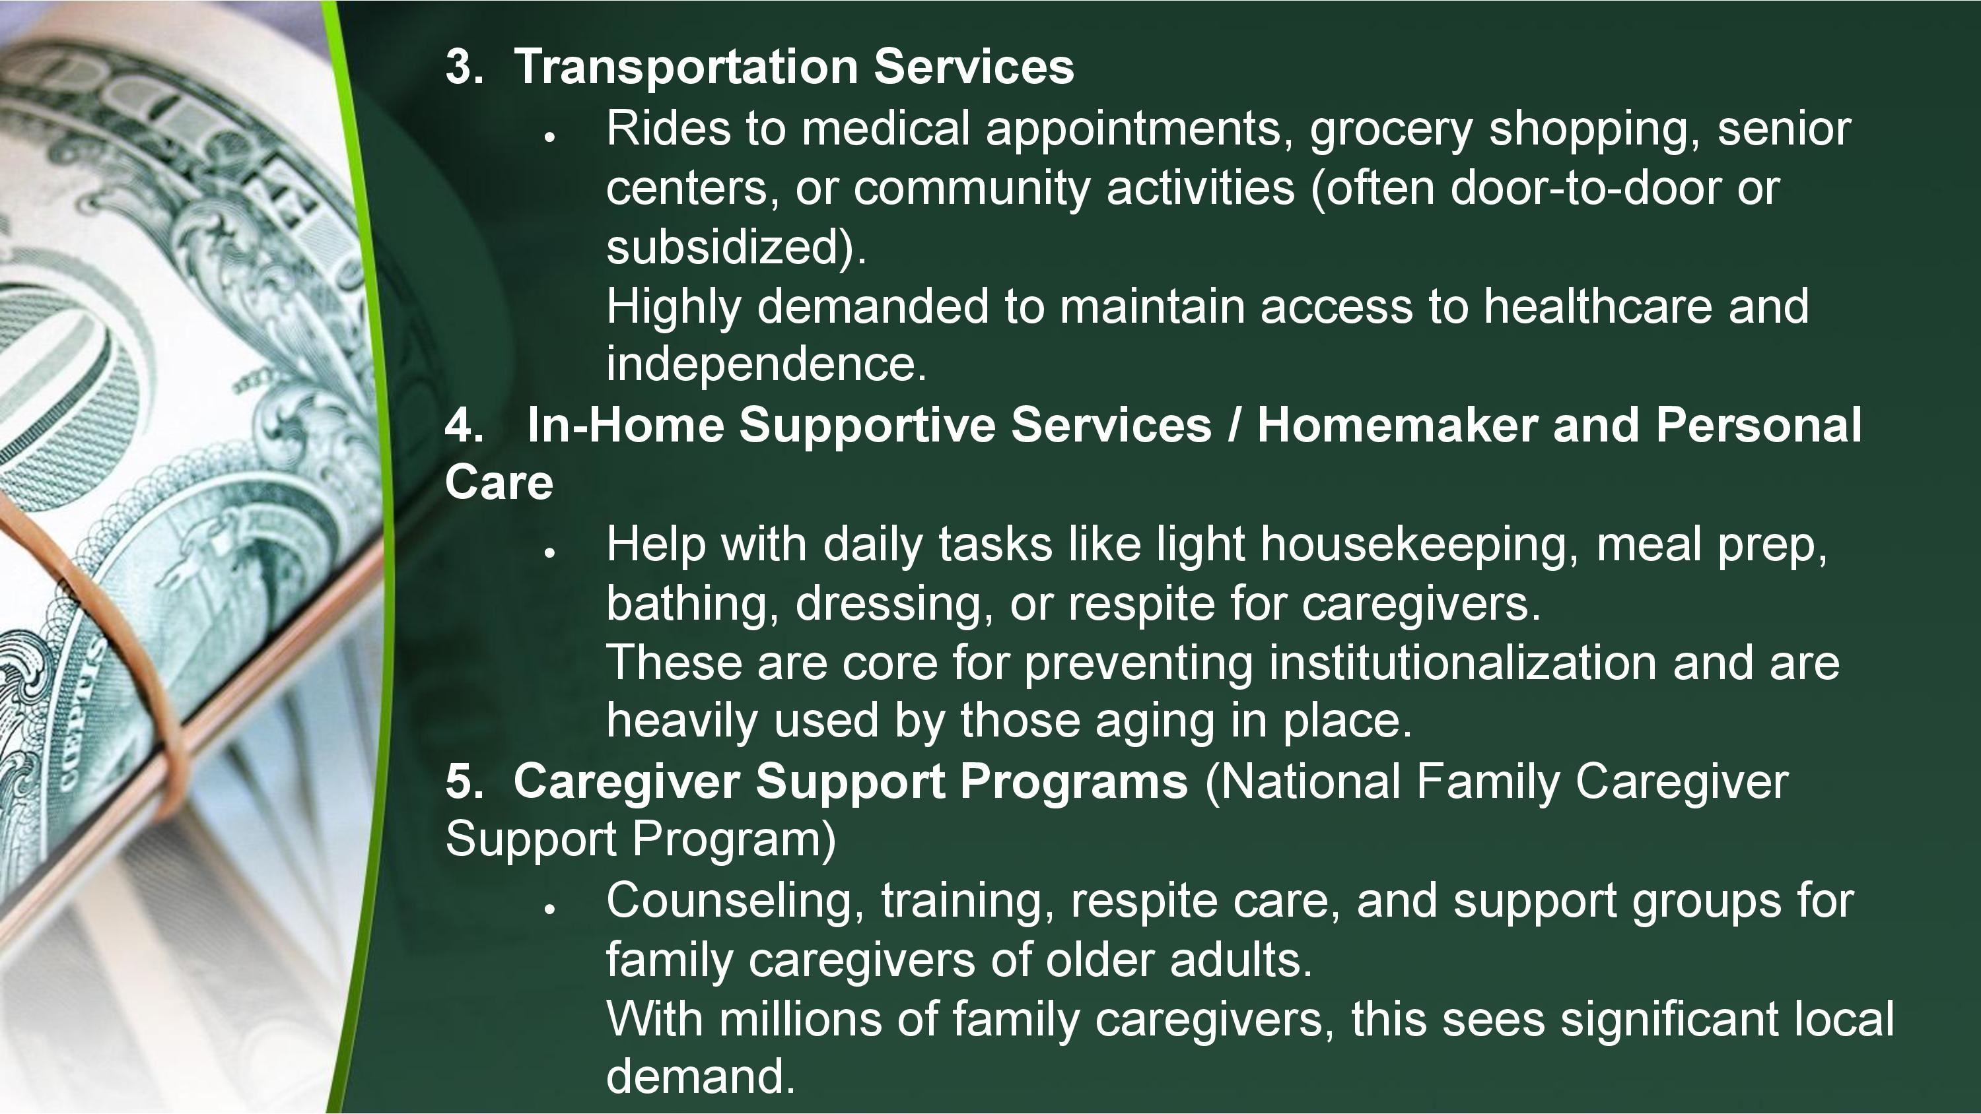

Slide 19


Slide 20
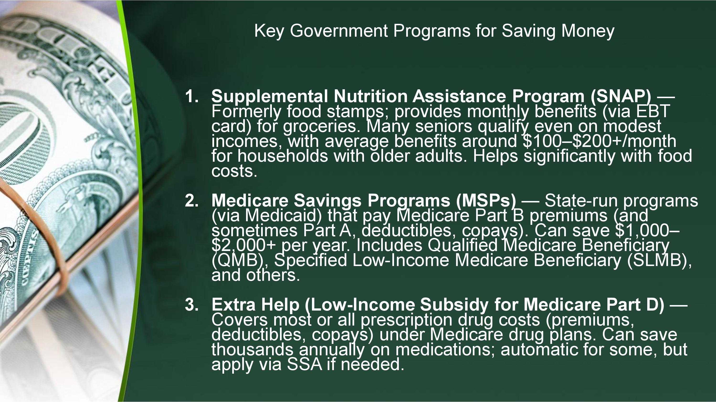

Slide 21
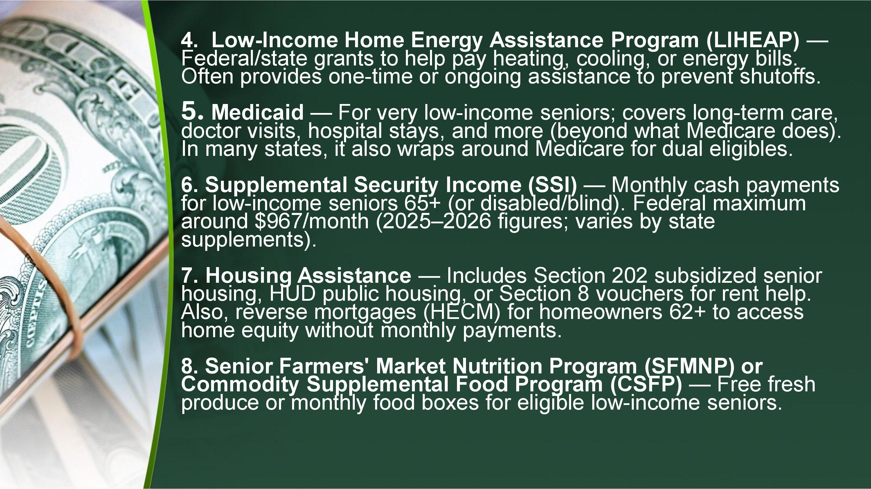

Slide 22
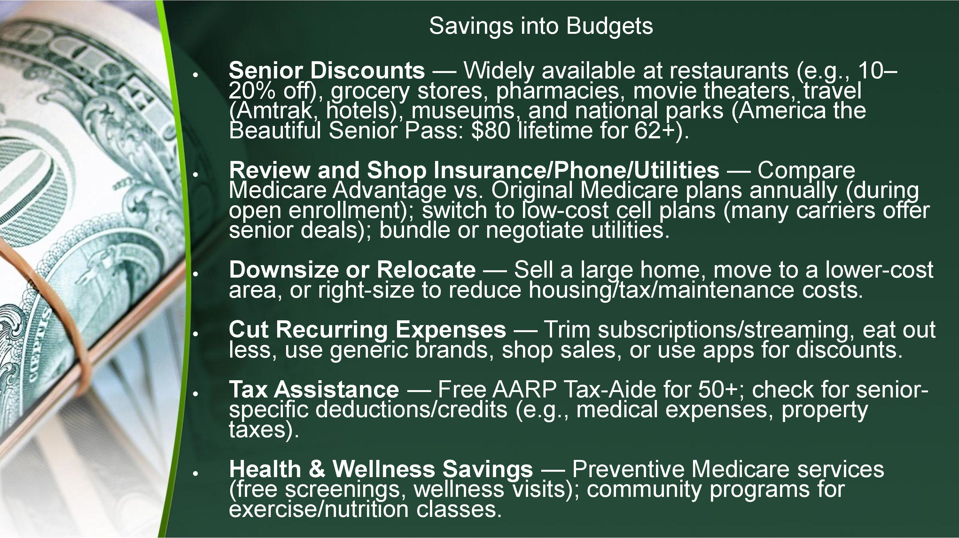

Slide 23
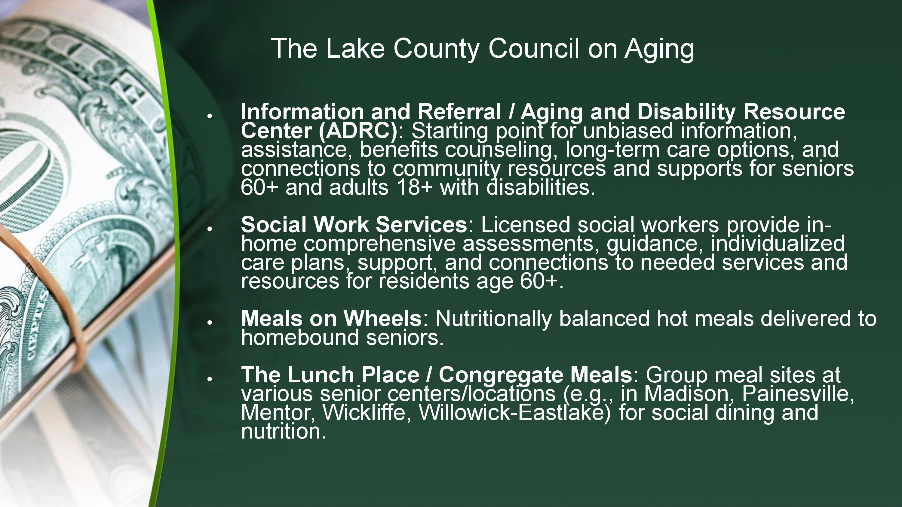

Slide 24
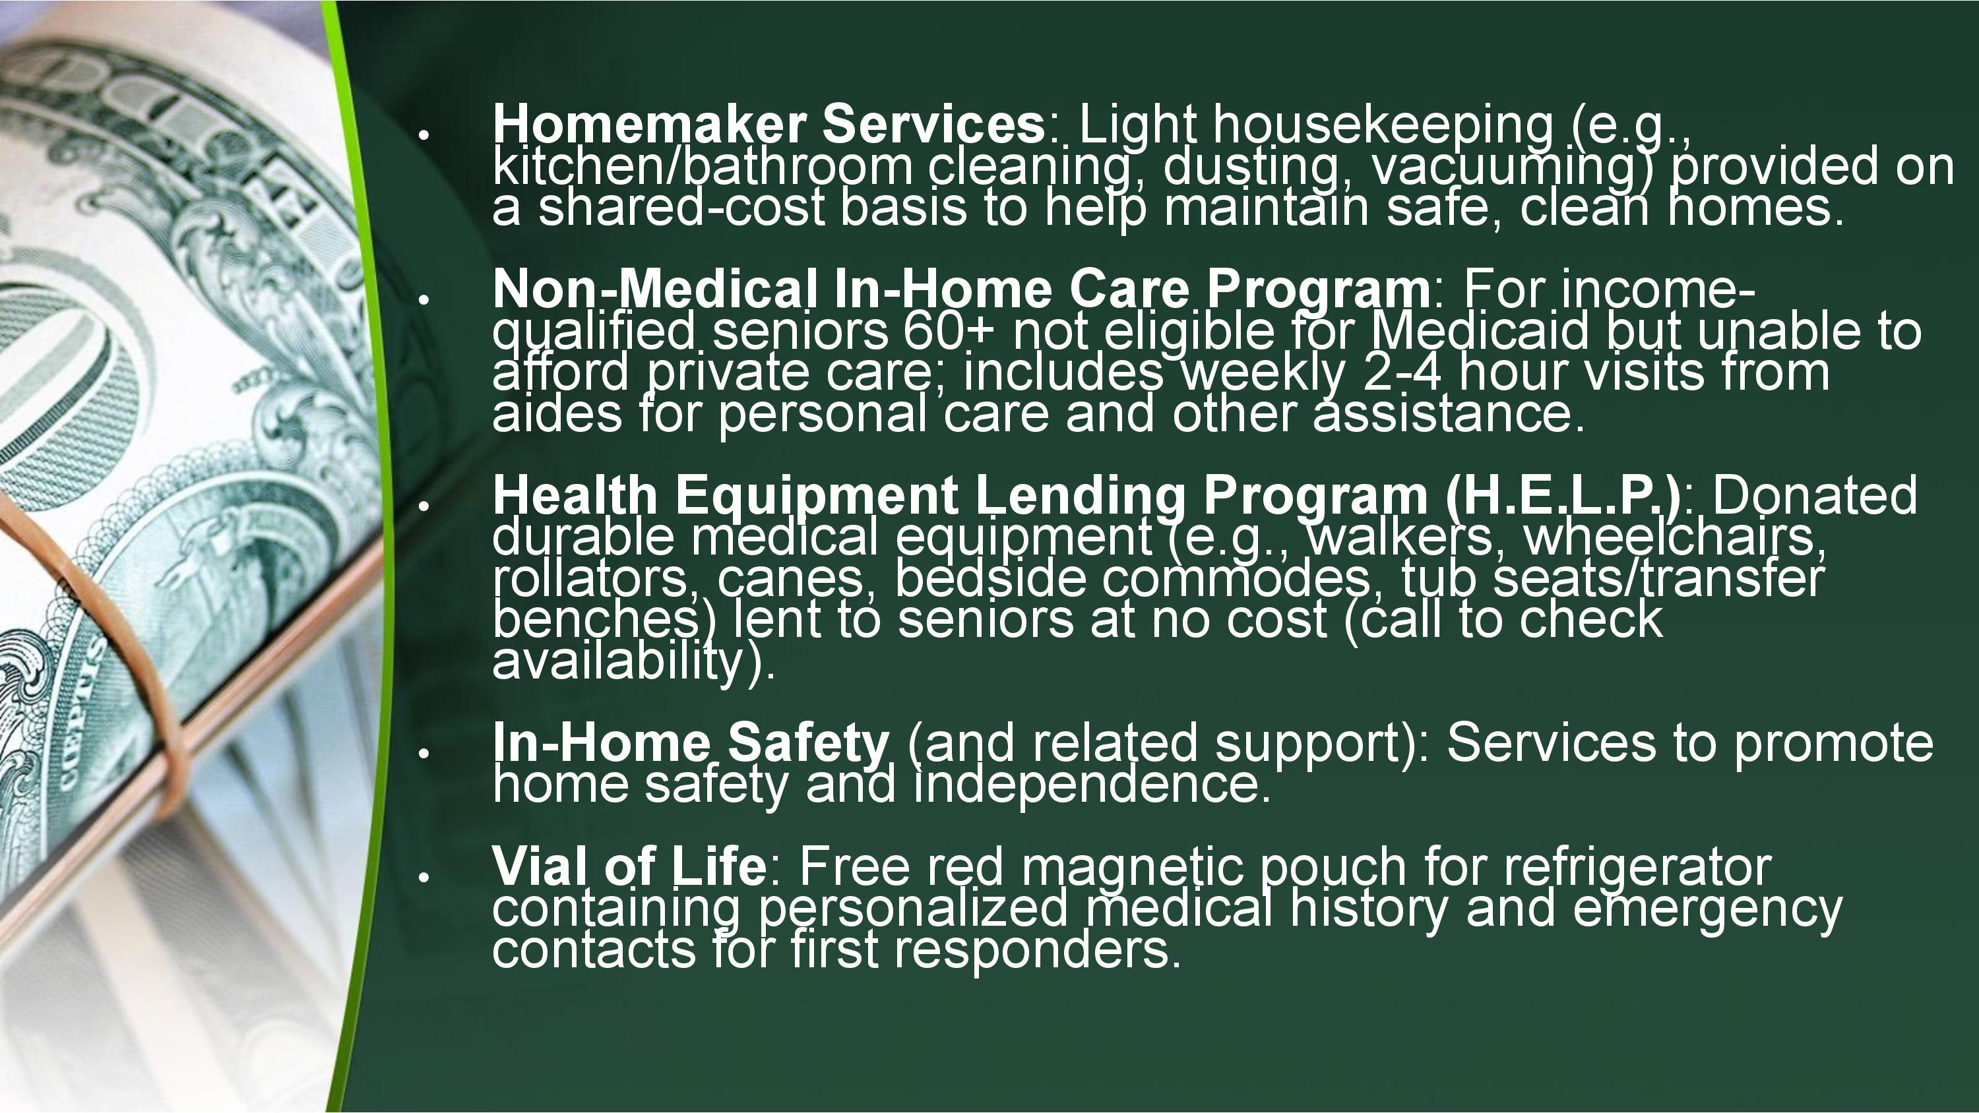

Slide 25


Slide 26
Fallow Research
Ohio Property Tax Survey
Communications between August 20-22, 2025, surveyed 500 Ohio adults regarding a proposed 2026 constitutional amendment to eliminate property taxes.
Overall Support: 61% of Ohioans favored eliminating property taxes
Republicans: 41% favored abolishing property taxes
Democrats: 39% favored abolishing property taxes

Slide 27





State of Ohio Budget as percentage of Ohio’s gross domestic product over 50 years
Year | Percentage of GDP
1976 | 6.45%
1977 | 5.87%
1978 | 5.83%
1979 | 5.80%
1980 | 6.72%
1981 | 7.32%
1982 | 7.45%
1983 | 7.85%
1984 | 7.07%
1985 | 7.15%
1986 | 7.39%
2015 | 10.54%
2016 | 10.84%
2017 | 10.57%
2018 | 10.44%
2019 | 10.16%
2020 | 11.39%
2021 | 10.72%
2022 | 10.49%
2023 | 10.49%
2024 | 11.35%
2025 | 11.43%

Slide 28
Trends Over the Last 50 Years
1970s–1980s: Lower overall state spending relative to economy; education and welfare were top categories, but Medicaid was smaller pre-major expansions.
1990s–2000s: Medicaid growth accelerated (due to federal matching and enrollment increases), rising to 20–30%+ of total.
2010s–2020s: Medicaid surged (post-ACA expansion in Ohio ~2014), often becoming the top category. Education shares have been relatively stable but pressured during recessions. Total spending shifted toward health/human services amid aging population and federal funds.
Overall, health/human services have grown as a share (from ~20% in earlier decades to 40%+ recently), while education's relative share has declined slightly amid other priorities.

Slide 29
Ohio classifies real property into two main classes for taxation purposes:
Class 1: “Residential”
and agricultural real property
Class 2: “Commercial”
industrial, mineral, and public utility
As of 2025
67% tax revenue
33% tax
revenue

Slide 30

Agenda
Ohio’s Property Tax System: The Backbone of Local Funding
Total Revenue Loss: A $24 Billion Disaster
Services Cut: What Vanishes Without Funding?
Forced Mergers: Small Cities and Schools Lose Identity
First Responders: Lives at Risk with Fewer Resources
Seniors Abandoned: Essential Services Disappear
Libraries Shuttered: Community and Knowledge Hubs Lost
Revenue Replacement Options: Tax Hikes and New Burdens
Pay-Per-Service Reality: Costs Shift to Individuals
Population Influx: Overcrowding Ohio’s Strained Systems
Impacts Across Ages: From Children to Retirees
Call to Action: Protect Ohio’s Future

Slide 31
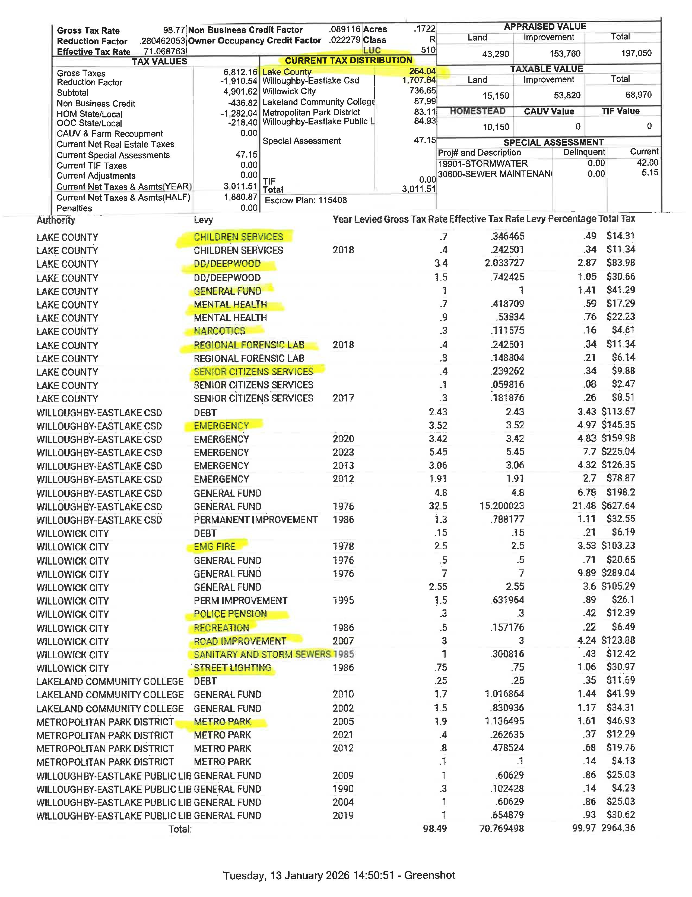

Slide 32
Ohio Income Tax Reductions and State Funding to Local Governments and Schools
1985-1992 9.165%
2005-2010 7.50%
2025-2026 2.75% (flat rate)
Shrinking share of State of Ohio budget to local government fund over the past 50 years

Slide 33
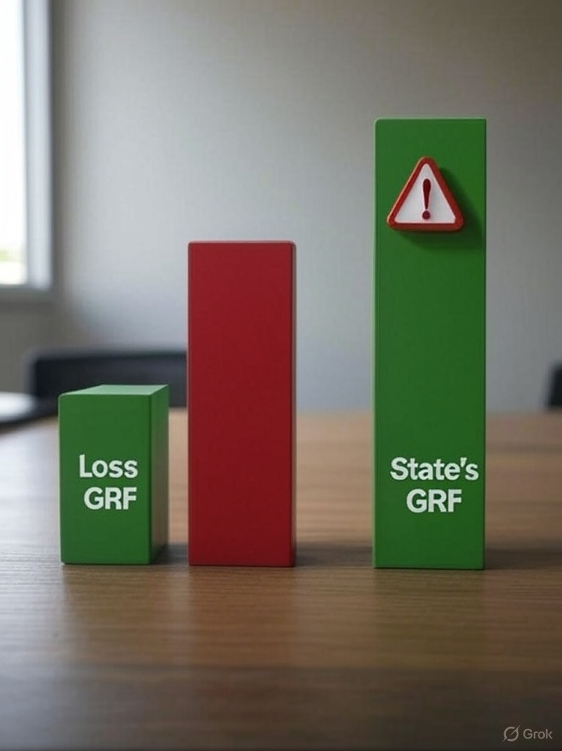
Total Revenue Loss:
A $24 Billion Disaster
State Budget can’t absorb loss, no replacement matches scale: (27.98 GRF)
Decimate local government services and schools, especially rural areas
35% of Ohioans face “unsustainable future”

Slide 34
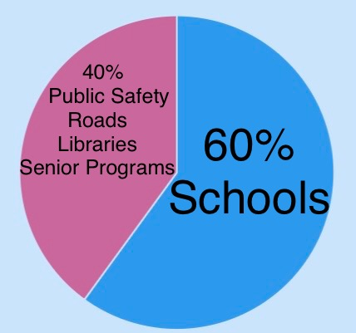
Ohio’s Property
Tax System:
The Backbone of
Local Funding
Funds: schools, public safety, roads, libraries, senior programs and more

Slide 35
Services Cut: What Vanishes Without Funding?
Jeopordize: Vital services for all ages
Public Safety: Police, Fire, EMS (50%+ budget cuts; layoffs, slower responses)
Education: School funding (60% from property taxes) slashed; larger classes, fewer teachers, no extracurriculars
Infrastructure: roads, bridges, water/sewer maintenance halted
Parks/Recreation: Closures of community centers, playgrounds, public pools
Social Services: Mental health, addiction programs, child welfare cut drastically
Libraries: 48 libraries with no levies close; others reduce hours / staff
Senior Services: Meals, transport, in-home care eliminated
Zoning/Planning: No staff for permits, inspections, stalled development

Slide 36

Forced Mergers:
Small Cities and Schools Lose Identity
Small towns lose mayors, councils, and autonomy as budgets collapse, forcing mergers with larger cities
School districts consolidate, rural schools merge with urban ones, loss of local control, longer student commutes
Impact: Loss of community identity, diluted services, unfair tax shifts

Slide 37

Seniors Abandoned:
Essential Services Disappear
Property taxes fund senior programs: Meals, transport, in-home care vanish
Homestead exemptions ($25-$50k off taxable value) at risk, pricing seniors out of their homes
Impact: Isolation, health risks for 65+ Ohioans on fixed incomes ($38,600 limit)
No replacement: “Taxing them out” worsens without levies

Slide 38

Revenue Replacement Options:
Tax Hikes and New Burdens
All Possible Solutions to Replace $24B:
State Sales Tax Increase
Taxing Food
Larger Payroll Taxes
New Taxes: Business gross receipts, luxury taxes, or sin taxes
User Fees: Pay-per-service models
Local levies: Unfeasible at scale; voter resistance
Impact: No option matches stability of property taxes

Slide 39
List of Additional Taxes Ohio Collects:
Sales and Use Tax (recent revenue $14.1 billion in FY 2025)
Individual (Personal) Income Tax (Nearly $10.4 billion in FY 2025)
Commercial Activity Tax (CAT) / Business Gross Receipts Tax ($6 million)
Motor Fuel / Gasoline Excise Tax (38.5 cent per gallon, higher for diesel)
Cigarette and Tobacco Excise Taxes ($712 million in FY 2025)
Alcoholic Beverage Taxes ($60 million in FY 2024)
Other / Miscellaneous State Taxes: insurance premiums, public utilities, gaming/casinos, etc.
Property Tax (recent revenue $23.9 billion)

Slide 40
What Does Ohio Receive Annually From Sin Taxes?
Medical Marijuana and Adult-Use (Recreational) $35-116 million
Gambling (Casinos, Sports Betting, etc.) November 2025 - $26.7 million
Alcohol (Beer, Wine, Liquor) $100-150 million
Ohio Lottery (FY 2025: Record $1.447 billion vs $4.38 billion in traditional sales)

Slide 41
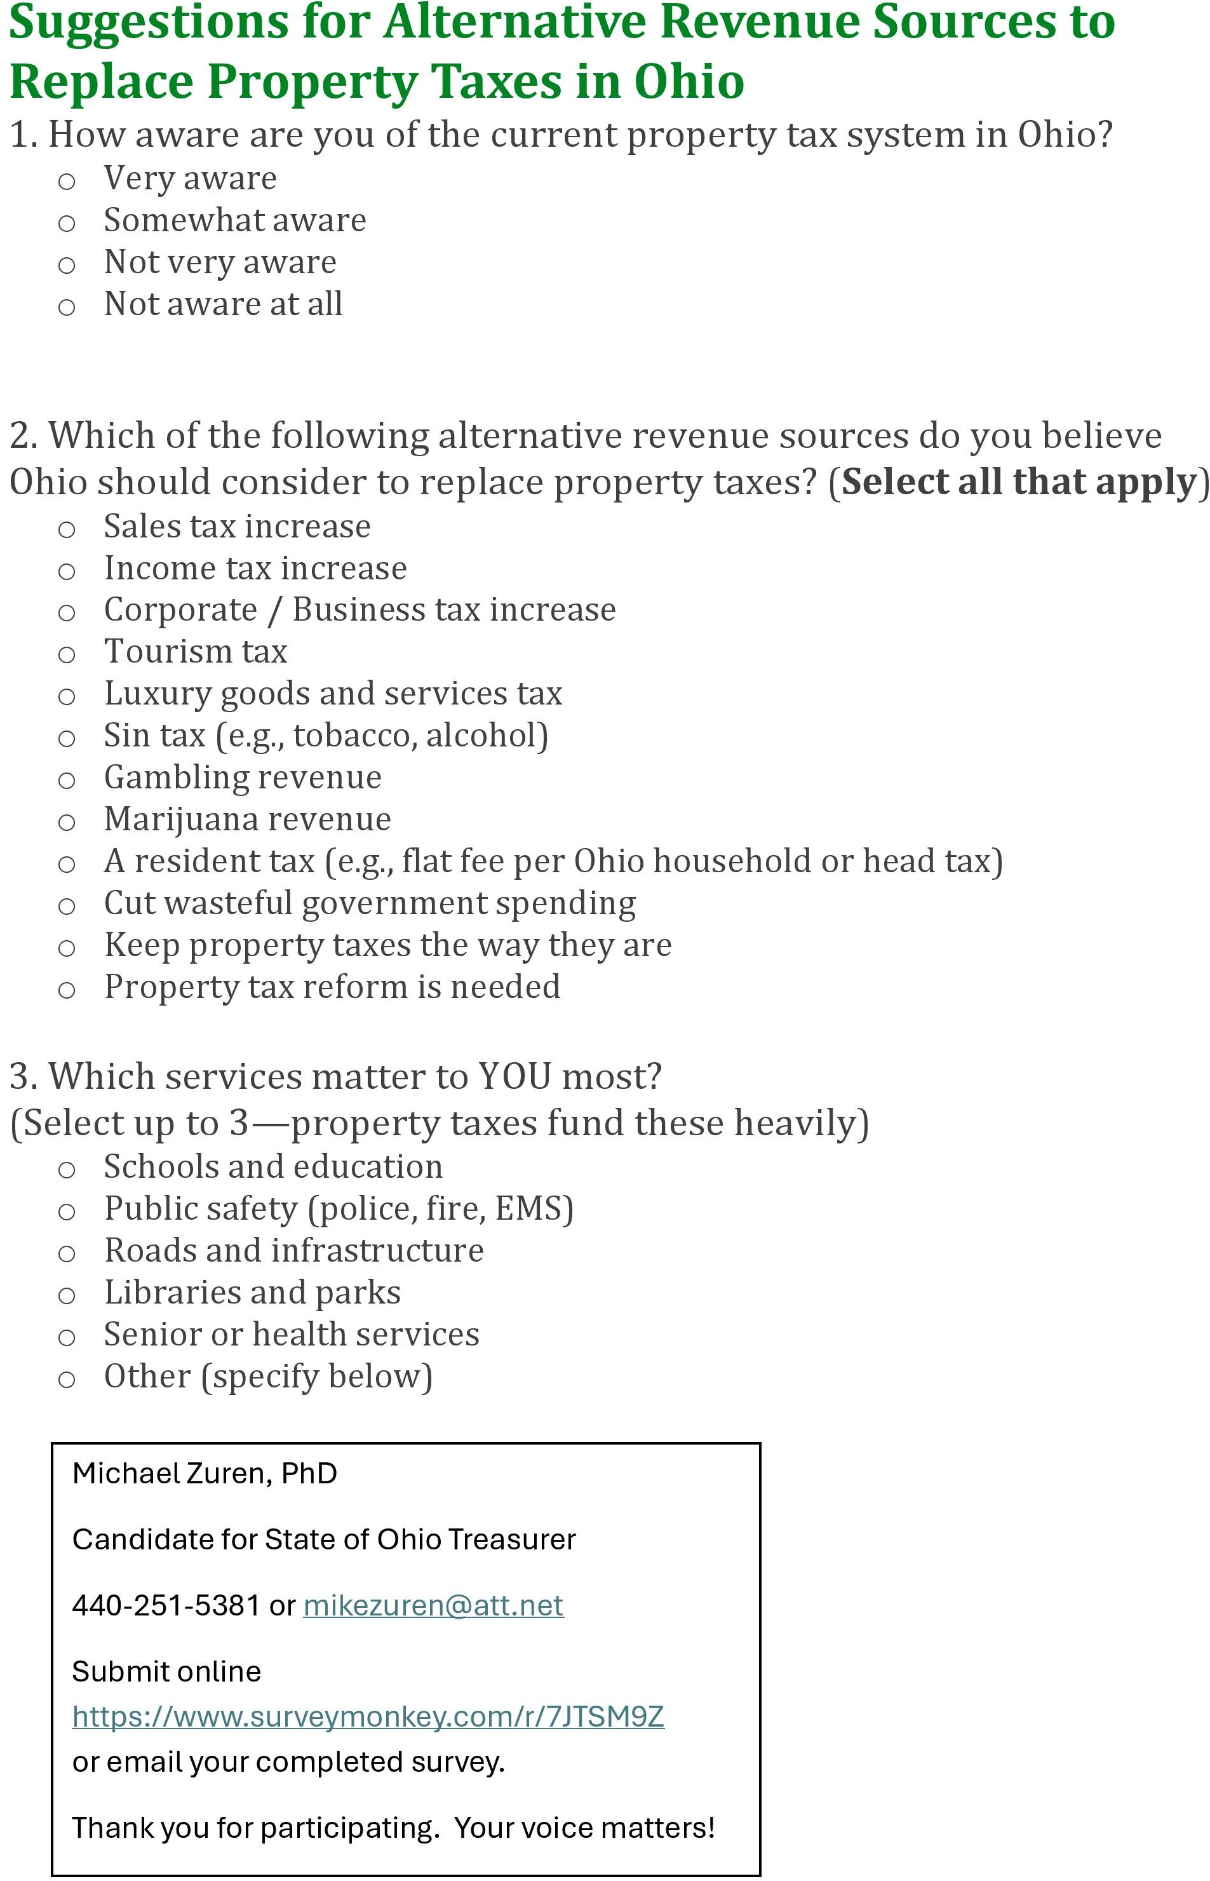
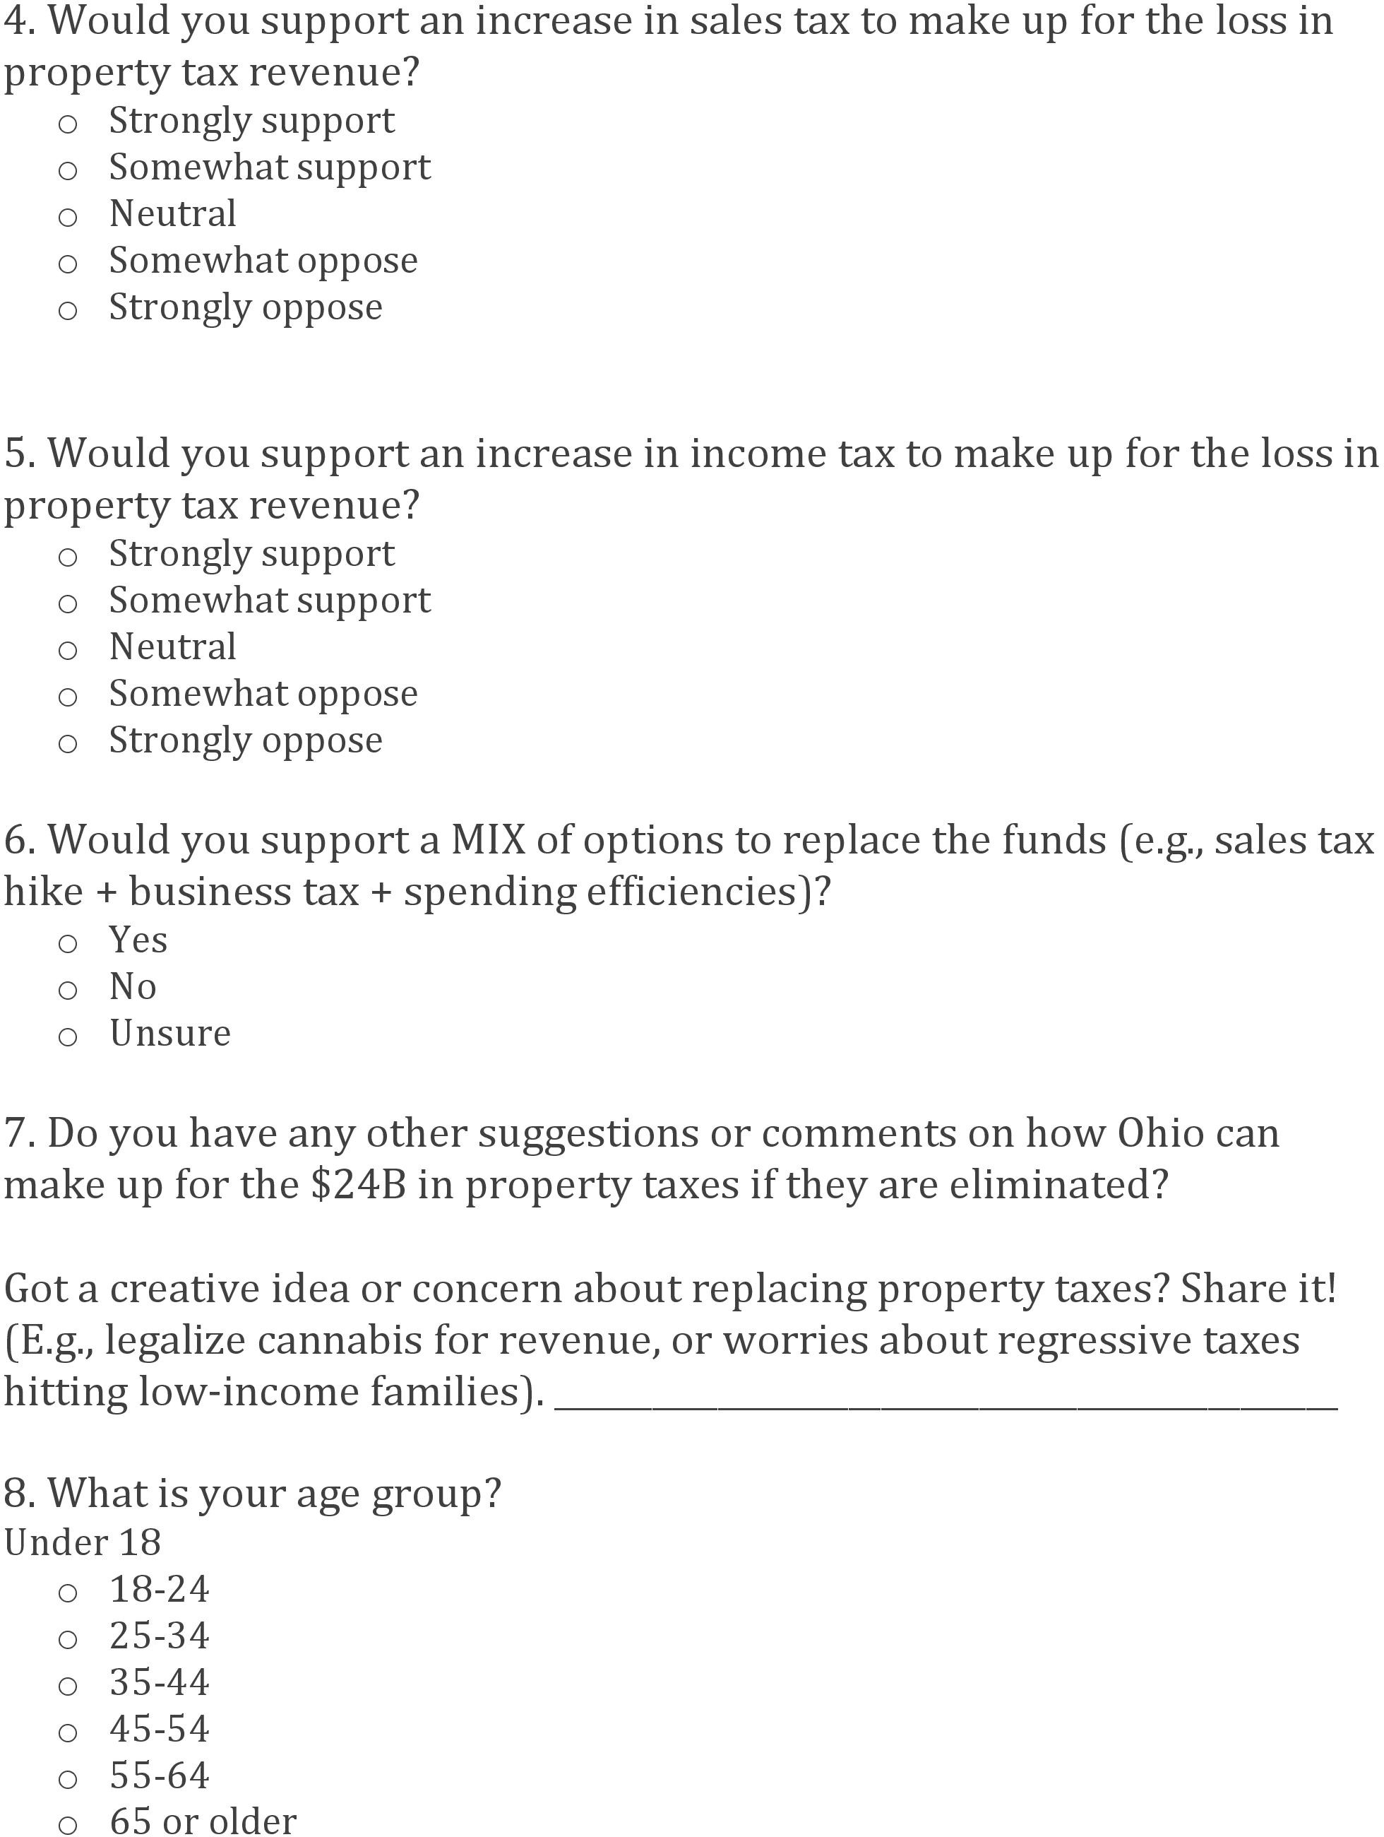

Slide 42
Ohioans Speak Out: Survey Reveals Preferences for Replacing Property Taxes
Cut Wasteful Spending
2. Increase Sin Taxes on Marijuana, Gambling & Tobacco
3. Impose Premiums on Luxury Goods

Slide 43
Survey Results: Priorities for Public Services
1. Public Safety
2. Schools
3. Roads
Suggestions and Concerns
1. School Funding
2. Concerns for Seniors and the Disabled
3. Support for Low-income Families

Slide 44
Suggestions to Reduce Spending at State Levels
Eliminate long-vacant positions and streamline hiring/firing processes
Reform grant programs for efficiency
Implement outcome-based budgeting
Devolve federal programs and reduce mandates: Convert programs like Medicaid to block grants with more flexibility for cost control

Slide 45

Thank you
Michael Zuren, PhD
440-251-5381
mikezuren@att.net

