Slide 1
LEARN LOCAL GOVERNMENT & FINANCIAL LITERACY
PRESENTED BY LAKE COUNTY TREASURER, MICHAEL ZUREN

Slide 2

BUILD YOUR FINANCIAL WELL-BEING
Spend less than you earn
Save for future spending
Only borrow what you can afford
Grow your earning capacity
Protect what you have

Slide 3
Local Government: Counties, Cities, Townships
1. The U.S. government levels:
Federal - State - Local
2. County government: The big regional boss
3. Cities & Municipalities: Your town or city hall
4. Why This Matters to You + Fun Facts

Slide 4
What Is Local Government?
Local Government = the level closest to YOU!
Handles daily services: roads, schools, parks, police/fire, trash pickup, libraries, and zoning (what can be built where).
Created and given power by state governments
Two main tiers in most states:
Counties (larger areas, often including cities)
Municipalities (cities, towns, villages) + Townships in some states

Slide 5
County Government – The Regional Level
Key responsibilities:
Sheriff & jails
Property taxes & assessments
Elections & voter registration
Roads & bridges (especially in rural areas)
Public health, social services (on behalf of state)
Land use planning in unincorporated areas
(Running the county jail, Managing welfare programs, and
Recording marriages & land deeds)

Slide 6
Cities & Municipal Governments – Your Town/City
Governed by: Mayor + City Council (most common) or Council-Manager
Key responsibilities:
Police & fire departments
Streets, sidewalks, streetlights
Water/sewer, garbage collection
Parks & recreation
Zoning & building permits
Local libraries & community centers

Slide 7
Fun Local Government Trivia (Quick Quiz!)
1. How many counties are in the U.S.?
2. What state has NO counties?
3. True/False: Cities get all their power from the federal government.
4. What’s one quirky local service?

Slide 8

COURSE TOPICS
Planning and goals
Career preparation
Spending and credit
Consumer protection
Income
Money management
Saving and investing
Risk management

Slide 9


WHY IS FINANCIAL EDUCATION IMPORTANT?
STUDENTS EXPOSED TO AN ECONOMIC WAY OF THINKING AND TO PERSONAL FINANCIAL CONCEPTS AT AGE APPROPRIATE LEVELS CAN MORE EASILY APPLY SOUND DECISION-MAKING SKILLS, DEVELOP STABLE SAVING AND SPENDING HABITS, AND LINK EDUCATION SUCCESS TO CAREER AND LIFE SUCCESS

Slide 10
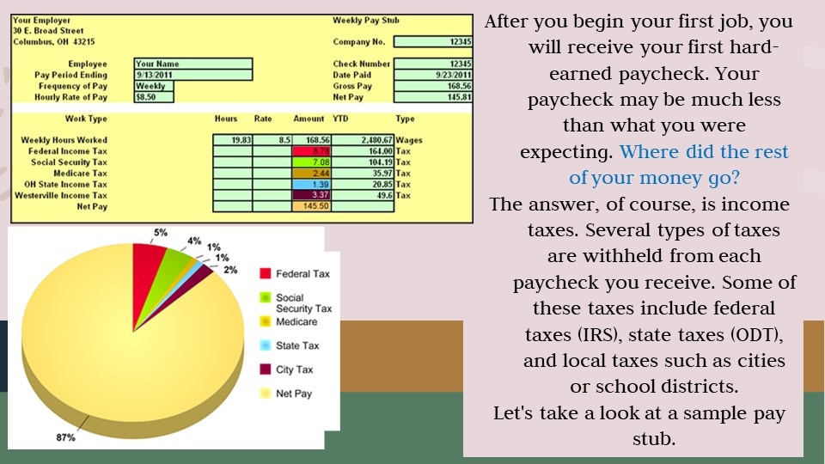

Slide 11
EXAMPLE
Gross Pay 500.00
Federal 33.27
FICA 31.00
Medicare 7.25
State 5.20
Net Pay 423.28

Slide 12

SMART goals are: Specific Measurable Attainable Realistic Time Bound
An example of a clearly written financial goal would be:
“To pay off credit card bills by 2024.”
“To save money for college for the next five years.”
“To establish an emergency fund of $2,000 in 18 months.”
All of the above
An example of a long-term goal would be:
A family vacation
Buying a used car
Purchasing a cell phone
Saving for retirement

Slide 13


Nicole set a goal to buy a car in the next few months. She plans to make a $2,500 down payment and has already saved $1,300. If she can save $150 each month, how long will it take her to save the entire $2,500: A . 6 months B. 8 months C. 10 months D. 12 months

Slide 14

28
Values, peers, family,
feelings, and habits can influence:
Education
Relationships
Financial Decisions
All of the above

Slide 15
Financial Tips for Young Adults
Learn Self-Control
If you’re lucky, your parents taught you this skill when you were a kid. If not, keep in mind that the sooner you learn the fine art of delaying gratification, the sooner you’ll find it easy to keep your personal finances in order. Although you can effortlessly buy an item on credit the minute you want it, it’s better to wait until you’ve actually saved up the money for the purchase. Do you really want to pay interest on a pair of jeans or a box of cereal?

Slide 16
If you make a habit of putting all your purchases on credit cards despite not being able to pay your bill in full at the end of the month, then you might still be paying for those items in 10 years.

Slide 17

Credit cards are convenient, and paying them off on time helps you build a good credit score. And some offer appealing rewards.
Except in rare emergencies, though, make sure to always pay your balance in full when the bill arrives. Also, don’t carry more cards than you can keep track of. This financial tip is crucial for creating a healthy credit history.

Slide 18

A debit card is equally handy and takes the money from your checking account at once, keeping you from racking up an interest-bearing balance.
A debit card is equally handy and takes the money from your checking account at once, keeping you from racking up an interest-bearing balance.

Slide 19

“Pay yourself first.” No matter how much you owe in student loans or credit card debt, and no matter how low your salary may seem, it’s wise to find some amount—any amount—of money in your budget to sock away in an emergency fund every month.

Slide 20


Slide 21
BASICS OF MONEY MANAGEMENT: EXPENSES –
NEEDS VS. WANTS
Needs: Essentials like school supplies, transportation, or basic food
Wants: Fun stuff like streaming subscriptions, clothes, or eating out
Prioritizing needs over wants is key to staying balanced

Slide 22
WHAT IS BUDGETING?
Budgeting is a plan that matches your income to expenses, savings, and goals. It’s like a roadmap for your money – helping you live within your means and avoid surprise.
Why budget? It prevents overspending and builds good habits early.

Slide 23
STEPS TO CREATE A BUDGET
Track your income for a month
List all expenses and categorize (needs, wants, savings)
Use the 50/30/20 rule: 50% on needs,
30% on wants, 20% on savings
4. Set limits for each category
5. Review and adjust monthly

Slide 24
Example Budget for a High School StudentAssume monthly income:
$200 (from allowance and part-time work).
Using 50/30/20:
Needs (50%): $100 (e.g., bus fare, lunch, school supplies)
Wants (30%): $60 (e.g., movies, snacks, apps)
Savings (20%): $40 (for goals like a new phone)
Category | Amount | Examples
Needs | $100 | Transportation, basic meals
Wants | $60 | Entertainment, clothing
Savings | $40 | Emergency fund or goals

Slide 25
TRACKING AND ADJUSTING YOUR BUDGET
Log expenses daily.
Review weekly: Are you over / under?
Adjust as needed – life changes!

Slide 26

EDUCATOR
SALARY: $4,000
NET PAY: $3,200
FIXED EXPENSES:
RENT $800
UTILITIES $200
STUDENT LOAN $300
INSURANCE $100
VARIABLE EXPENSES:
SAVINGS
GROCERIES
DINING OUT
ENTERTAINMENT
CLOTHING
DOG / CAT
CAR PAYMENT
CHARITY

Slide 27

MANUFACTURER
SALARY: $3,000
NET PAY: $2,400
FIXED EXPENSES:
RENT $800
UTILITIES $200
INSURANCE $100
VARIABLE EXPENSES:
SAVINGS
GROCERIES
DINING OUT
ENTERTAINMENT
CLOTHING
DOG / CAT
CAR PAYMENT
CHARITY

Slide 28

RETAILER
SALARY: $2,500
NET PAY: $2,000
FIXED EXPENSES:
RENT $800
UTILITIES $200
INSURANCE $100
VARIABLE EXPENSES:
SAVINGS
GROCERIES
DINING OUT
ENTERTAINMENT
CLOTHING
DOG / CAT
CAR PAYMENT
CHARITY

Slide 29


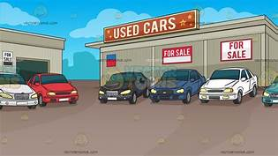


MONTHLY FIXED EXPENSES:
RENT $800
UTILITIES $200
INSURANCE $100
CELL PHONE $100
MONTHLY VARIABLE EXPENSES:
SAVINGS $0 or $50 or $100
GROCERIES $300
DINING OUT $25 PER MEAL
FAST FOOD $10 PER MEAL
ENTERTAINMENT $0 or $50 or $100
CLOTHING $0 or $50 or $100
DOG / CAT $0 or $100
CAR PAYMENT $250 used / $400 new
GASOLINE $100
CAR REPAIRS $100
LAKETRAN $0 or $100
CHARITY $0 or $50 or $100

Slide 30
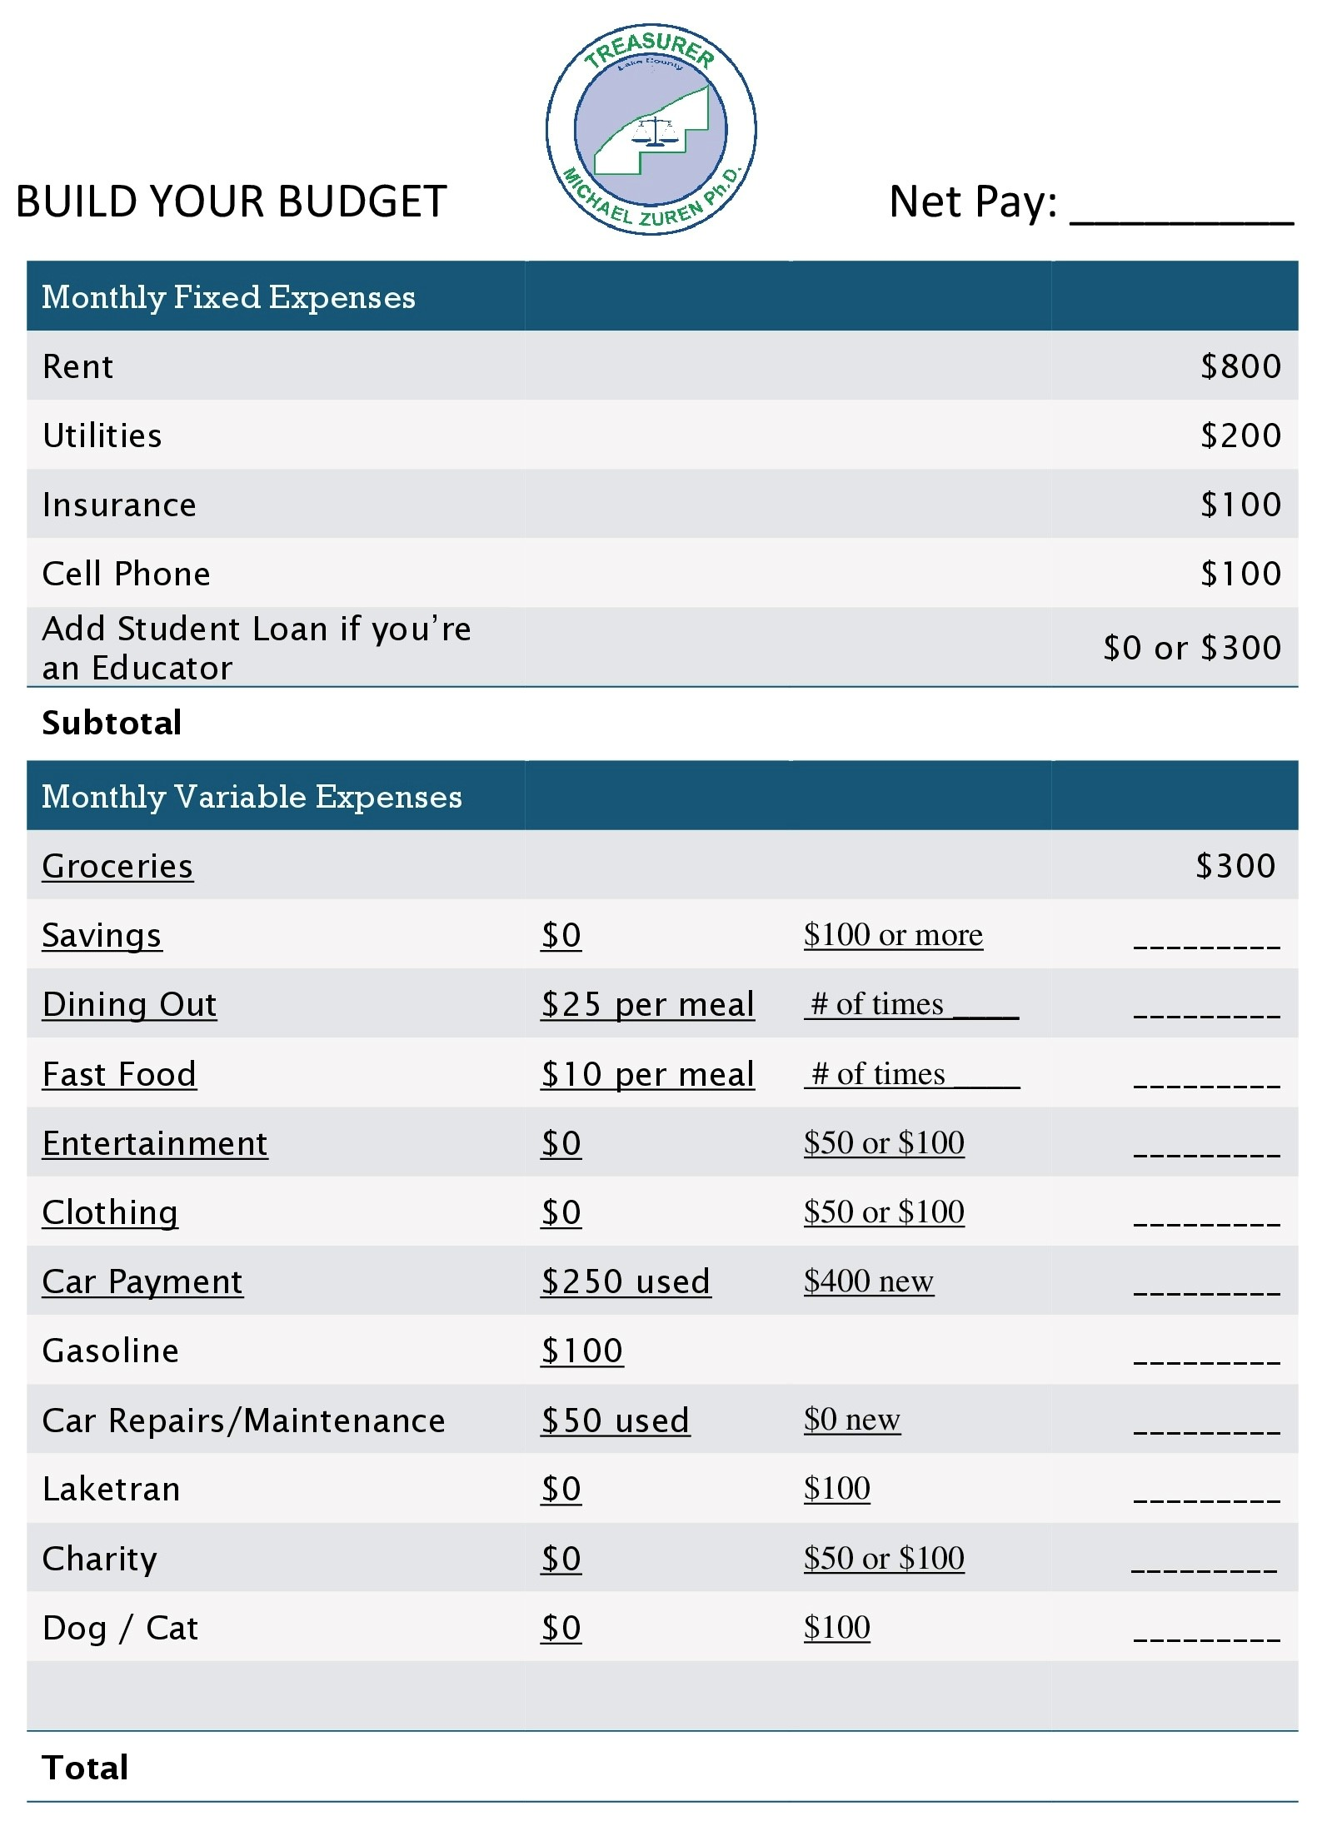

Slide 31

WINDFALL OR EXPENSE

Slide 32
setting up and maintaining a budget
income | budget | actual | difference
Job #1 | $ | $ | $
Job #1 | $ | $ | $
Other | $ | $ | $
total monthly income | $ | $ | $
expenses | budget | actual | difference
fixed regular expenses
Rent | $ | $ | $
Car insurance | $ | $ | $
Car payment | $ | $ | $
Credit card | $ | $ | $
fixed irregular expenses
Savings | $ | $ | $
Food | $ | $ | $
Utilities | $ | $ | $

Slide 33
setting up and maintaining a budget (continued)
expenses | budget | actual | difference
transportation
Bus fare | $ | $ | $
Gas and oil | $ | $ | $
Parking and tolls | $ | $ | $
Repairs | $ | $ | $
other
Medical expenses | $ | $ | $
Clothing | $ | $ | $
Entertainment | $ | $ | $
Household items | $ | $ | $
Personal items | $ | $ | $
Tuition | $ | $ | $
School expenses | $ | $ | $
total monthly expenses | $ | $ | $

Slide 34

Which of the following is affected by one’s values in life?
Decisions
Goals
Personal life
All of the above

Slide 35

CREDIT is the ability to borrow money or access goods or services with the understanding that you’ll pay later.

Slide 36
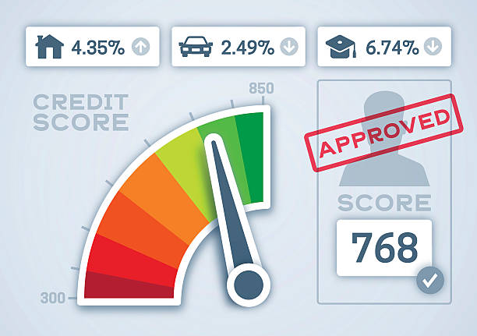
What Makes up a Credit Score?
Do credit scores matter when applying for credit (credit cards, installment loans, or mortgages), insurance, or even a new job? The answer is simple. Banks, lenders, insurance companies, and employers all use credit scores to determine if you will be granted the credit applied for and what the interest rate will be, if you are hired, or the risk of insuring you. This system used by banks and lenders is often referred to as “risk-based pricing”. Credit scores are the lender’s indicator of risk or the likelihood a borrower could default on a debt. Consumer credit agencies such as Transunion, Equifax, and Experian have created algorithms or a statistical calculation, which use an individual’s past credit history and use of credit to measure the likelihood they would become late or default on their debt.

Slide 37
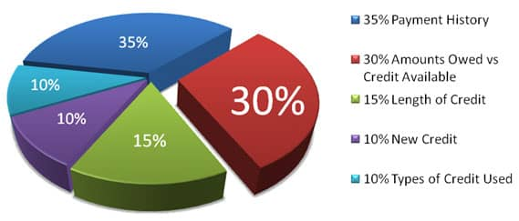
How Credit Scores are Calculated:
The Fair Isaac Corporation developed the “FICO” scoring system. Under this system, credit scores range between 300 and 850.

Slide 38


What is sales tax?
1. tax paid on income
tax earned on savings
tax paid on purchases
tax paid on all expenses
What is interest?
1. money paid on purchases
money earned on an account
money paid for expenses
money paid on taxes

Slide 39
MANY PROFESSIONAL ATHLETES AND CELEBRITIES – PEOPLE WHO CAN AFFORD TO LIVE DESIRED LIFESTYLES – HAVE GOALS FOR THEIR PROFESSIONAL AND PERSONAL ACHIEVEMENTS. WHY DO SUCCESSFUL PEOPLE SET GOALS?
A. Goal-setting allows them to measure progress toward accomplishments or lifestyle changes they desire
B. Setting goals provides them with direction
C. Goal-setting gives them an opportunity to show off to others
D. Both “a” and “b”

Slide 40


Slide 41


Slide 42


