Slide 1

FINANCIAL LITERACY
FOR KIDS AGES 5 – 12
LEARN LOCAL GOVERNMENT &
PRESENTED BY LAKE COUNTY TREASURER MICHAEL ZUREN

Slide 2
Local Government: Counties, Cities, Townships
1. The U.S. government levels:
Federal - State - Local
2. County government: The big regional boss
3. Cities & Municipalities: Your town or city hall
4. Why This Matters to You + Fun Facts

Slide 3
What Is Local Government?
Local Government = the level closest to YOU!
Handles daily services: roads, schools, parks, police/fire, trash pickup, libraries, and zoning (what can be built where).
Created and given power by state governments
Two main tiers in most states:
Counties (larger areas, often including cities)
Municipalities (cities, towns, villages) + Townships in some states

Slide 4
County Government – The Regional Level
Key responsibilities:
Sheriff & jails
Property taxes & assessments
Elections & voter registration
Roads & bridges (especially in rural areas)
Public health, social services (on behalf of state)
Land use planning in unincorporated areas
(Running the county jail, Managing welfare programs, and
Recording marriages & land deeds)

Slide 5
Cities & Municipal Governments – Your Town/City
Governed by: Mayor + City Council (most common) or Council-Manager
Key responsibilities:
Police & fire departments
Streets, sidewalks, streetlights
Water/sewer, garbage collection
Parks & recreation
Zoning & building permits
Local libraries & community centers

Slide 6
Fun Local Government Trivia (Quick Quiz!)
1. How many counties are in the U.S.?
2. What state has NO counties?
3. True/False: Cities get all their power from the federal government.
4. What’s one quirky local service?

Slide 7
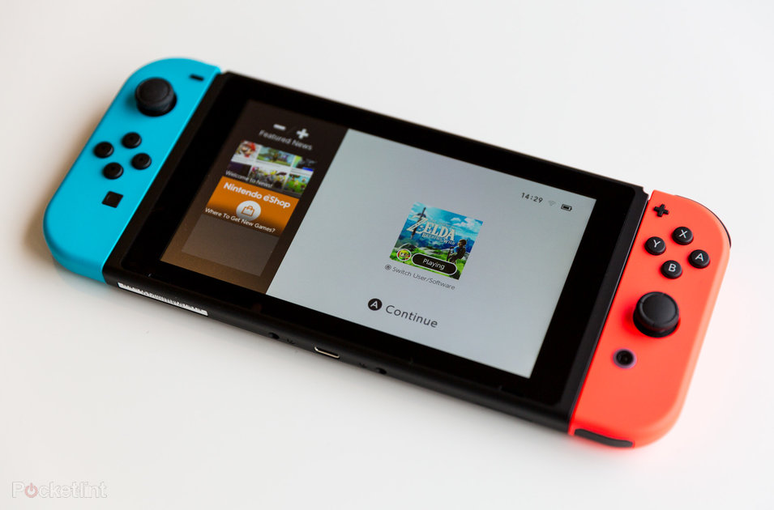
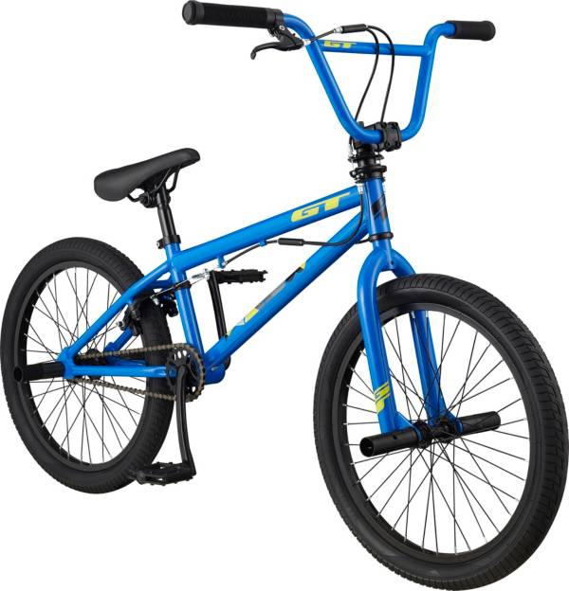

What things cost?

Slide 8
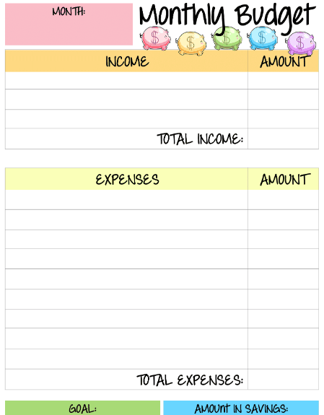

Slide 9
MONEY IS EARNED BY WORKING AND IS USED TO BUY THINGS
CHORES
ALLOWANCES
SPENDING
SAVING

Slide 10
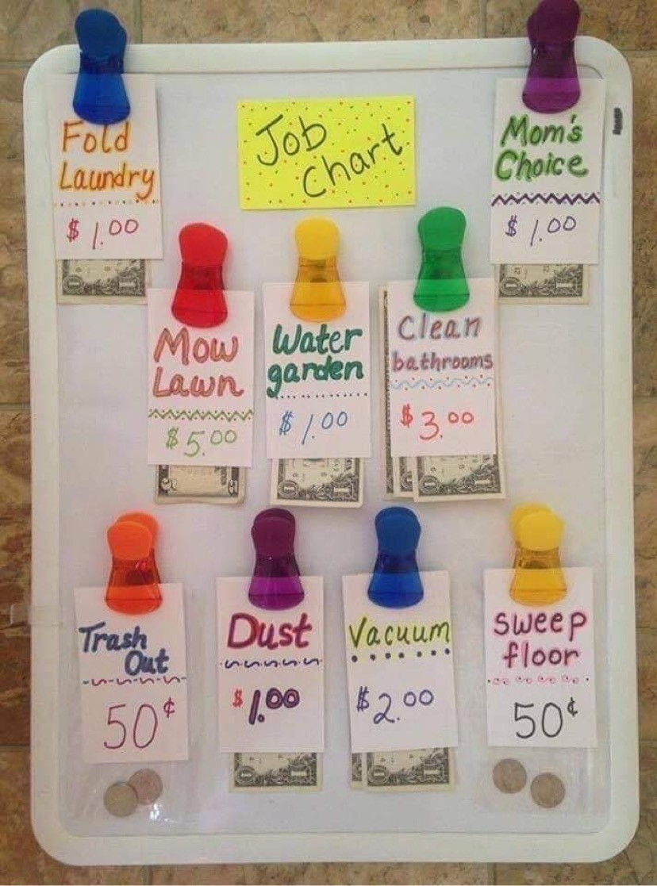
CREATE AN ALLOWANCE CHORE BOARD

Slide 11
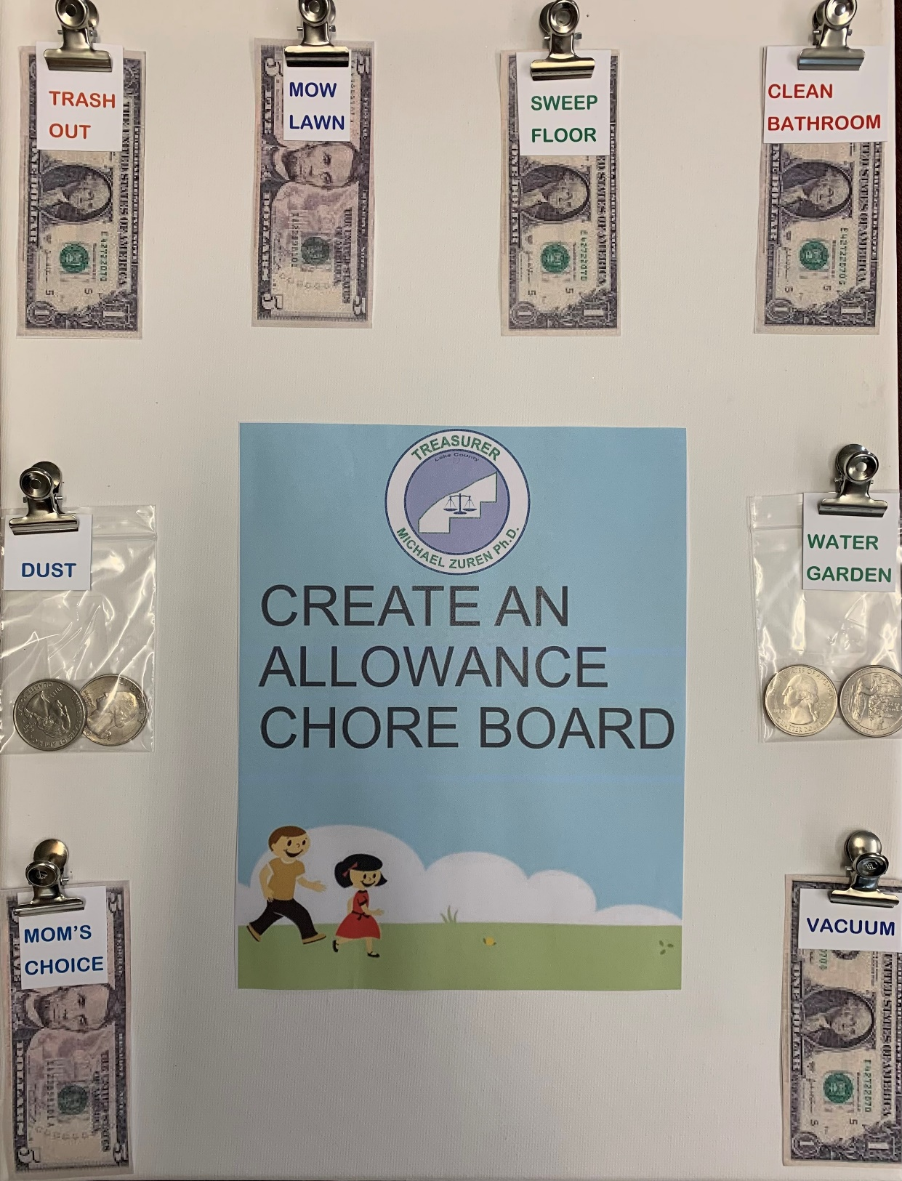
ANOTHER EXAMPLE
OF AN ALLOWANCE
CHORE BOARD
BE CREATIVE AND HAVE FUN EARNING, SAVING AND SPENDING WISELY!

Slide 12
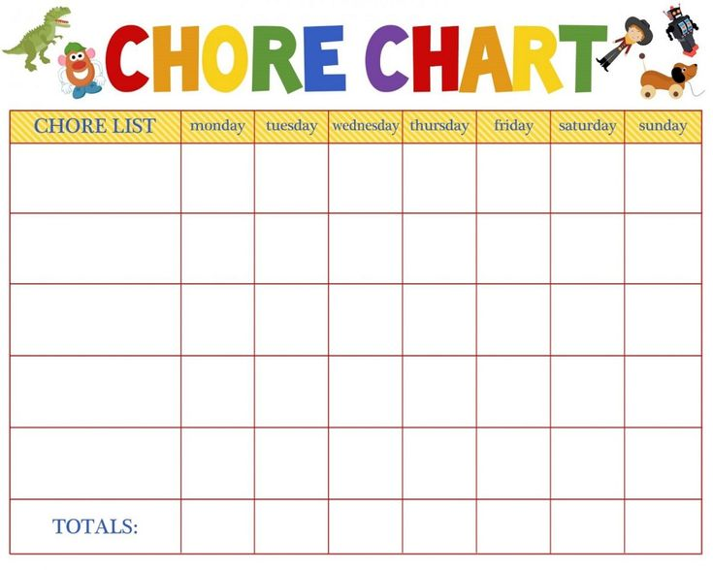
CREATE YOUR OWN
CHORE CHART
BRUSH TEETH
MAKE BED
CLEAN UP TOYS
SWEEP FLOOR
TAKE OUT TRASH

Slide 13
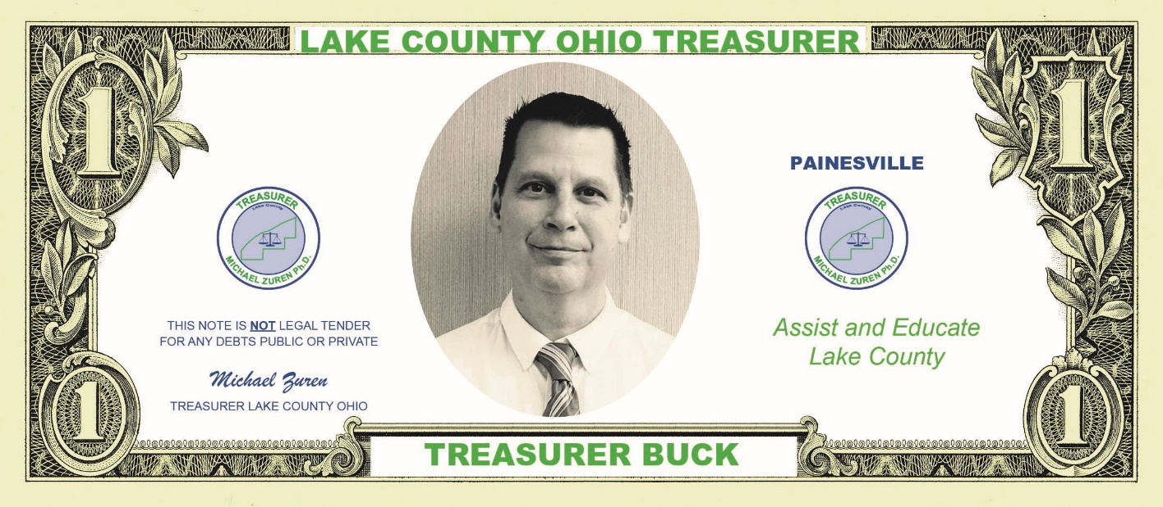
Encourage imaginative play such as pretend store with a toy cash register, play coins, and plastic cards

Slide 14
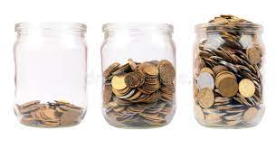
Encourage Saving for Small Goals
Your kids are ready to start learning a slightly more complex concept of savings. The notion of long-term savings is still obscure, so start by encouraging your kids to save for shorter-term goals.
Encourage your kids to save a small amount of their allowance each week in their own personal saving jar, saving for goals such as a special toy, or a birthday or holiday gift for someone special.
Continue filling a family savings jar or piggy bank, promoting a sense of accomplishment as money accumulates.

Slide 15
SAVE $1 A WEEK
4 weeks = $4.00
10 weeks = $10.00
26 weeks = $26.00
52 weeks = $52.00

Slide 16
Money Management
Step 1 EARN
Step 2 SAVE
Step 3 EARN
Step 4 SAVE
Step 5 SPEND
When you use a debit or credit card, are you using your own money?
If you save $1 a week, how many weeks will it take before you can buy a $5 fidget?
Do chores to earn money.

Slide 17
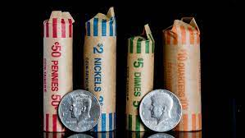
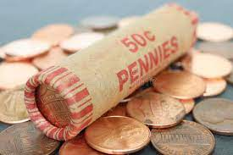
Get coin wrappers and have your kids roll coins. They can be exchanged for dollar bills to be added to savings at home, or can be used for special purchases like birthday or holiday gifts.

Slide 18
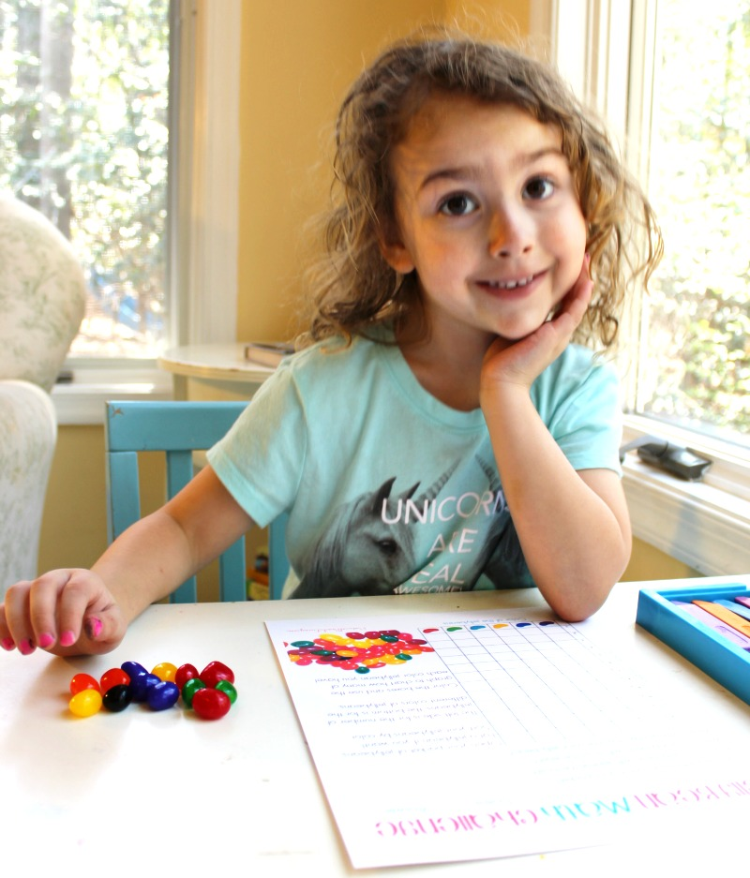
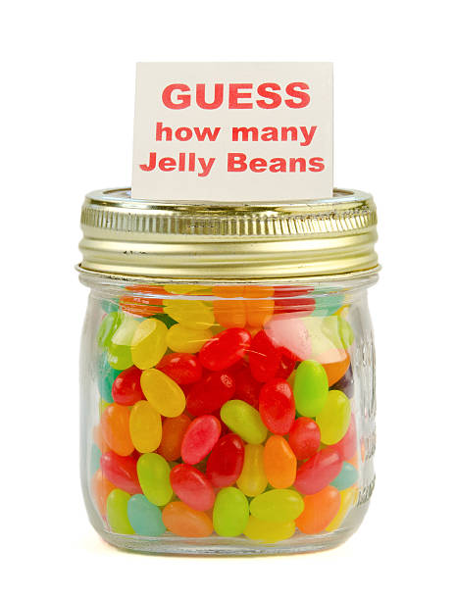
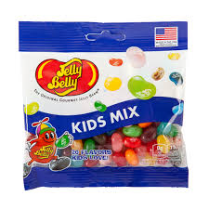

Slide 19
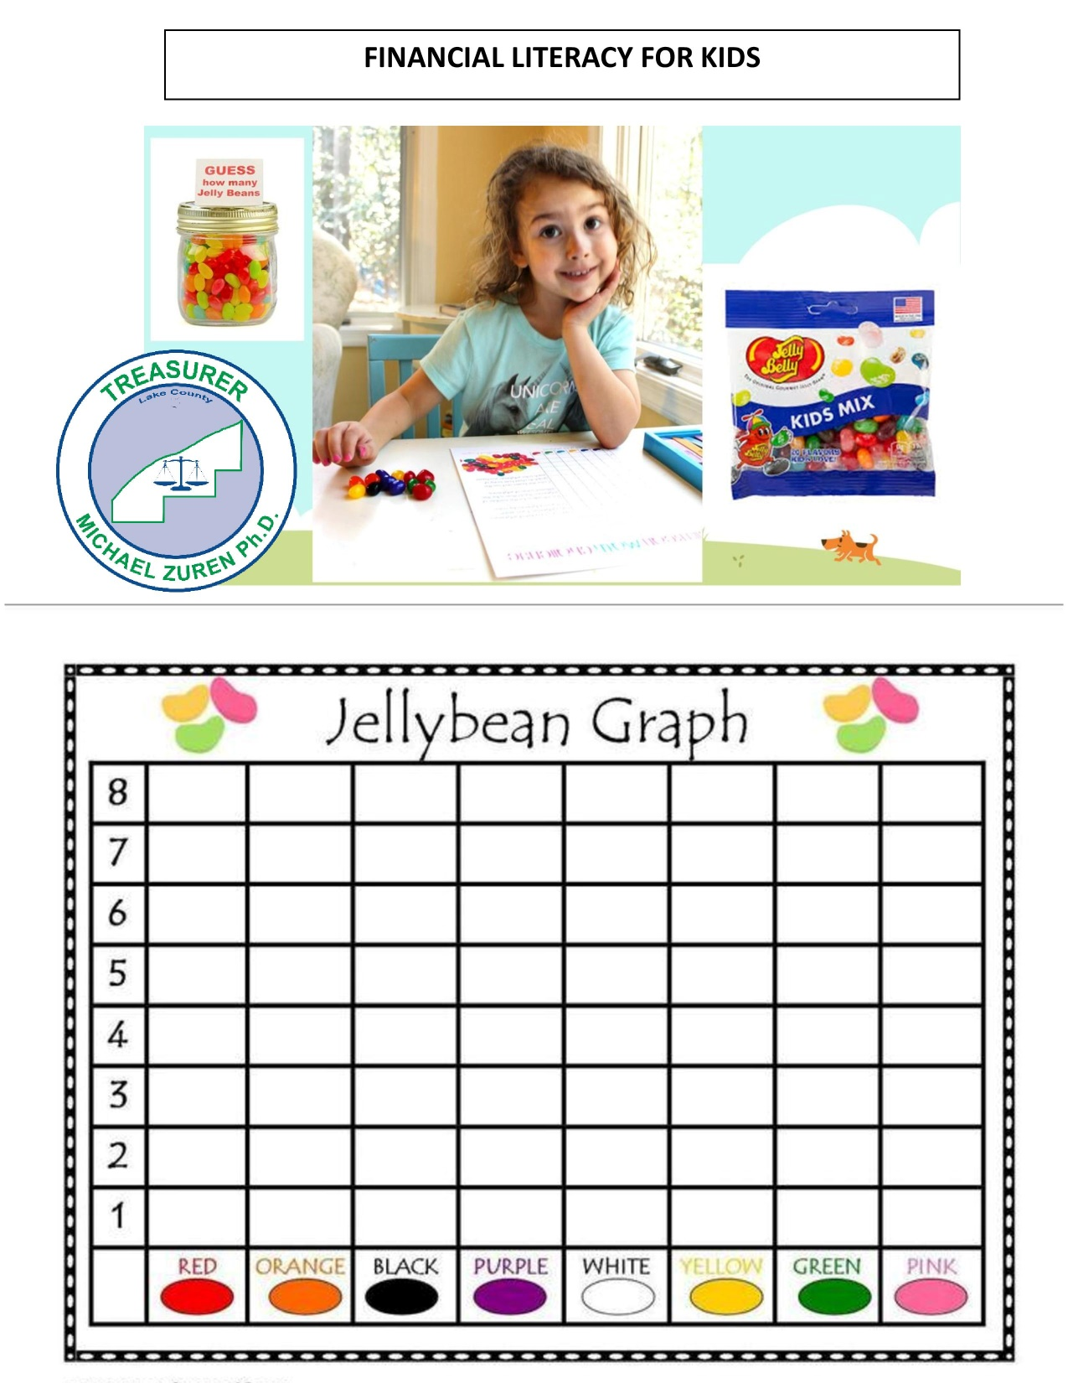

Slide 20


Slide 21
Curiosity About Cash Versus Cashless
Perhaps your child received a gift card, watched you pay with a phone or card at the store or online, or saw you withdraw cash from the ATM: Any of these might spark questions about cash versus cashless payments. Because conceptual thinking has not yet developed, use simple terms and ideas when answering.
Explain that your card or phone makes paying for things easier.

Slide 22
Draw a diagram to show your kids how money flows to help them make the link between ‘real’ and ‘invisible’ money:
You earn money by working.
Your employer deposits your earnings straight into the bank.
You choose when to spend it and how much to spend.
You also choose how to pay, by using a card, your phone, or cash from the ATM.

Slide 23
Explain that using plastic, your phone, or getting money from the ATM doesn’t mean that you can have anything you want, whenever you want. Even though you can’t see it, you’re spending real money that you’ve had to earn and there’s a finite amount available.
Expand knowledge of digital finances through age-appropriate, educational online games, apps, and other virtual resources. Be sure to disable additional purchase options first!

Slide 24
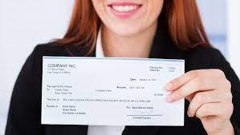
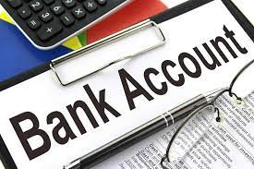

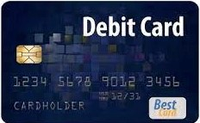
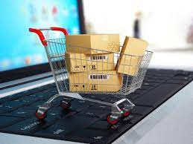
Paycheck
How Money Flows
Bank Account
Debit Card
Purchase

Slide 25
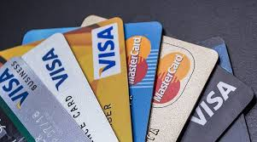

How Money Flows
Purchase
Credit Card
Future Income

Slide 26
Banking Basics
Continue to keep the concept of banking simple, but introduce new concepts beyond the fact that a bank keeps your money safe. Your kids are only a few years away from having their own account, so make sure their experiences are positive ones.
Explain that your paycheck gets deposited at the bank, then you can spend it using cash, cards, or your phone.

Slide 27
Visit the bank with your kids, taking the time to go inside to make deposits and withdrawals.
Explain how an ATM allows you to withdraw money that you’ve earned, even when the bank is busy or closed. Youngsters often incorrectly think that ATMs print money and give it away free, as much and as often as you want.

Slide 28

ALWAYS KEEP LEARNING
ALWAYS KEEP EARNING
ALWAYS KEEP SAVING

