Slide 1
MICHAEL ZUREN, PhD Lake County Treasurer
Lake County Council
on Aging

Slide 2

LAKE COUNTY DOUBLES HOMESTEAD AND OWNER OCCUPANCY CREDITS FOR (one year)
2026 PAYABLE 2025 PROPERTY TAXES

Slide 3
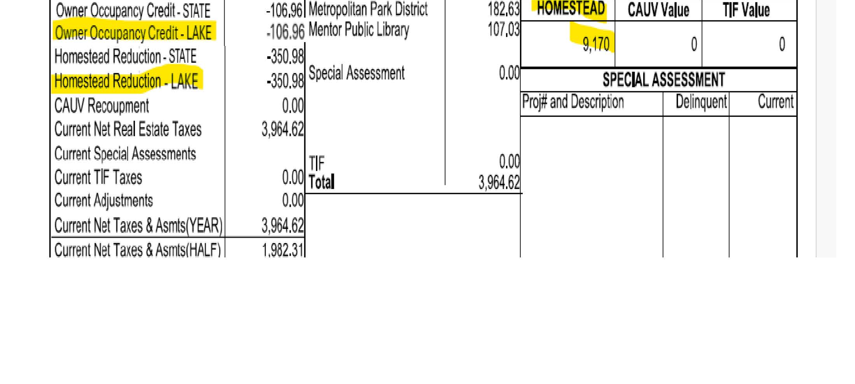

Slide 4
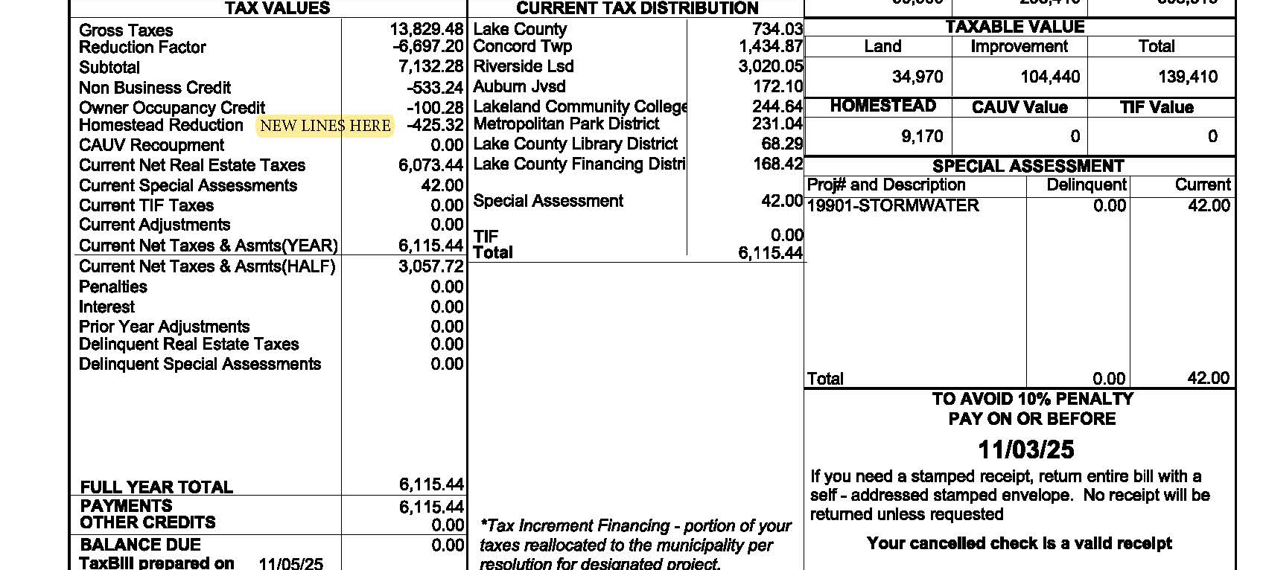

Slide 5
Recent Ohio Legislation Affecting Property Taxes
House Bill 186 (HB 186): This bill addresses property taxes in school districts operating at the "20-mill floor" (the minimum levy for school operations, affecting about 75% of districts). It ties future tax increases to inflation rates, provides a one-time tax credit to offset the 2023 and 2024 spikes (estimated at $400 million annually for homeowners), and includes a temporary $465 million state offset to schools over two years to maintain 2024 revenue levels. Effective for tax year 2026.
House Bill 335 (HB 335): Targets "inside millage" (up to 10 mills levied without voter approval). It prohibits most political subdivisions from levying new inside millage (except townships, limited to 2024 levels) and empowers local governments to offer homestead exemptions for vulnerable residents without state funding. Originally proposed to eliminate inside millage entirely for $3.5 billion in savings, the final version caps increases instead. Effective for tax year 2026.

Slide 6
Financial Literacy for Seniors
Top Resources
Organization | Resource | Why It’s Great for Seniors | Access
AARP Foundation | Money Fit for Older Adults | Free workshops on Social Security, Medicare, budgeting | Online, in-person, phone: 1-855-850-2525
National Council on Aging (NCOA) | BenefitsCheckUp | Finds income/medical assistance programs | Online tool
Consumer Financial Protection Bureau (CFPB) | Money as You Grow for Adults | Simple guides on debt, savings, scams | Online, printable
Ohio Department of Aging | Ohio Senior Health Insurance Information Program (SHIIP) | Medicare, insurance counseling | 1-800-686-1578
FINRA Investor Education | Save and Invest | Fraud prevention, investment basics | Online, videos

Slide 7
Identity Theft Protection:
Why Seniors Are Vulnerable
Action | How to Implement | Tools/Resources
Freeze Credit Reports | Prevent new accounts from being opened | Equifax, Experian, TransUnion
Monitor Accounts | Check statements weekly | Free: Credit Karma; Paid: LifeLock
Use Strong Passwords | Unique passwords for each account | LastPass, 1Password
Enable 2FA | Add extra security layer | Built into most bank/investment apps
Shred Documents | Destroy sensitive papers | Cross-cut shredder ($30–$100)
Identity Theft Protection
Why Seniors Are Vulnerable

Slide 8
Identity Theft Resources
Resource | Contact | Services
Ohio Attorney General | 1-800-282-0515 | Consumer protection, fraud reporting
Ohio Senior Legal Helpline | 1-866-243-7878 | Free legal advice on identity theft
AARP Ohio Fraud Watch | Local events | Free fraud prevention workshops

Slide 9
Quick Reference Emergency Numbers
Issue | Contact | When to Call
Identity Theft | 1-877-438-4338 | Immediate fraud detection
Financial Exploitation | Ohio AG: 1-800-282-0515 | Suspected scam
Medicare Questions | 1-800-MEDICARE | Billing disputes
Social Security Fraud | 1-800-269-0271 | Stolen benefits
Local Senior Help | 211 | Emergency assistance
Quick Reference Emergency Numbers

Slide 10

FINANCIAL TIPS FOR SENIORS CITIZENS

Slide 11
Objectives: Guard against identity theft Manage your money How to identify & report financial exploitation Resources & information on protecting your assets

Slide 12
Why are older adults at risk of financial exploitation?

Slide 13
Some older adults may:
Have regular income and accumulated assets.
Be trusting and polite.
Be lonely and socially isolated.
Be vulnerable due to grief from the loss of a spouse, family member, friend, or pet.

Slide 14

Exploitation by Caregivers and In-Home Helpers – Tips to Defend Yourself at Home

Slide 15
Secure your private financial documents.
Require receipts for purchases made by helpers.
Monitor bank accounts and telephone bills.
Do not let hired caregivers or helpers open your mail, pay your bills, or manage your finances.

Slide 16
Never let caregivers use your credit/debit card to run errands or make purchases.
Check your free credit reports at annualcreditreport.com

Slide 17
Budget Closely and Track Expenses Never Stop Learning About Finances Automate Your Finances

Slide 18
How do I check the credentials of my financial adviser?
You can check a broker’s background via the Financial Industry Regulatory Authority (FINRA) BrokerCheck at finra.org or by calling 1-800-289-9999

Slide 19
Scam where debt collectors try to trick their victims into paying a debt that doesn’t exist, and demand the debt is paid immediately!

Slide 20
Planning ahead: * Gives you control and options for your situation * Allows time for gathering information, comparing options, and determining how to handle it

Slide 21

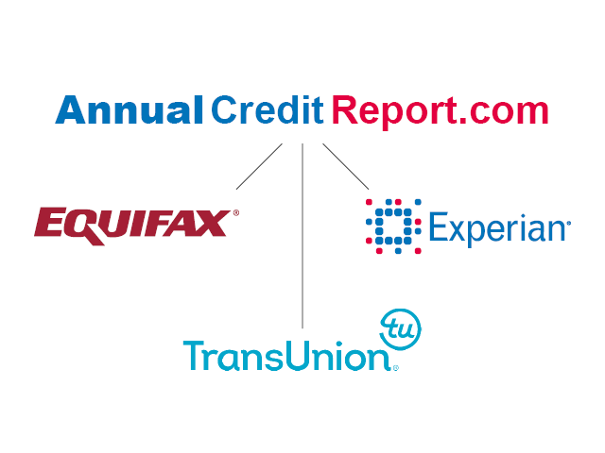
KEEP A CLOSE EYE ON CREDIT

Slide 22
Your Personal Monthly Budget

Slide 23
Most Used Local Services
1. Nutrition Programs (Meals)
Home-delivered meals (e.g., Meals on Wheels) and congregate meals at senior centers. These are among the highest-utilized services, serving millions annually, as they address food security, nutrition, and social isolation for homebound or low-mobility seniors.
2. Information, Referral, and Assistance (including Aging and Disability Resource Centers - ADRCs)
One-on-one help connecting seniors to resources, benefits counseling, options counseling, and navigating programs like Medicare/Medicaid. This is often the entry point and one of the most contacted services.

Slide 24
3. Transportation Services
Rides to medical appointments, grocery shopping, senior centers, or community activities (often door-to-door or subsidized). Highly demanded to maintain access to healthcare and independence.
4. In-Home Supportive Services / Homemaker and Personal Care
Help with daily tasks like light housekeeping, meal prep, bathing, dressing, or respite for caregivers. These are core for preventing institutionalization and are heavily used by those aging in place.
5. Caregiver Support Programs (National Family Caregiver Support Program)
Counseling, training, respite care, and support groups for family caregivers of older adults. With millions of family caregivers, this sees significant local demand.

Slide 25
6. Health Promotion and Disease Prevention
Classes/workshops on chronic disease self-management, fall prevention, exercise, nutrition education, and screenings. Popular for proactive wellness.
7. Long-Term Care Ombudsman Program
Advocacy and complaint resolution for residents in nursing homes, assisted living, or other long-term care facilities. Essential for protecting vulnerable seniors.

Slide 26
Key Government Programs for Saving Money
Supplemental Nutrition Assistance Program (SNAP) — Formerly food stamps; provides monthly benefits (via EBT card) for groceries. Many seniors qualify even on modest incomes, with average benefits around $100–$200+/month for households with older adults. Helps significantly with food costs.
Medicare Savings Programs (MSPs) — State-run programs (via Medicaid) that pay Medicare Part B premiums (and sometimes Part A, deductibles, copays). Can save $1,000–$2,000+ per year. Includes Qualified Medicare Beneficiary (QMB), Specified Low-Income Medicare Beneficiary (SLMB), and others.
Extra Help (Low-Income Subsidy for Medicare Part D) — Covers most or all prescription drug costs (premiums, deductibles, copays) under Medicare drug plans. Can save thousands annually on medications; automatic for some, but apply via SSA if needed.

Slide 27
4. Low-Income Home Energy Assistance Program (LIHEAP) — Federal/state grants to help pay heating, cooling, or energy bills. Often provides one-time or ongoing assistance to prevent shutoffs.
5. Medicaid — For very low-income seniors; covers long-term care, doctor visits, hospital stays, and more (beyond what Medicare does). In many states, it also wraps around Medicare for dual eligibles.
6. Supplemental Security Income (SSI) — Monthly cash payments for low-income seniors 65+ (or disabled/blind). Federal maximum around $967/month (2025–2026 figures; varies by state supplements).
7. Housing Assistance — Includes Section 202 subsidized senior housing, HUD public housing, or Section 8 vouchers for rent help. Also, reverse mortgages (HECM) for homeowners 62+ to access home equity without monthly payments.
8. Senior Farmers' Market Nutrition Program (SFMNP) or Commodity Supplemental Food Program (CSFP) — Free fresh produce or monthly food boxes for eligible low-income seniors.

Slide 28
Savings into Budgets
Senior Discounts — Widely available at restaurants (e.g., 10–20% off), grocery stores, pharmacies, movie theaters, travel (Amtrak, hotels), museums, and national parks (America the Beautiful Senior Pass: $80 lifetime for 62+).
Review and Shop Insurance/Phone/Utilities — Compare Medicare Advantage vs. Original Medicare plans annually (during open enrollment); switch to low-cost cell plans (many carriers offer senior deals); bundle or negotiate utilities.
Downsize or Relocate — Sell a large home, move to a lower-cost area, or right-size to reduce housing/tax/maintenance costs.
Cut Recurring Expenses — Trim subscriptions/streaming, eat out less, use generic brands, shop sales, or use apps for discounts.
Tax Assistance — Free AARP Tax-Aide for 50+; check for senior-specific deductions/credits (e.g., medical expenses, property taxes).
Health & Wellness Savings — Preventive Medicare services (free screenings, wellness visits); community programs for exercise/nutrition classes.

Slide 29
The Lake County Council on Aging
Information and Referral / Aging and Disability Resource Center (ADRC): Starting point for unbiased information, assistance, benefits counseling, long-term care options, and connections to community resources and supports for seniors 60+ and adults 18+ with disabilities.
Social Work Services: Licensed social workers provide in-home comprehensive assessments, guidance, individualized care plans, support, and connections to needed services and resources for residents age 60+.
Meals on Wheels: Nutritionally balanced hot meals delivered to homebound seniors.
The Lunch Place / Congregate Meals: Group meal sites at various senior centers/locations (e.g., in Madison, Painesville, Mentor, Wickliffe, Willowick-Eastlake) for social dining and nutrition.

Slide 30
Homemaker Services: Light housekeeping (e.g., kitchen/bathroom cleaning, dusting, vacuuming) provided on a shared-cost basis to help maintain safe, clean homes.
Non-Medical In-Home Care Program: For income-qualified seniors 60+ not eligible for Medicaid but unable to afford private care; includes weekly 2-4 hour visits from aides for personal care and other assistance.
Health Equipment Lending Program (H.E.L.P.): Donated durable medical equipment (e.g., walkers, wheelchairs, rollators, canes, bedside commodes, tub seats/transfer benches) lent to seniors at no cost (call to check availability).
In-Home Safety (and related support): Services to promote home safety and independence.
Vial of Life: Free red magnetic pouch for refrigerator containing personalized medical history and emergency contacts for first responders.

Slide 31
Volunteer Opportunities: Includes Meals on Wheels delivery, nutrition site assistance, grocery shopper program, friendly visitor program, Ohio Senior Health Insurance Information Program (OSHIIP), and office help.
Other Support: Benefits assistance, options counseling, emergency food preparations (e.g., blizzard bags), and connections to transportation or other community partners.

Slide 32
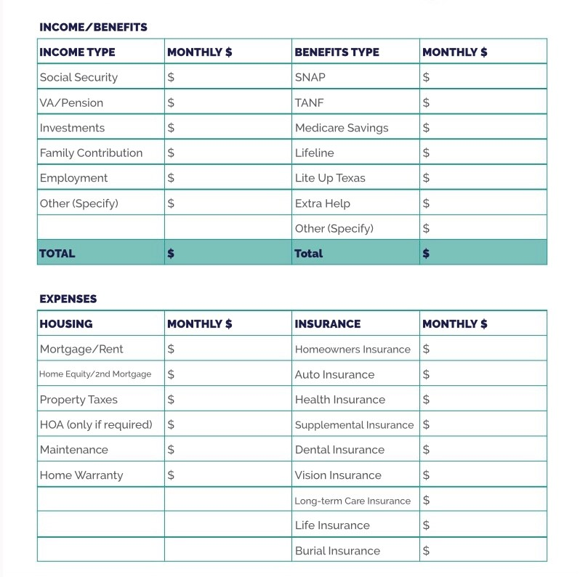

Slide 33
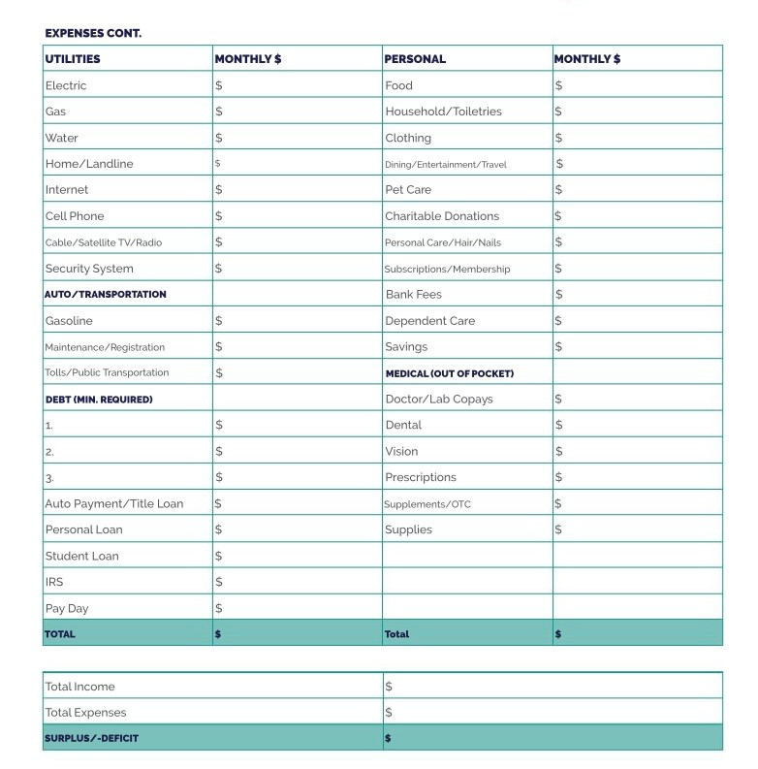

Slide 34
Budgeting Fundamentals
Track income vs. expenses: Categorize needs (housing, food, utilities) vs. wants (entertainment, travel).
The 50/30/20 rule adapted for seniors: 50% essentials, 30% flexible spending, 20% savings/emergency fund.
Inflation impact: How rising costs affect fixed incomes and tips for adjustments.

Slide 35
Senior-Focused Budgeting
Healthcare and long-term care: Budgeting for premiums, copays, and potential assisted living.
Downsizing strategies: Reducing housing costs, energy-saving tips, or part-time gigs.
Emergency funds: Aim for 3-6 months of expenses; where to keep it (high-yield savings).
Tools: Simple apps like Mint or Excel templates; paper trackers for non-tech users.

Slide 36
Common Pitfalls and Solutions:
Overspending on grandchildren or subscriptions; how to set boundaries.
Debt management: Prioritizing high-interest debt and consolidation options.

Slide 37
Debt Dilemma:
$20k credit card debt at 22%
A) Minimum payments only
B) Avalanche method
(pay high-interest first)
C) Consolidate at 9% personal loan

Slide 38
Investment Risk:
Market down 15%
Sell in panic
Hold & buy more on dip C
Ignore (you have emergency fund)

Slide 39
Retirement Catch-Up
Age 50+
Max IRA catch-up ($1k extra)
Skip for vacation
Roth conversion in low-tax year

Slide 40
Scam Alert
You’ve won $50k crypto prize-send
$2k gas fees first
Pay
Report & Block

Slide 41
Emergency Fund Test
Car repair $4k surprise
Credit card
Use emergency savings
Borrow from family

Slide 42
Programs for Seniors
Homestead Exemption Qualifications
Must be 65 or older or totally disabled
You must own your home on January 1st in the year you are applying for the homestead exemption
If house is in a Trust or Life Estate, copy of trust is required
Must be your primary Residence
Income limitations $38,600 (2024) to qualify based on the Modified Adjusted Gross Income (located on line 3 of the State Income Tax Return plus line 11 of the Ohio Schedule A)
If you do not file a State Tax Return, proof of age is required with completed exemption application
If qualified, Law Exempts the first $25,000 of value

Slide 43
Programs for Veterans
Disabled Veterans and Surviving Spouses Program
Must be 100% disabled for the year applying for exemption
VA disabled Veterans do not have any income requirements
If qualified, Law Exempts the first $50,000 of value
Notes:
43

Slide 44
How to obtain an application
Christopher Galloway
Lake County Auditor
105 E. Main Street
Painesville, Ohio 44077
Attn: Homestead Dept
440-350-2532
Form available online at Auditor’s website
www.lakecountyohio.gov/auditor

Slide 45
In an effort to assist low-income senior citizens with utility costs, the Board of Lake County Commissioners and the Department of Utilities established a program to provide a 30% discount on LAKE COUNTY water and sewer bills
must be 65 years of age or older
own and occupy the property
meet the income qualifier established by the Ohio Homestead Exemption
Residents must contact the utilities office 440-350-2070 or visit lakecountyohio.gov/utilities and print Senior Citizen Discount Application

Slide 46
Your bank will never send you an email asking you to verify your account number or any other identifying information.
True
False

Slide 47
Where can you check a financial adviser’s background?
FINRA BrokerCheck
Social Security Administration
State Securities Regulator
Federal Trade Commission

Slide 48
What can you do to prepare financially for a disaster? a. Set up automatic bill payments b. Know where to find important documentation in an emergency. c. Review insurance information regularly to ensure you have adequate coverage. d. All of the above.

Slide 49
Which forms of identification should you have readily available in case of emergency?
Driver’s License
Insurance Card
Social Security Card
Passport
Birth Certificate

Slide 50
Who of the following may be perpetrators of elder financial exploitation? Select all that apply. a. Family members and caregivers b. Friends or neighbors c. Telephone and mail scammers d. Financial advisers

Slide 51
If you receive a call or an email from someone claiming to be in trouble and in need of emergency funds, what should you do? Select all that apply. a. Call the individual at a known phone number to verify that the need is legitimate. b. Immediately wire funds to the account number provided. c. Hang up immediately. d. If the call is from a hospital or law enforcement agency, look up the number to verify who it is.

Slide 52
What is TRUE of a durable power of attorney (POA)?
a. It remains in place if you become incapacitated.
b. It allows the person you select to make financial decisions on your behalf.
It can be changed or revoked.
No one else can monitor the actions of your designated POA.

Slide 53
What practices should you AVOID in selecting someone to repair your roof?
Getting three bids in writing from local established contractors.
Using contractors who come to your door and tell you they are working for a neighbor.
Asking if the contractor has the required licenses and getting his/her license numbers.
Paying in advance.

Slide 54
Questions and Answers

