Slide 1


Slide 2
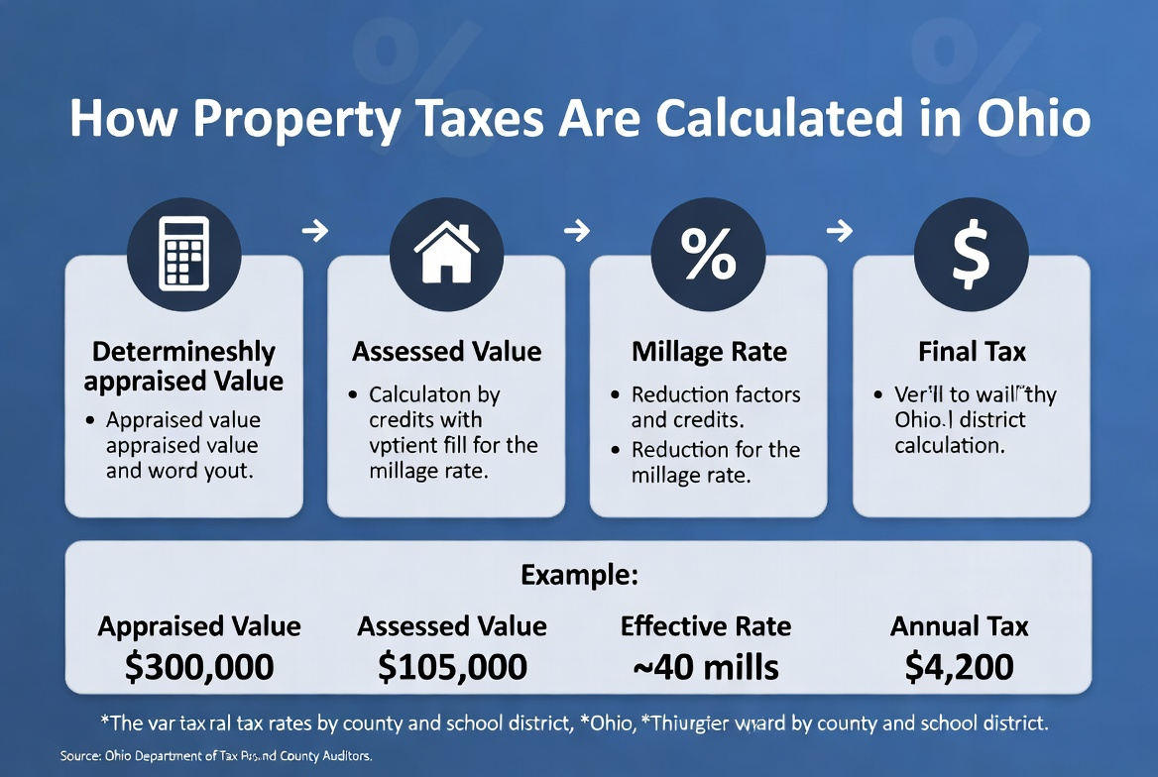

Slide 3
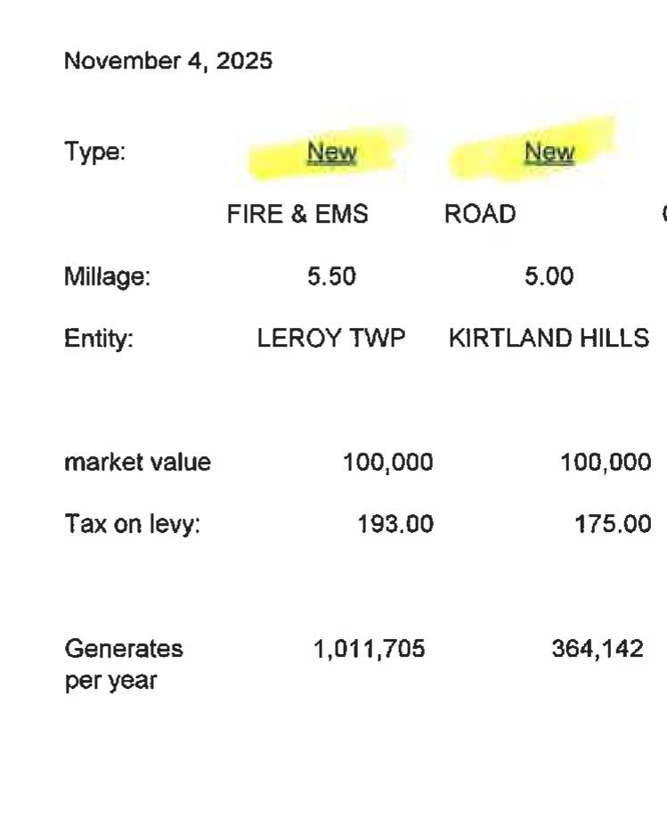

Slide 4
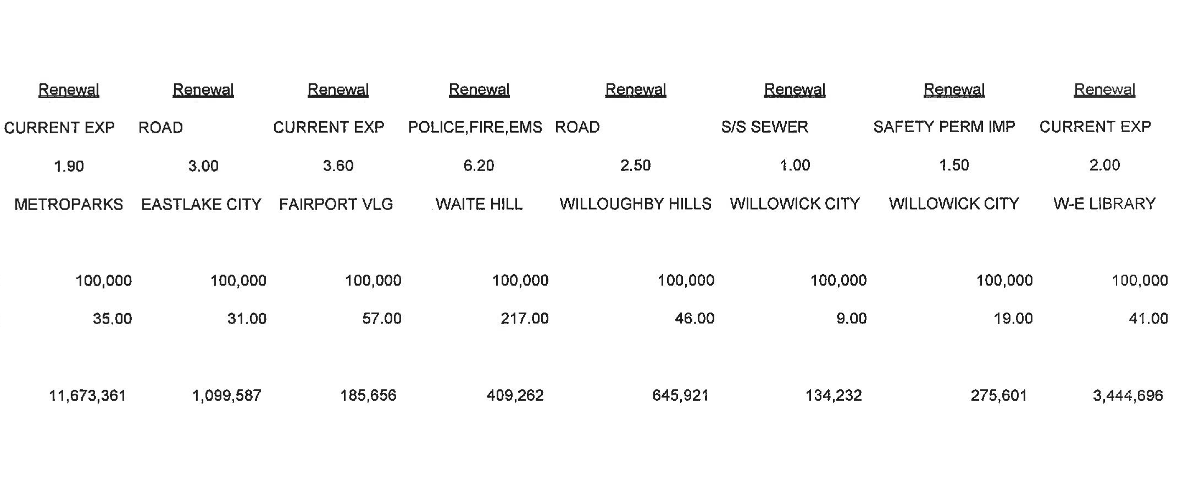

Slide 5
What does this mean for you?
=
Let’s calculate

Slide 6

Ohio Property Tax – Deep Dive
The Impact on Ohio’s Future for All Ages
Presented by:
Michael Zuren, PhD
Lake County Treasurer

Slide 7
Lake County Doubles the Homestead Exemption and Owner-Occupancy Credit (2026 only)
Owner-Occupancy
2.5% reduction doubled to 5% on qualifying levies on certain property taxes for anyone who owns and lives in their home as their primary residence
Using local county funds (no state reimbursement for the extra amount)
Homestead Exemption
For qualifying seniors (65+), permanently disabled people, or surviving spouses

Slide 8
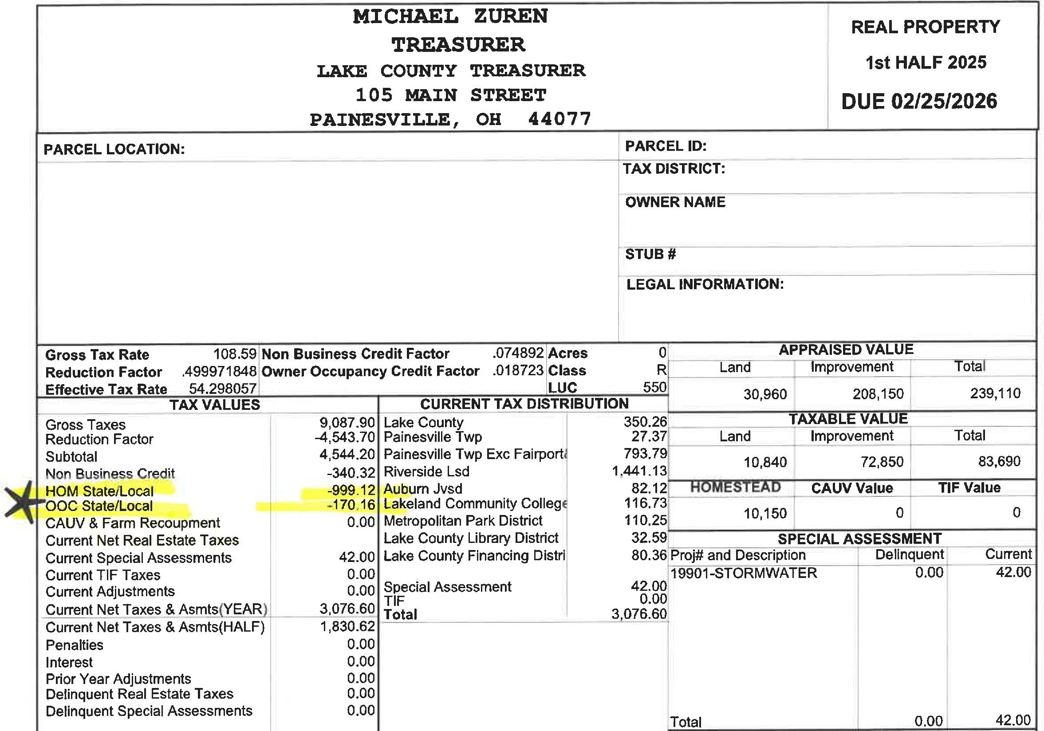

Slide 9
5 New Property Tax Laws:
HB 124: Gives county auditors more oversight in determining property valuations and modifies the process for sales-assessment ratio studies.

Slide 10
Ohio House Bill 124
Control over sales data selection:
Gives auditors the primary role in deciding which recent home sales data is included to track market trends and set new values.

Slide 11
HB 129: Requires fixed-sum levies (like many school emergency levies)
to be included in the calculation of a school district's 20-mill floor, which can help lower tax rates.

Slide 12
HB 129 Primarily lowers property taxes by curbing unvoted tax increases:
Under prior law, certain levies (like emergency, substitute, incremental growth, conversion levies, and the property tax portion of combined levies) did NOT count toward this floor. This allowed districts to collect additional revenue from rising property values without new levies.

Slide 13
HB 186: Establishes an "Inflation Cap Credit" for school district property taxes, linking growth to the rate of inflation. It also phases out the general 10% non-business credit and gradually increases the owner-occupied credit for homeowners living in their homes.

Slide 14
HB 186
In short: Your school taxes can’t rise more than inflation without a vote of the people (for the parts affected by this floor).
If they would, you get a credit to bring it back down.

Slide 15
HB 309: Expands the authority of county budget commissions to allow them to review and potentially reduce property tax rates if they determine collections are "unnecessary" or "excessive," even for voter-approved levies.

Slide 16
HB 309
County Budget Commission (usually the county auditor, treasurer, and prosecutor or a tax official).
HB 309 expands their authority: They can now review and reduce the tax rate (millage) on voted levies if the money collected is seen as “unnecessary” (more than really needed after accounting for reserves and other income) or “excessive” (higher rate than required for normal services).

Slide 17
HB 335: Limits revenue increases from "inside millage" (taxes local governments collect without voter approval) due to reappraisals or updates, capping the growth to the rate of inflation.

Slide 18


New 12 month payment plan | Homestead & VA tax credits
Financial Literacy | Identity Theft
CHRISTOPHER GALLOWAY,
Lake County Auditor

Slide 19
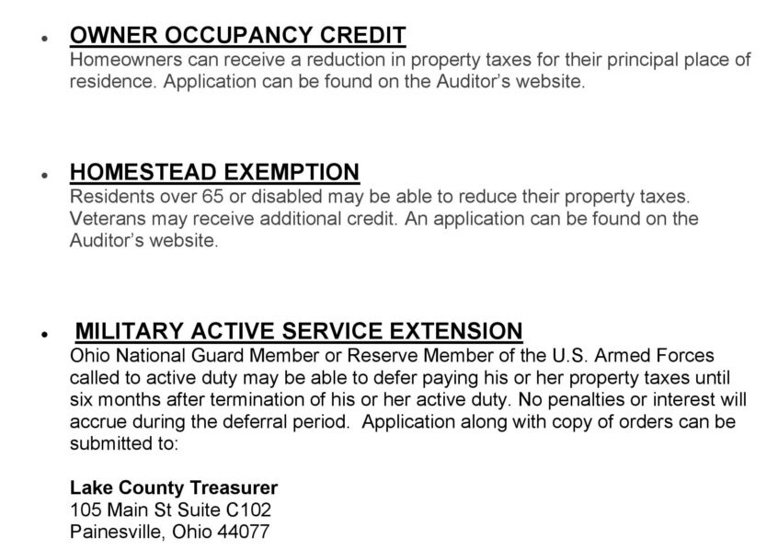
Tax
Savings

Slide 20
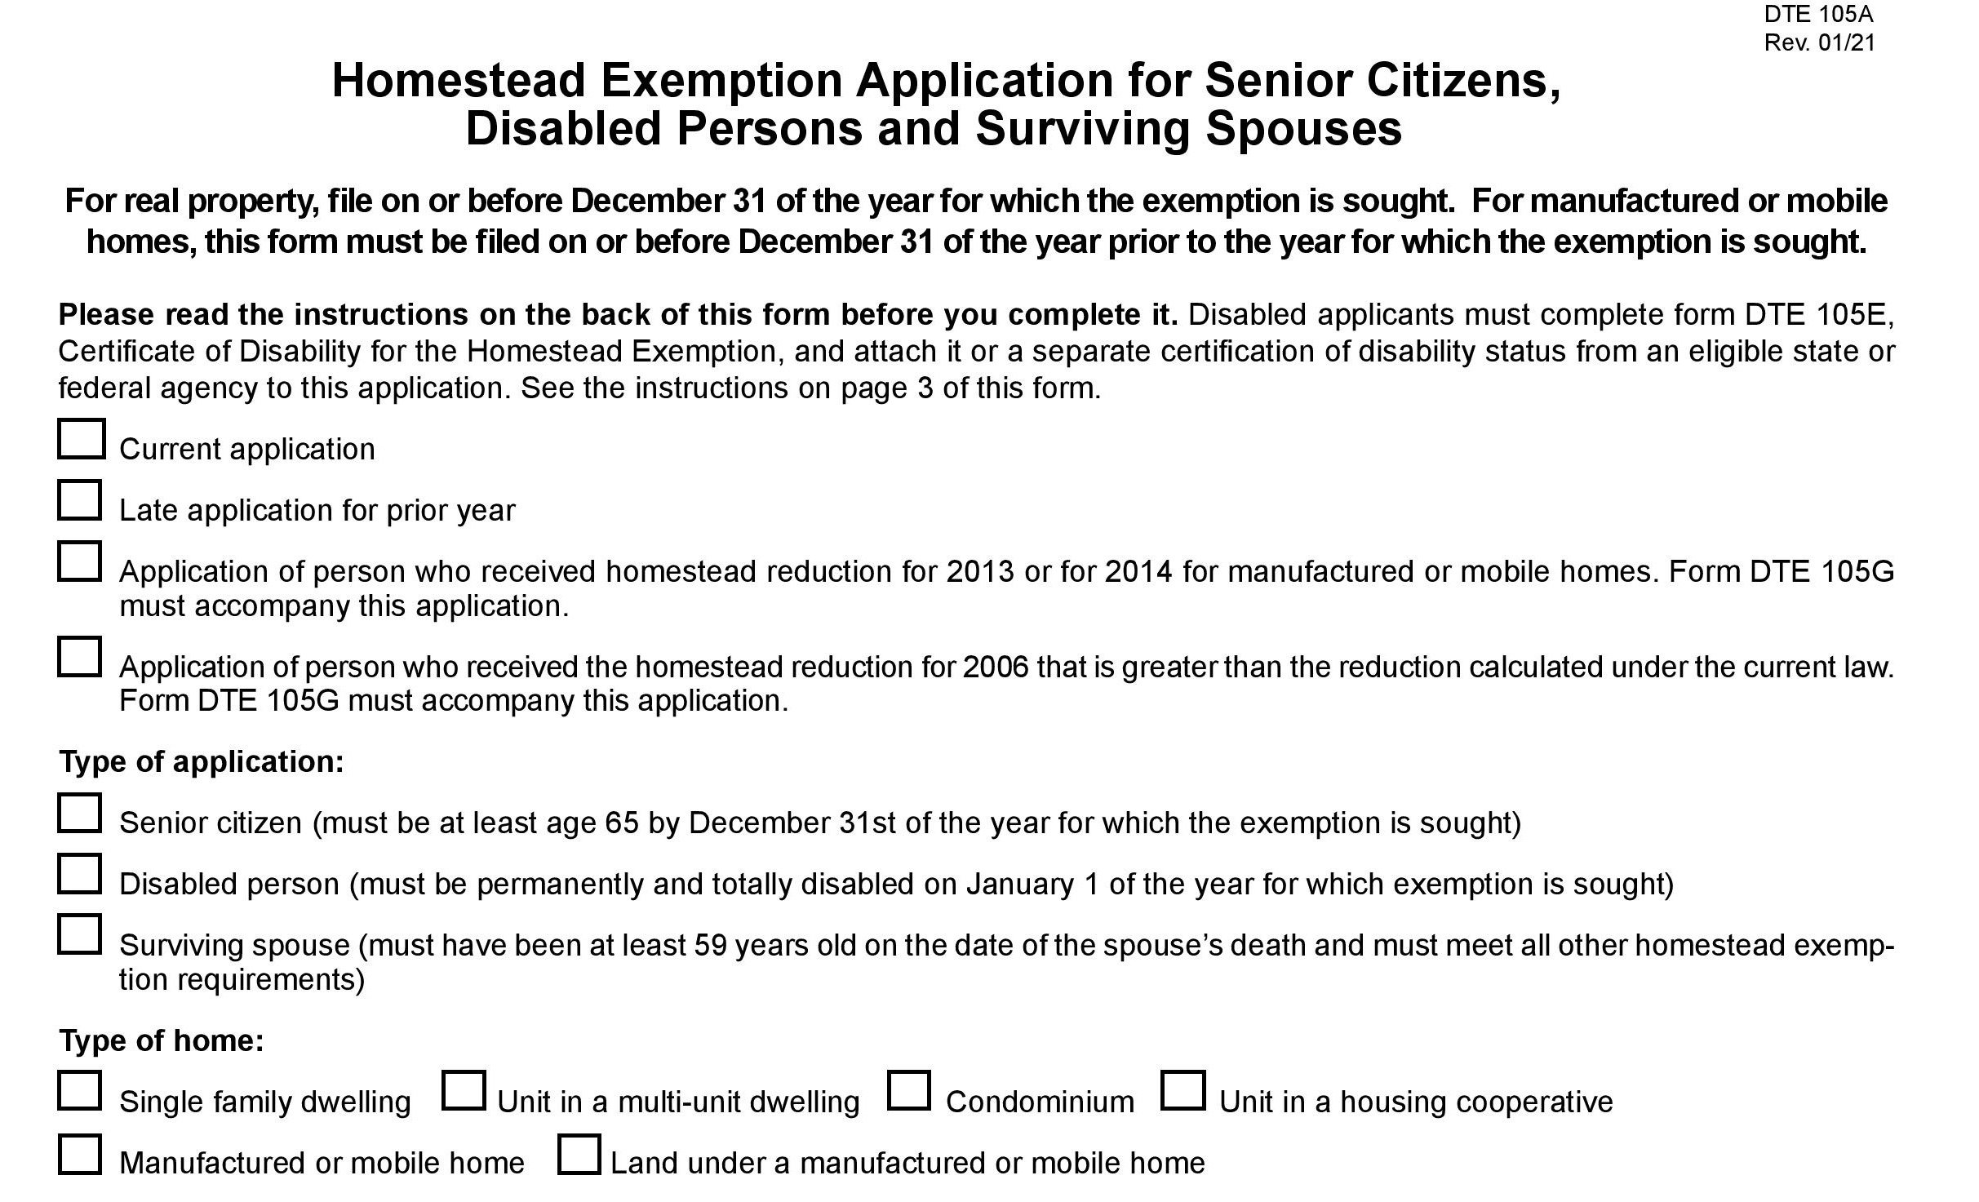

Slide 21
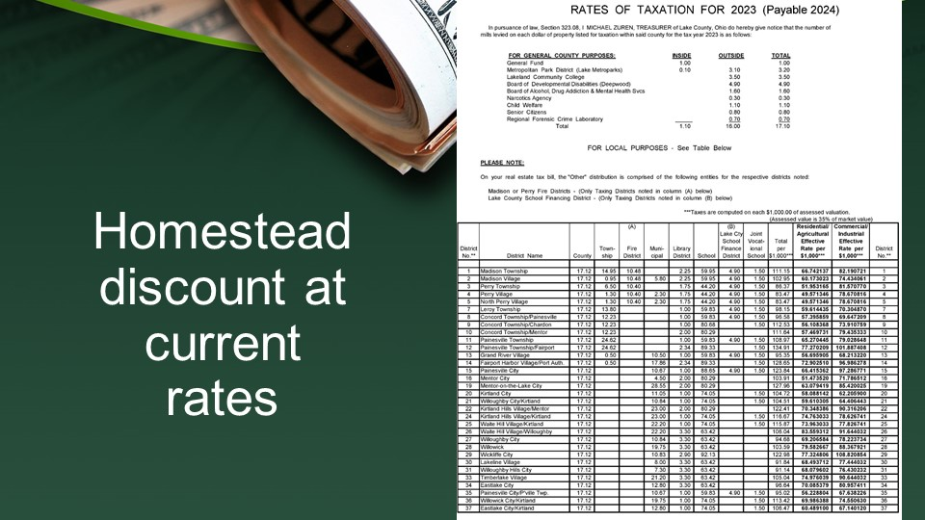

Slide 22


Slide 23
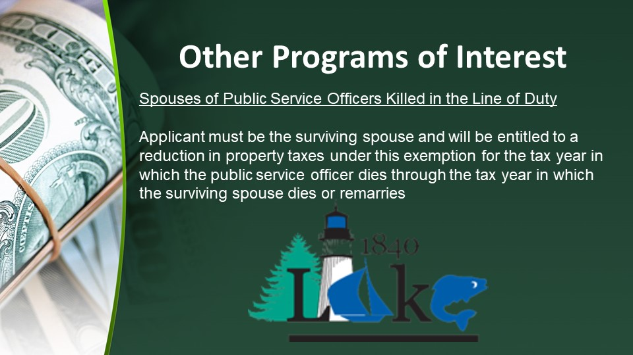

Slide 24
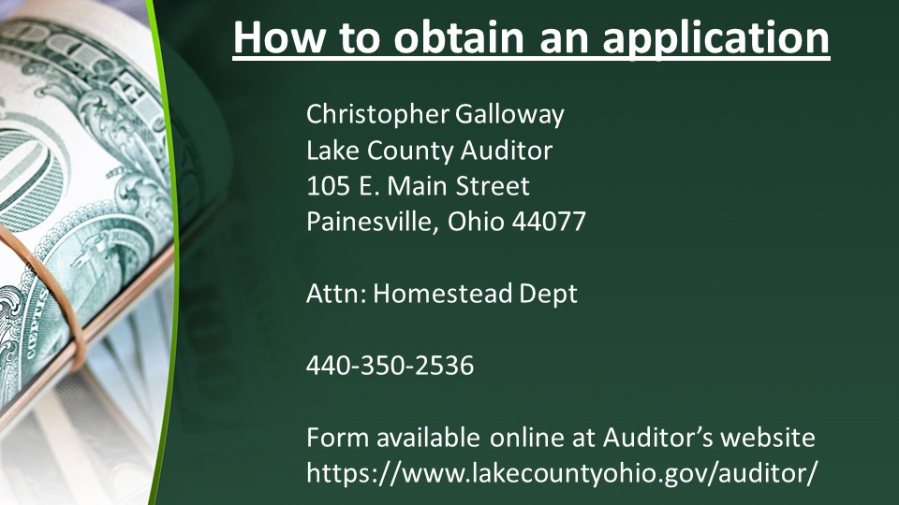

Slide 25


Slide 26
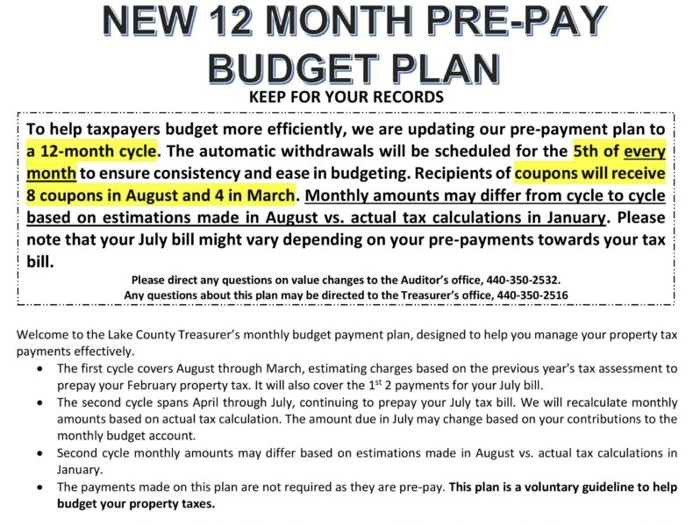
CHRISTOPHER GALLOWAY,
Lake County Auditor

Slide 27
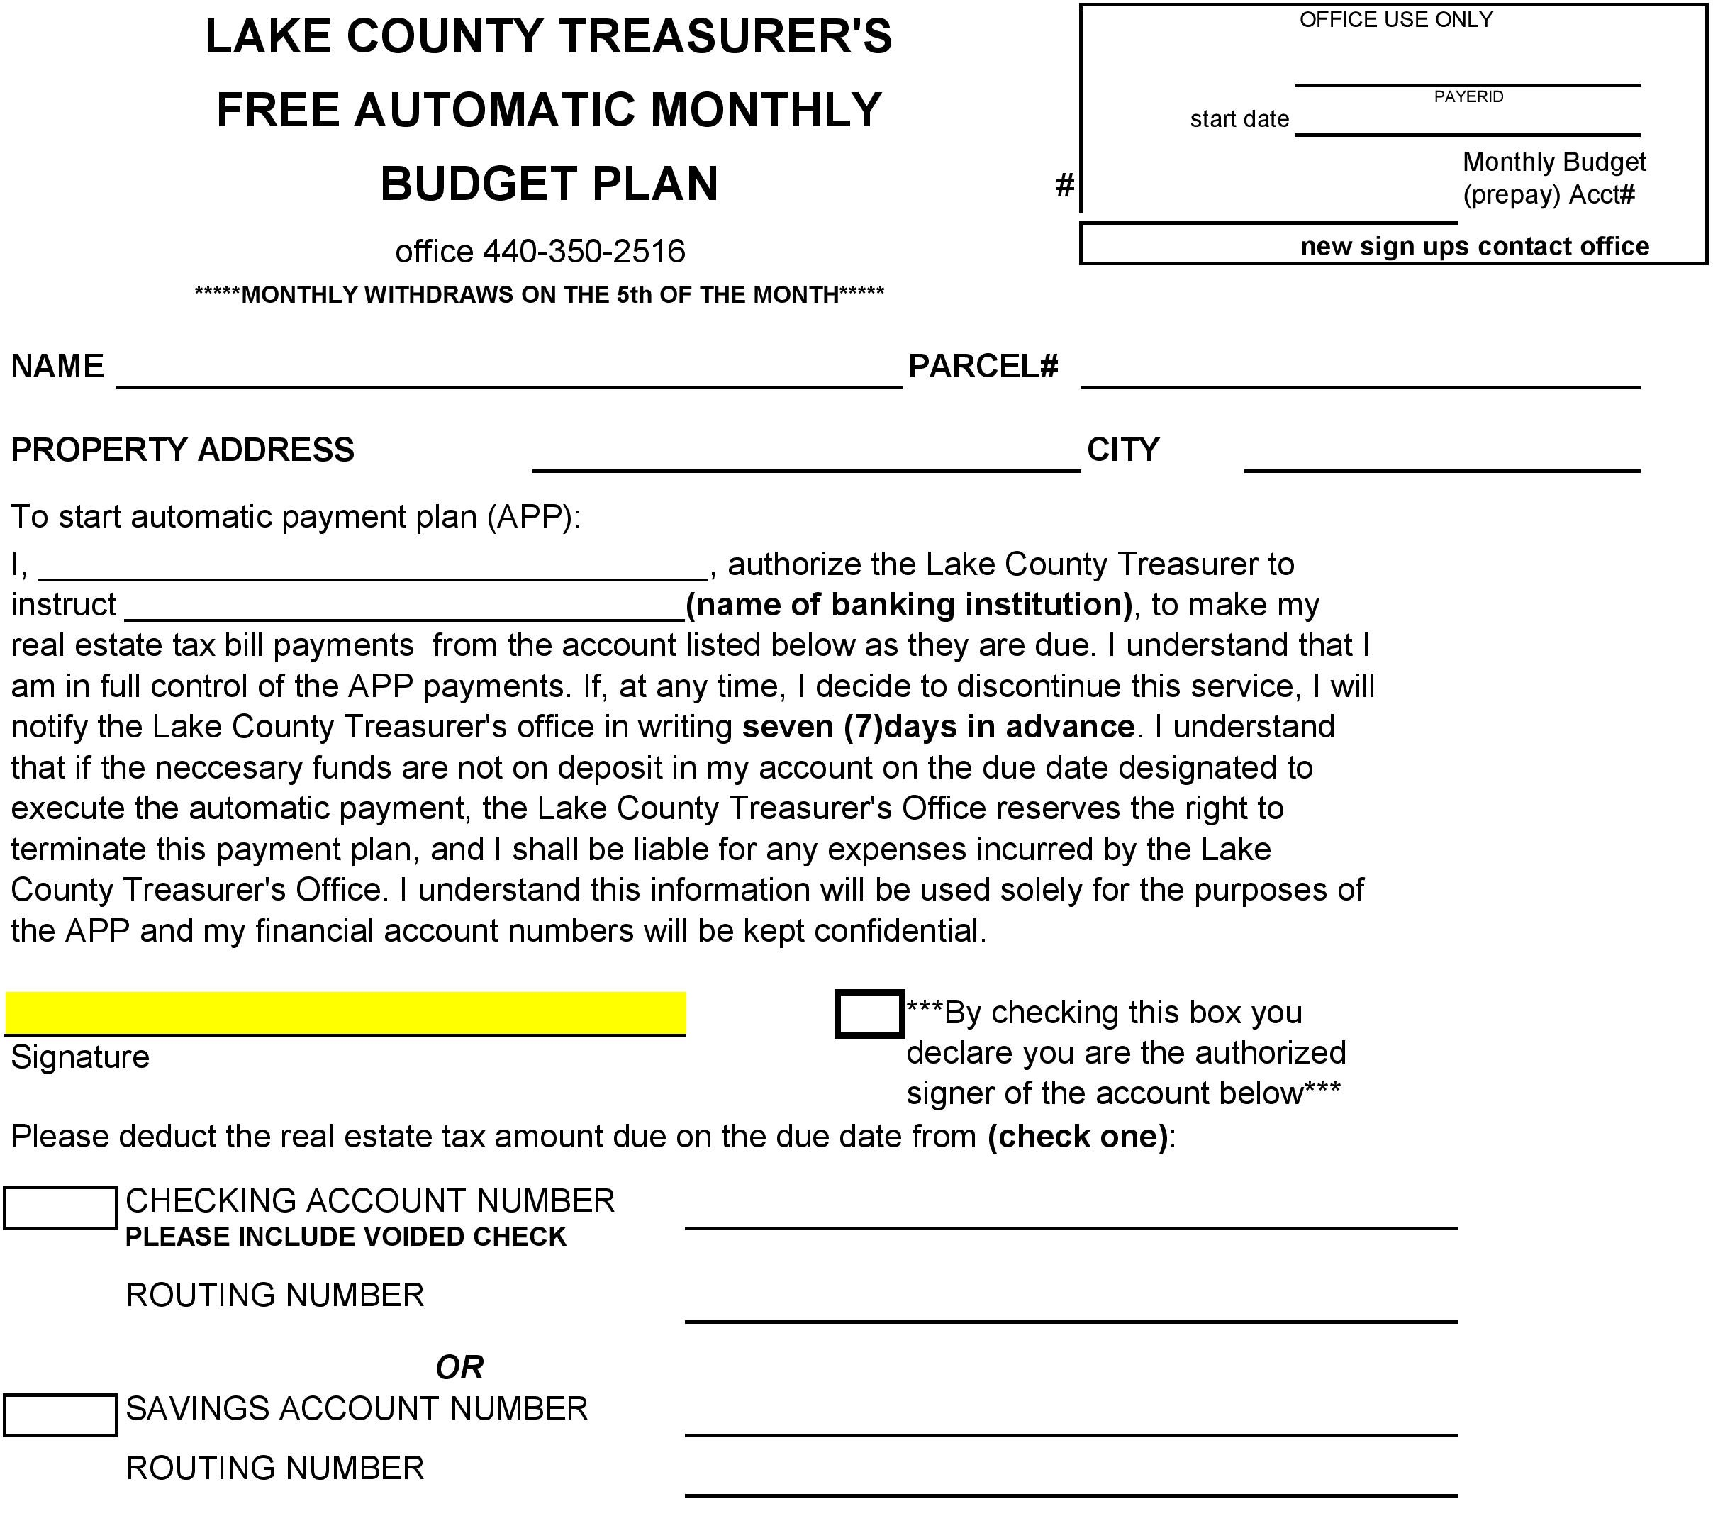

Slide 28
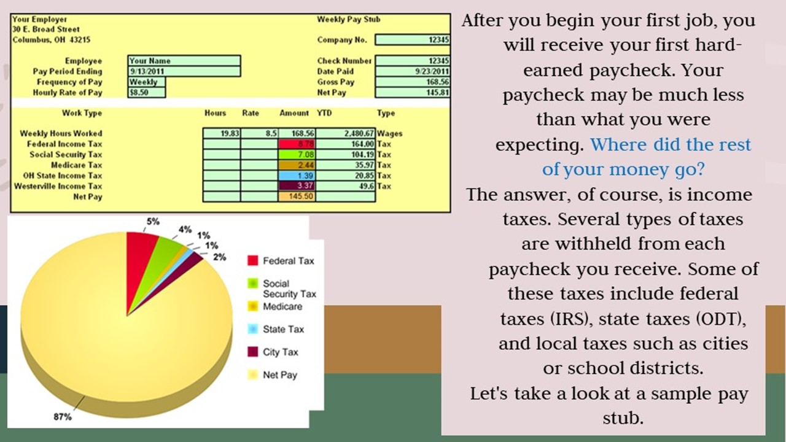

Slide 29


Slide 30
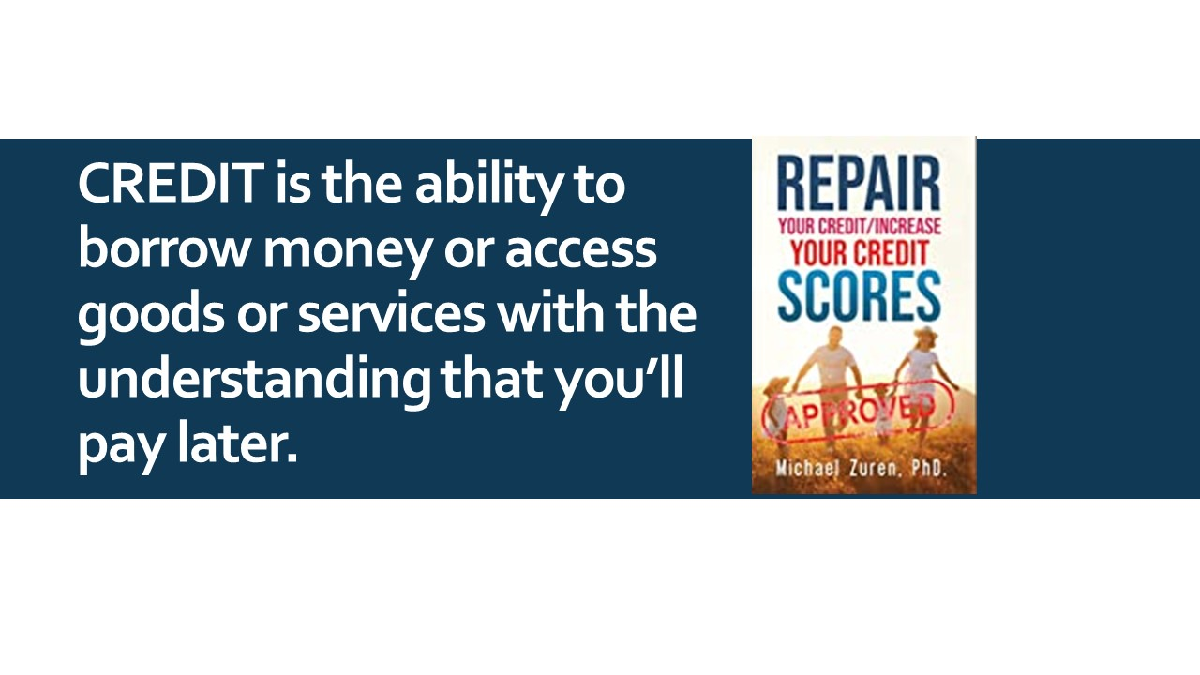

Slide 31
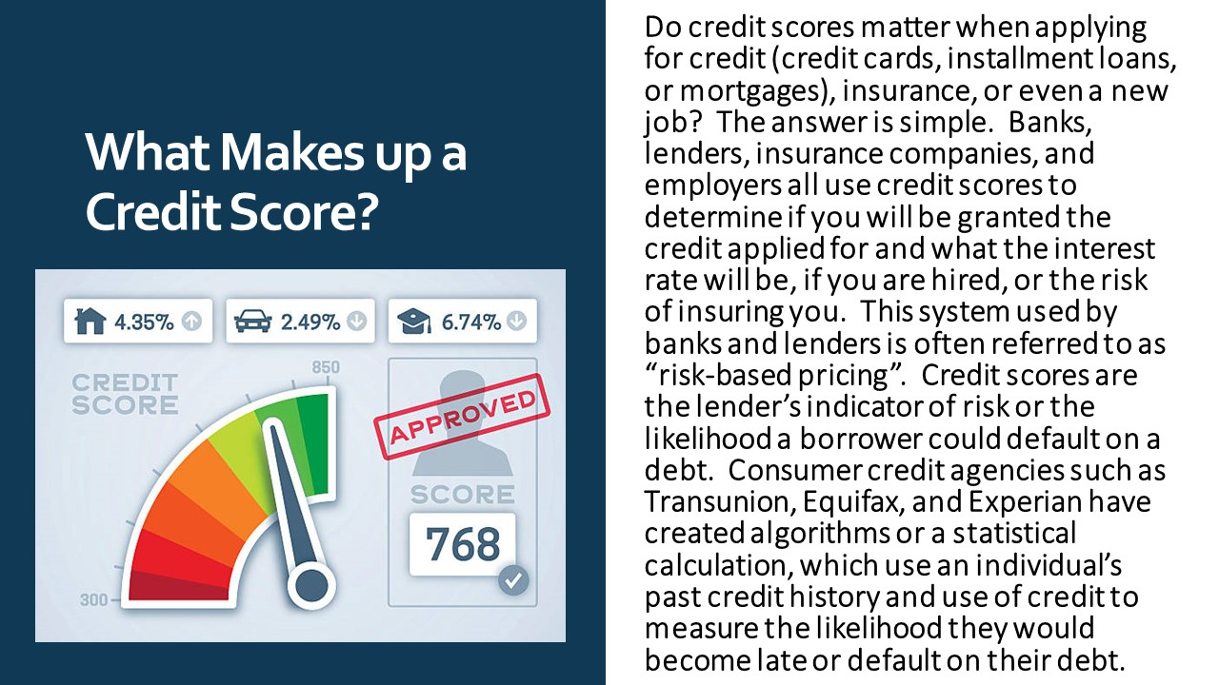

Slide 32
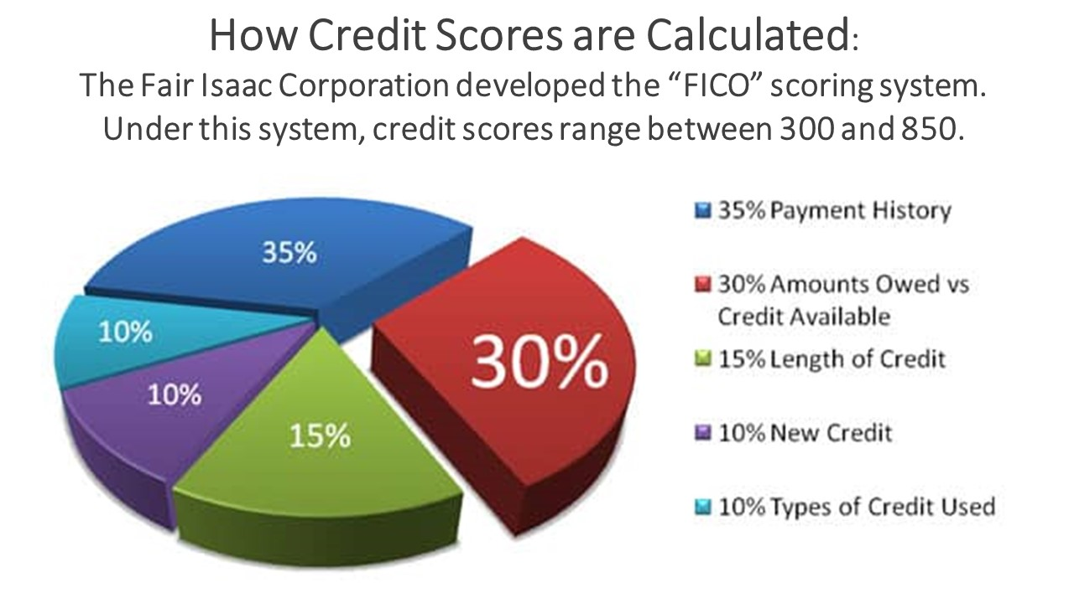

Slide 33
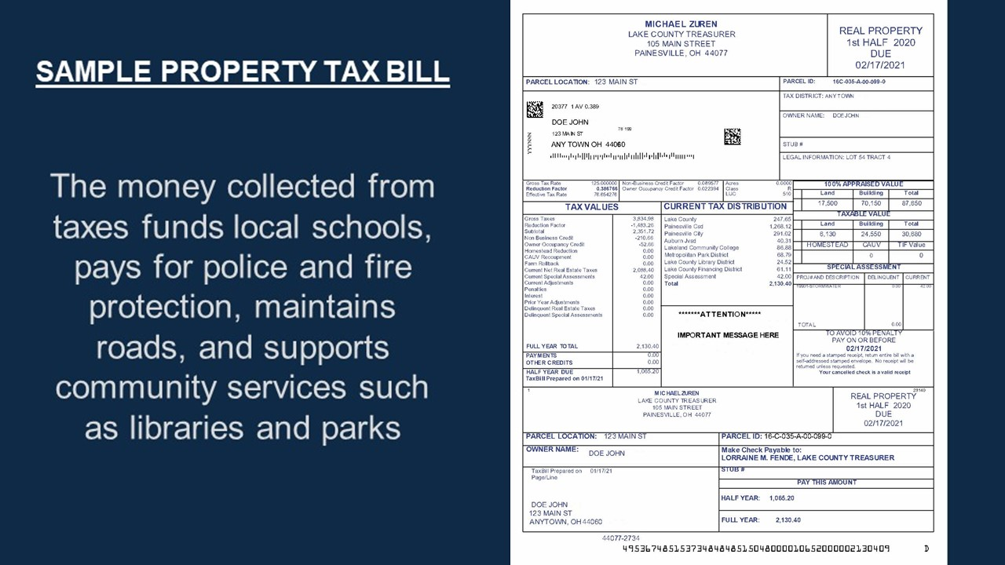

Slide 34
Identity Theft Explained
Identity theft occurs when a criminal steals your personal information and uses it without your permission, looking to steal your money, data and other personal assets.

Slide 35
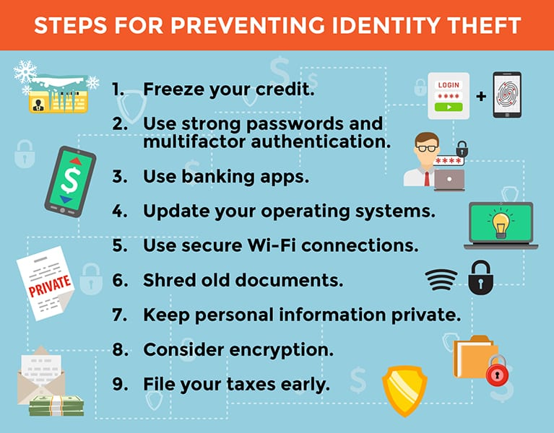

Slide 36
If you’re a victim:
Contact Federal Trade Commission
IdentityTheft.gov

Slide 37


Slide 38


Slide 39


Slide 40


Slide 41
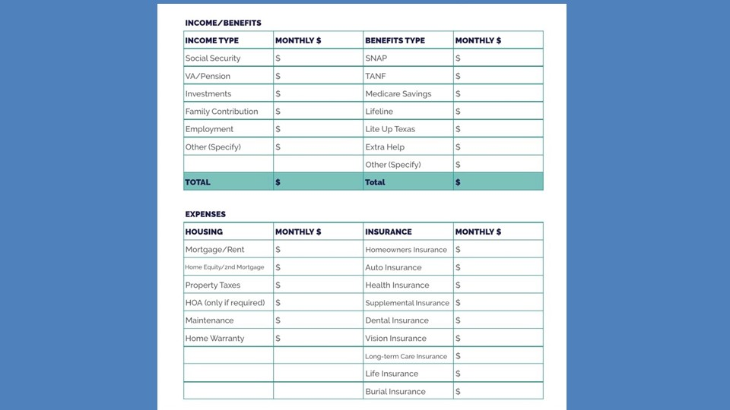

Slide 42
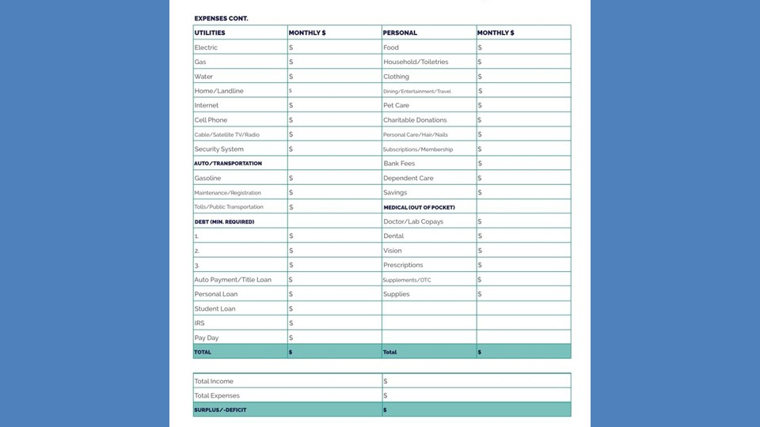

Slide 43

Thank you
Michael Zuren, PhD
440-251-5381
mikezuren@att.net

