Slide 1

Ohio Property Tax
& the November 2026 Lake County Ballot
The Impact on Ohio’s Future for All Ages
Michael Zuren, PhD
Lake County Treasurer
Lake County Council on Aging

Slide 2
How Property Taxes Are Calculated in Ohio
1 Appraised Value
2 Assessed Value
3 Millage Rate
4 Final Tax
The county auditor's estimate of market value
35% of appraised value, reduced by credits
Voted levies, less reduction factors & credits
Assessed value × effective rate
EXAMPLE
$300,000
$105,000
~40 mills
$4,200
Appraised value
Assessed value
Effective rate
Annual tax

Slide 3
On the Lake County Ballot: November 2026
15
9
3
3
local issues
property tax levies (8 renewals, 1 additional)
school income taxes
other: 2 Sunday-sales options, 1 village ordinance
Next: every issue, with what it asks and what it costs per $100,000 of county auditor’s market value. Issue numbers match the ballot list.

Slide 4
School District Issues
# | District | Request | Purpose | Starts / Term
4 | Kirtland Local (7 pcts + Geauga) | 4.36-mill renewal $2,278,636/yr · $134 per $100k | Current operating expenses | 2027, first due 2028 · 5 yrs
5 | Mentor Exempted Village (45 pcts + Geauga) | 3.5-mill ADDITIONAL $9,613,354/yr · $123 per $100k | Current expenses | 2026, first due 2027 · 5 yrs
6 | Painesville City Local (9 pcts) | 1.25% income tax | Current expenses | Jan 1, 2027 · continuing
7 | Riverside Local (30 pcts + Geauga) | 1% income tax | Current expenses & permanent improvements | Jan 1, 2027 · continuing
8 | Willoughby-Eastlake City (49 pcts) | 0.75% income tax | Current expenses & permanent improvements | Jan 1, 2027 · continuing

Slide 5
City & Township Levies (all renewals)
All are 5-year levies.
# | Jurisdiction | Request | Purpose | Starts
9 | Eastlake City (12 pcts) | 1.8 mills · $575,463/yr · $16 per $100k | Current operating | 2027, due 2028
10 | Kirtland City (4 pcts) | 0.85 mill · $156,412/yr · $11 per $100k | Senior citizen & community recreation | 2026, due 2027
11 | Willoughby City (18 pcts) | 2 mills · $1,267,480/yr · $37 per $100k | Streets, roads & bridges | 2026, due 2027
12 | Willoughby City (18 pcts) | 0.9 mill · $157,186/yr · $3 per $100k | Current expenses | 2026, due 2027
13 | Willowick City (9 pcts) | 0.5 mill · $70,824/yr · $5 per $100k | Parks & recreation | 2026, due 2027
17 | Concord Township (15 pcts) | 2.7 mills · $1,795,434/yr · $49 per $100k | Fire | 2027, due 2028
18 | Madison Township (10 pcts) | 1.9 mills · $587,707/yr · $33 per $100k | Police | 2027, due 2028

Slide 6
Sunday Sales & a Village Ordinance
14 · Eastlake Ward 1, Precinct A
15 · Willowick Ward 3, Precinct C
Local option: Sunday sale of wine & mixed beverages by Vine Gas LLC (D-6 permit), 33610–33650 Vine St.
Local option: Sunday sale of wine & mixed beverages by Lakeshore Gas LLC (D-6 permit), 29000 Lakeshore Blvd.
16 · Perry Village (by petition)
Would amend Chapter 133.01 to set the Village Fiscal Officer’s duties before the village signs agreements with a hyperscale data center involving tax abatements, PILOT programs, or special tax designation.

Slide 7
Two Tax Breaks Doubled (2026 only)
Owner-Occupancy Credit
Homestead Exemption
The 2.5% reduction doubles to 5% on qualifying levies for anyone who owns and lives in their home as their primary residence.
Paid with local county funds; the state does not reimburse the extra amount.
Available to qualifying seniors (65+), permanently disabled people, and surviving spouses.
The exemption is doubled for 2026.

Slide 8
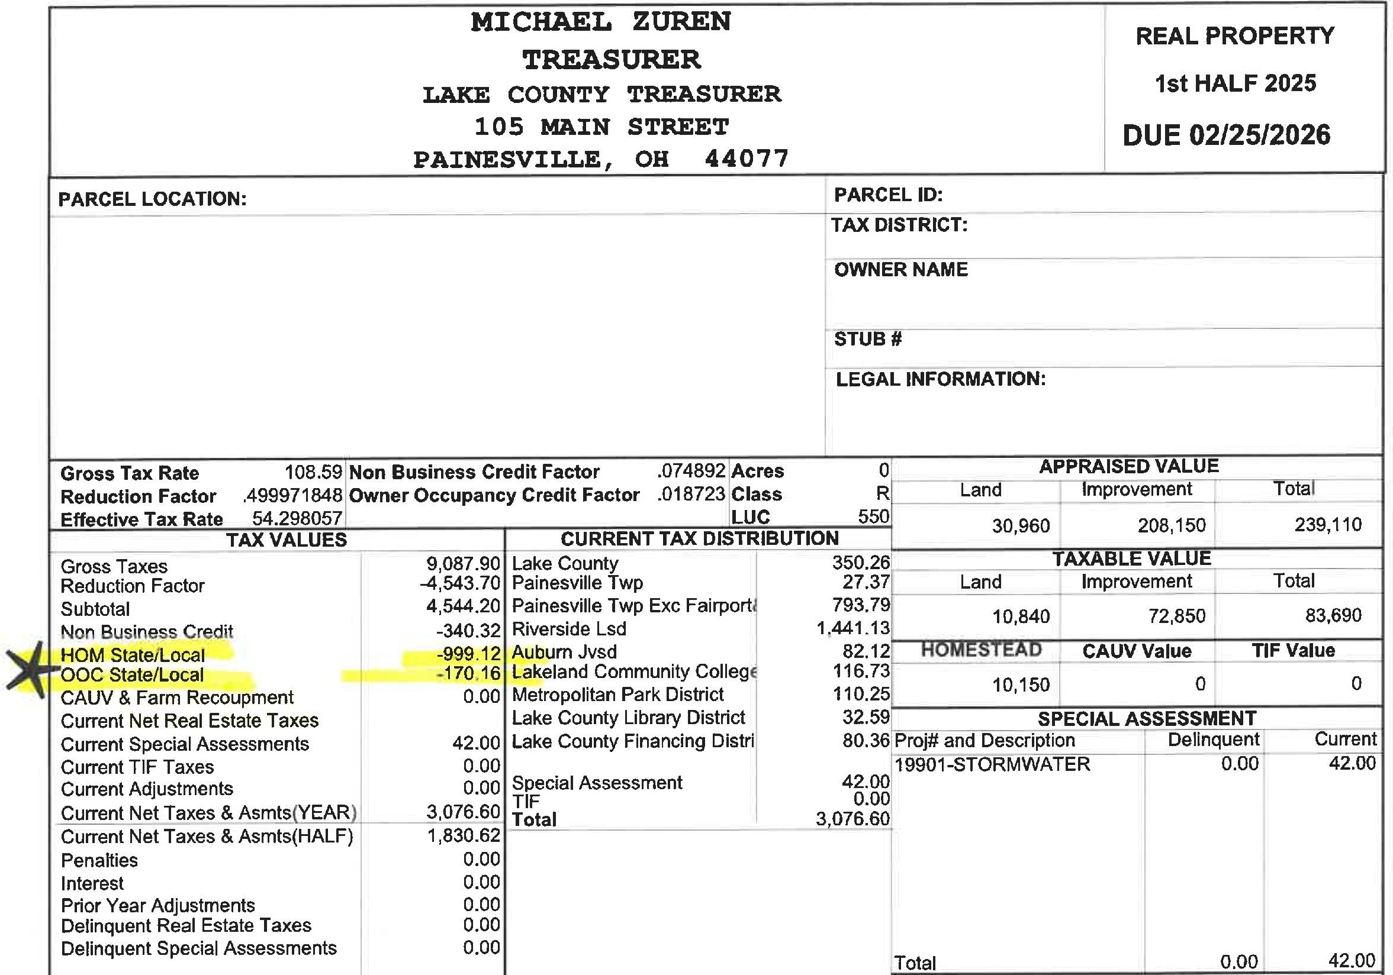

Slide 9
5 New Ohio Property Tax Laws
HB 124
HB 129
HB 186
More county auditor oversight of property valuations; changes sales-assessment ratio studies.
Fixed-sum levies now count toward a school district’s 20-mill floor, which can help lower rates.
“Inflation Cap Credit” for school taxes; phases out the 10% non-business credit; grows the owner-occupied credit.
HB 309
HB 335
County budget commissions can review and reduce rates if collections are “unnecessary” or “excessive,” even on voted levies.
Caps revenue growth from inside millage (no vote) at the rate of inflation after reappraisals.

Slide 10
In Plain English
HB 129 · Curbing unvoted increases
HB 186 · Inflation cap
Before, some levies didn’t count toward the 20-mill floor, so districts could collect more as values rose without a new levy. Now more of them count.
Your school taxes can’t rise more than inflation without a vote of the people. If they would, you get a credit to bring it back down.
HB 309 · Budget commission
HB 124 & HB 335
The commission (usually auditor, treasurer, and prosecutor) can cut the rate on voted levies if the money is more than needed.
Auditors get more say over which home sales set values, and inside-millage growth is held to inflation.

Slide 11
Help from the Lake County Treasurer
12-Month Payment Plan
Homestead & VA Tax Credits
A new way to spread out your tax bill
Find out if you qualify
by contacting the Auditor’s office
Financial Literacy
Identity Theft
Programs to build money know-how
Resources to protect yourself

Slide 12
Identity Theft Explained
What it is
If you’re a victim
Contact the Federal Trade Commission
IdentityTheft.gov
Identity theft occurs when a criminal steals your personal information and uses it without your permission, looking to steal your money, data and other personal assets.

Slide 13
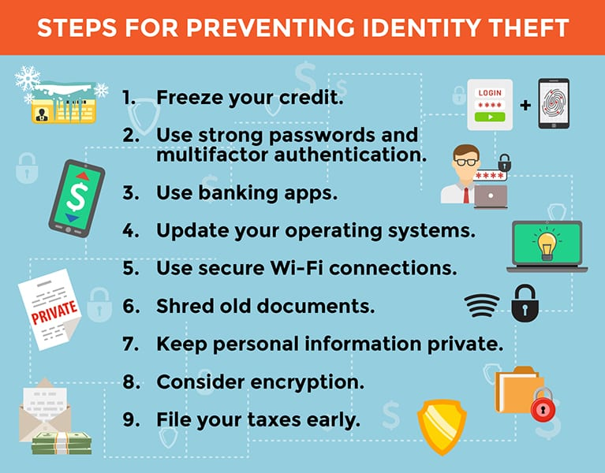

Slide 14
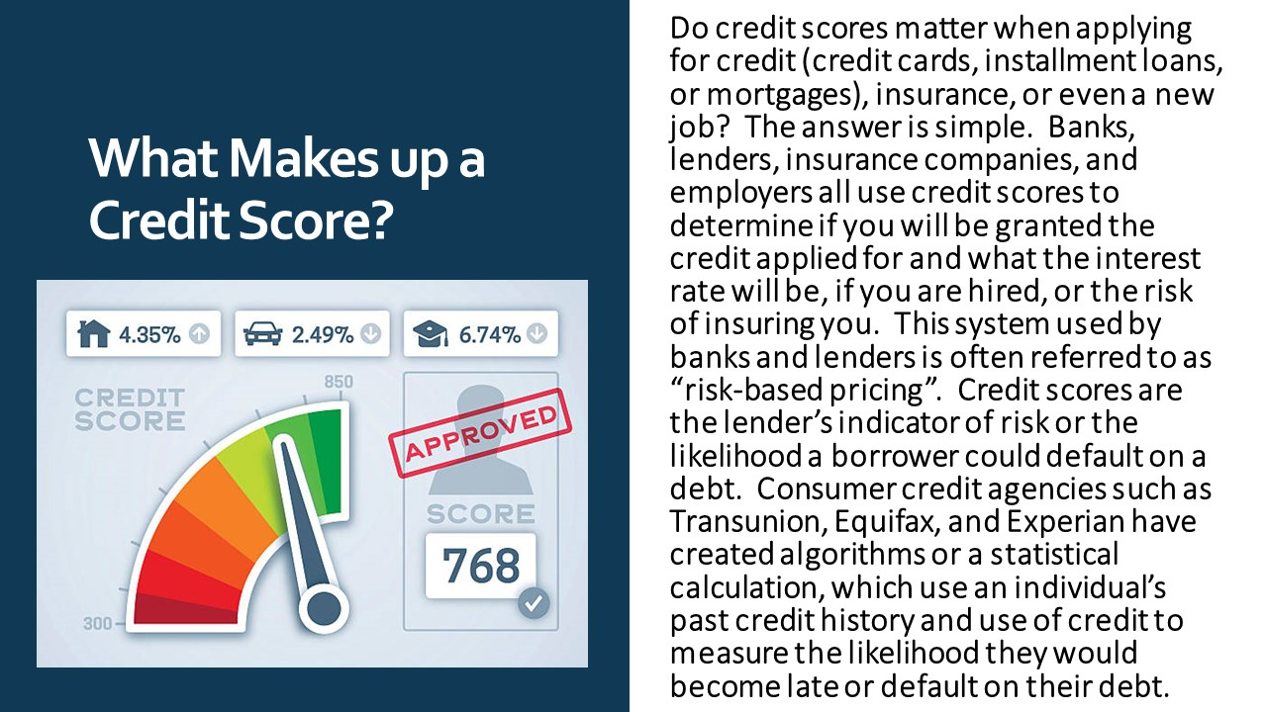

Slide 15
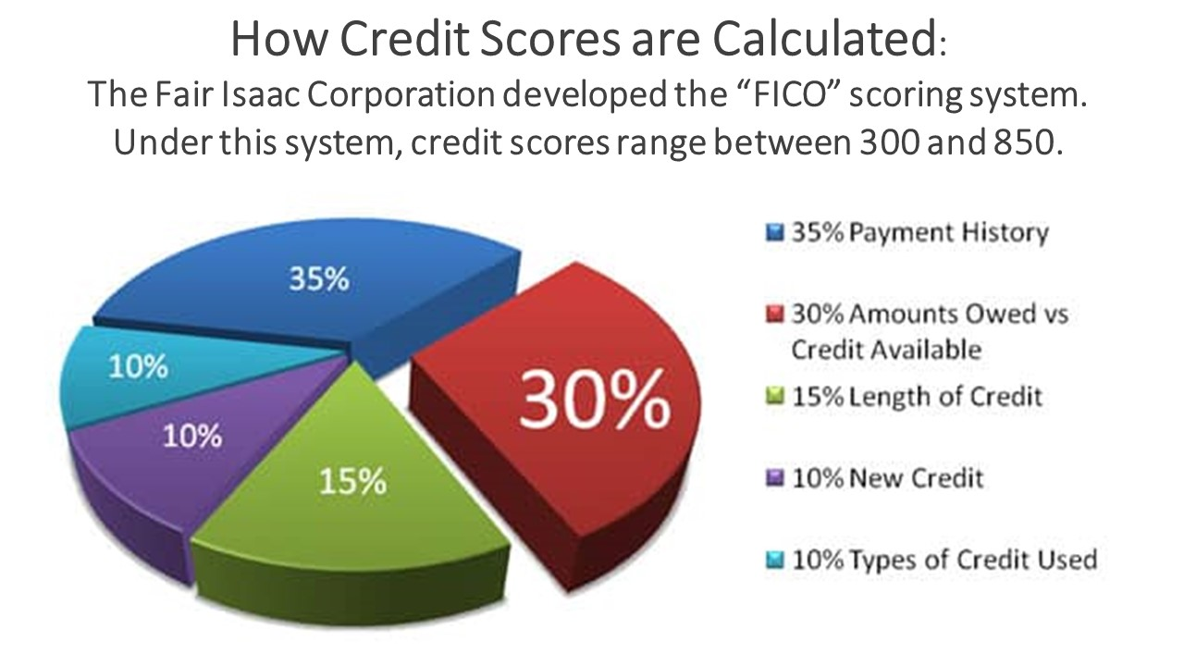

Slide 16
Seven Practical Ways to Save
01
Lower Property Taxes
05
Lower Healthcare Costs
Homestead Exemption + local piggyback
Medicare counseling, equipment loans
02
Cut Utility Bills
06
Home Help & Repairs
HEAP, PIPP+ & water/sewer discounts
Helping Hands, homemaker services
03
Reduce Food Costs
07
Statewide Discounts
Meals on Wheels, SNAP, Farmers’ Market
Golden Buckeye Card
04
Free / Low-Cost Rides
Laketran Seniors on the Go
2

Slide 17
1. Homestead Exemption
Lower the taxable value of your home and save hundreds each year.
WHO QUALIFIES
THE BENEFIT
Age 65+ (or turn 65 by year-end)
or permanently & totally disabled
Own and occupy the home as your
primary residence
Income limit (applicant + spouse):
• $40,000 for 2025 applications
• $41,000 for 2026 applications
Some pre-2014 recipients are
grandfathered without income test
Exempts ~$26,200–$29,000 of appraised value (higher for certain disabled veterans).
Lake County “piggyback”
Doubles the average state benefit — often from ~$500 to ~$1,000 annually for many households.
Apply: Lake County Auditor (SmartFile or form). Local doubling is automatic once approved.
3

Slide 18
2. Cut Utility Bills
HEAP & PIPP+
Water & Sewer 30% Off
Weatherization
Help with heating and electric bills. Income limit ~175% of federal poverty level.
Apply: energyhelp.ohio.gov, 1-800-282-0880, or Lake County DJFS / Lifeline Inc.
Available to owner-occupants age 65+ who also receive the Homestead Exemption.
Contact: 440-350-2070 or lakecountyohio.gov/utilities.
Some cities (e.g. Willowick) offer extra sewer discounts.
Long-term programs that reduce energy use through insulation, sealing, and efficiency upgrades — lowering bills permanently.
4

Slide 19
3. Reduce Food Costs
Meals on Wheels & Lunch Places
1
Home-delivered and congregate meals at senior centers through Lake County Council on Aging (LCCOA) for age 60+. Nutritious meals Mon–Fri (weekend options available) plus a safety check.
SNAP & Benefits Screening
2
Food assistance benefits. Screening available through LCCOA and Lake County Department of Job & Family Services.
Senior Farmers’ Market Nutrition
3
$50 in vouchers for local produce for income-eligible seniors (roughly under 185% of poverty level). Distributed via LCCOA; reapply each year.
Grocery Shopper Program
4
LCCOA also offers a grocery shopper program to help seniors who need assistance getting to the store.
5

Slide 20
4. Free or Low-Cost Transportation
Laketran Seniors on the Go
Free Dial-a-Ride (door-to-door) service plus expanded rides on local fixed routes (1–9) for eligible seniors.
Reserve in advance (1–12 days ahead)
Call 440-354-6100 or visit laketran.com
Complete a reduced-fare application with proof of eligibility
Saves money on gas, maintenance, and rideshares
Helps reduce isolation and stay independent
6

Slide 21
5. Lower Healthcare & Medical Costs
Free OSHIIP Medicare Counseling
Health Equipment Lending
Unbiased plan advice and help with Medicare Savings Programs or Extra Help (prescription drug cost reductions) via LCCOA or Western Reserve Area Agency on Aging.
Free loan of donated items such as walkers, wheelchairs, and tub seats through LCCOA.
Hospital Financial Assistance
In-Home / Homemaker Services
Programs available at University Hospitals Lake Health and Cleveland Clinic Mentor locations.
Non-medical in-home care or homemaker services on a sliding fee scale through LCCOA for those who don’t qualify for Medicaid waivers.
7

Slide 22
6. Help with Home Maintenance & Daily Tasks
Avoid costly paid services by using free or sliding-scale local programs.
Helping Hands for Seniors
Homemaker Services
Home Repair / Rehab
Lifeline Inc.
LCCOA
Local Programs
Free volunteer assistance with minor repairs, outdoor tasks, errands, and more for independent seniors age 60+.
Light housekeeping and other in-home support on a sliding fee scale.
Repair and rehab programs plus a Senior Housing Navigator for rental assistance, deposits, or downsizing options.
8

Slide 23
7. Golden Buckeye Card
Free for Ohio residents age 60+ (or certain disabled adults 18–59)
Discounts at thousands of participating businesses statewide — restaurants, some groceries, services, state parks camping, and more.
How to get it
Many people receive it automatically with their Ohio ID/license at age 60. Otherwise apply at libraries or senior centers.
Always ask about senior discounts even if a business isn’t listed on the official directory.
9

Slide 24
Best Starting Points
Contact these organizations for personalized screening — they often help with multiple programs at once.
Lake County Council on Aging
Lifeline Inc. / 211
Primary local hub for age 60+
440-205-8111 • lccoa.org (Mentor)
Dial 211 for referrals, Helping Hands,
energy help, and more
Lake County DJFS
Western Reserve Area Agency on Aging
SNAP, Medicaid, and related benefits
440-350-4000
Medicare counseling & regional support
216-621-0303
10

Slide 25
Important Reminders
Eligibility varies
Usually based on age, income, residency, and sometimes disability or homeownership.
Programs change
Income limits and benefits can change. Always verify current details directly with the agencies.
Stack the savings
Many seniors successfully combine several programs (taxes + utilities + meals + transportation) for meaningful monthly savings while staying in their homes.
Ask for help
LCCOA and partners can screen you for multiple programs in one visit — you don’t have to navigate everything alone.
11

Slide 26


Slide 27
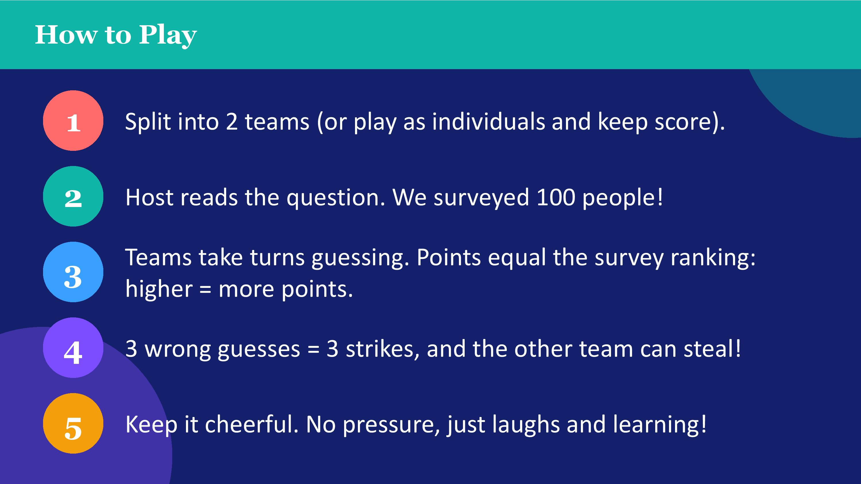

Slide 28
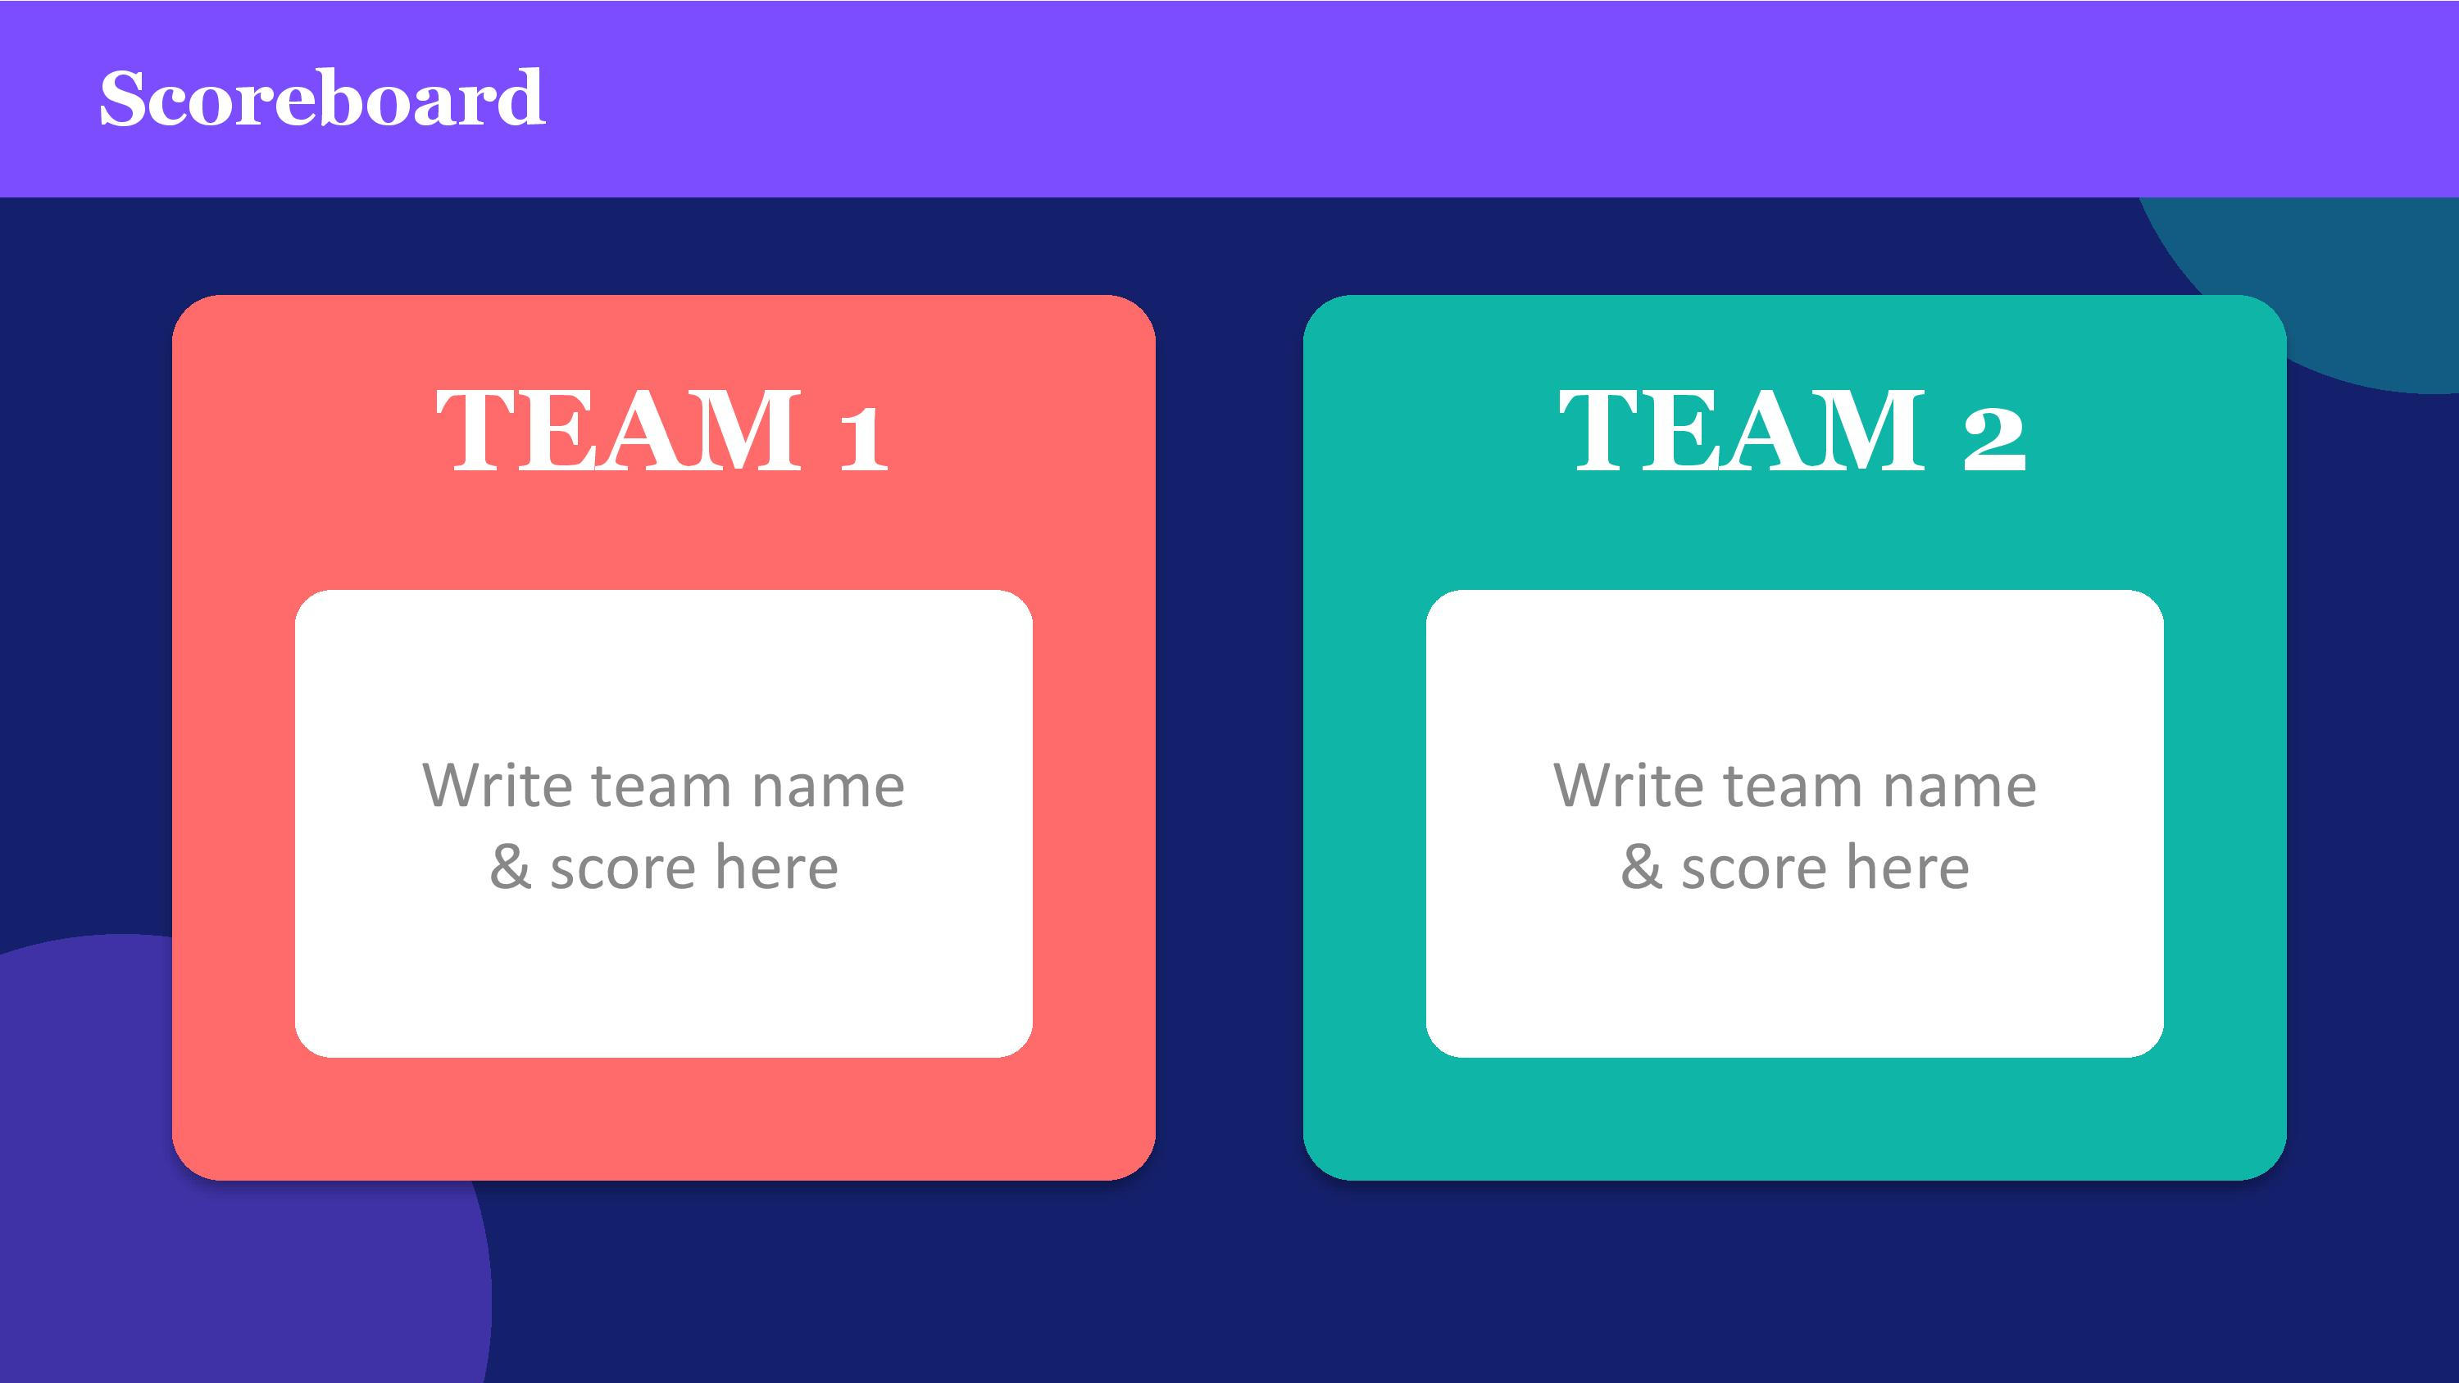

Slide 29
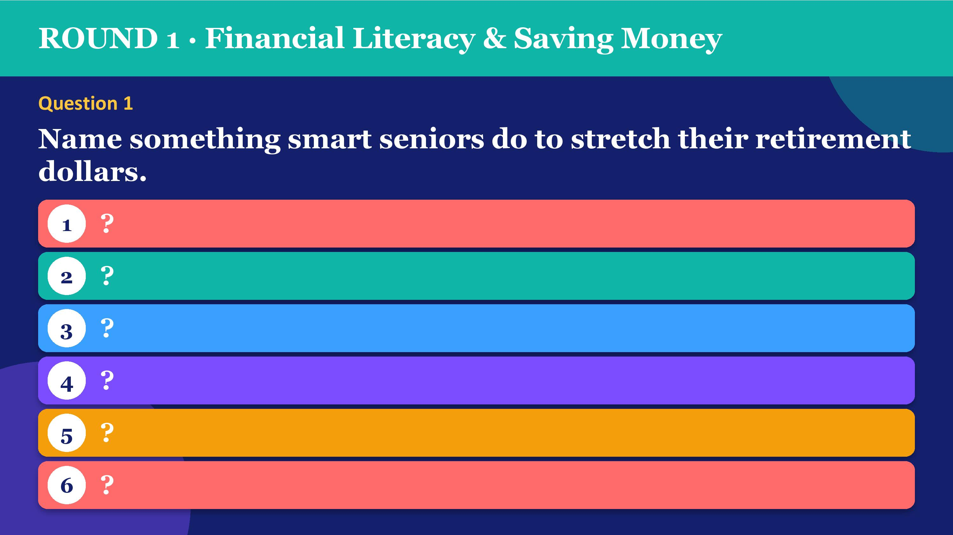

Slide 30
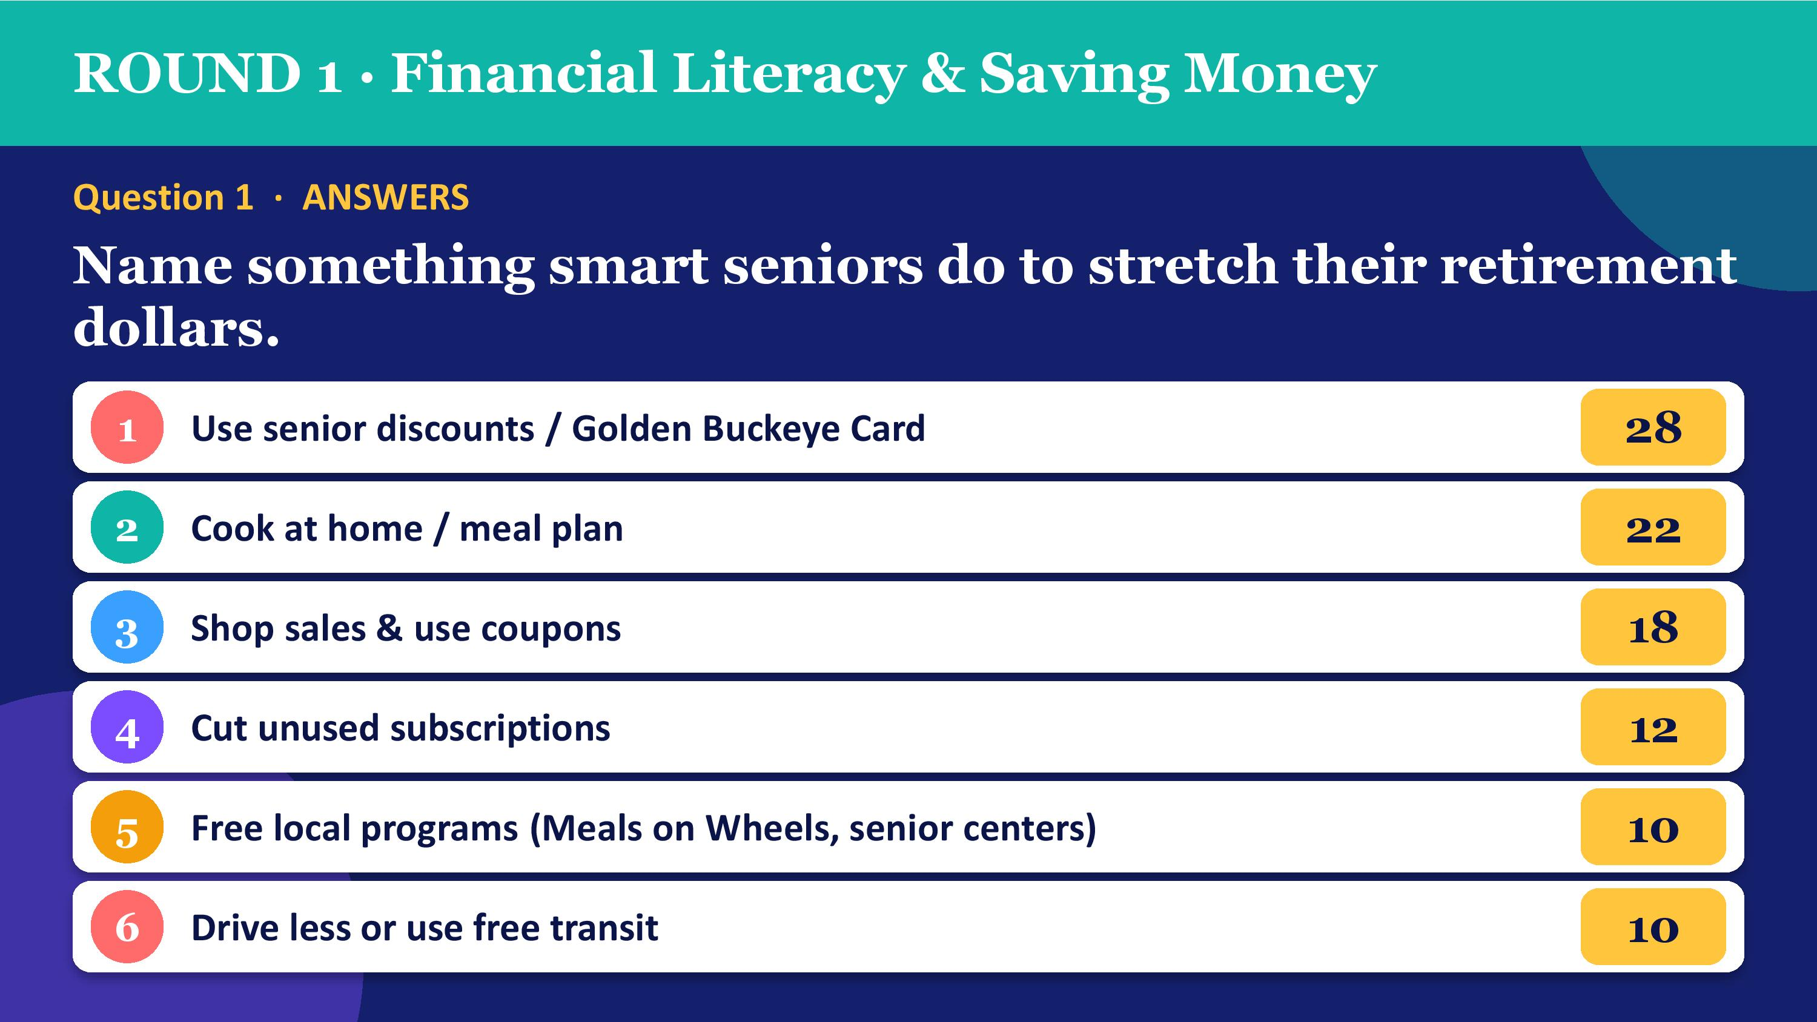

Slide 31
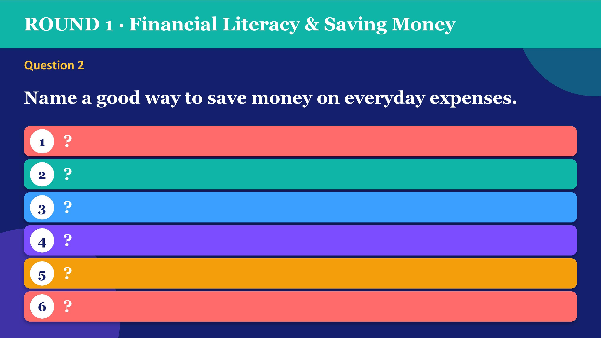

Slide 32
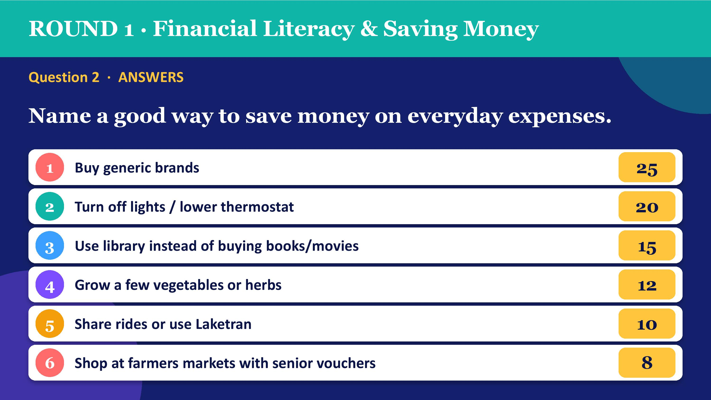

Slide 33
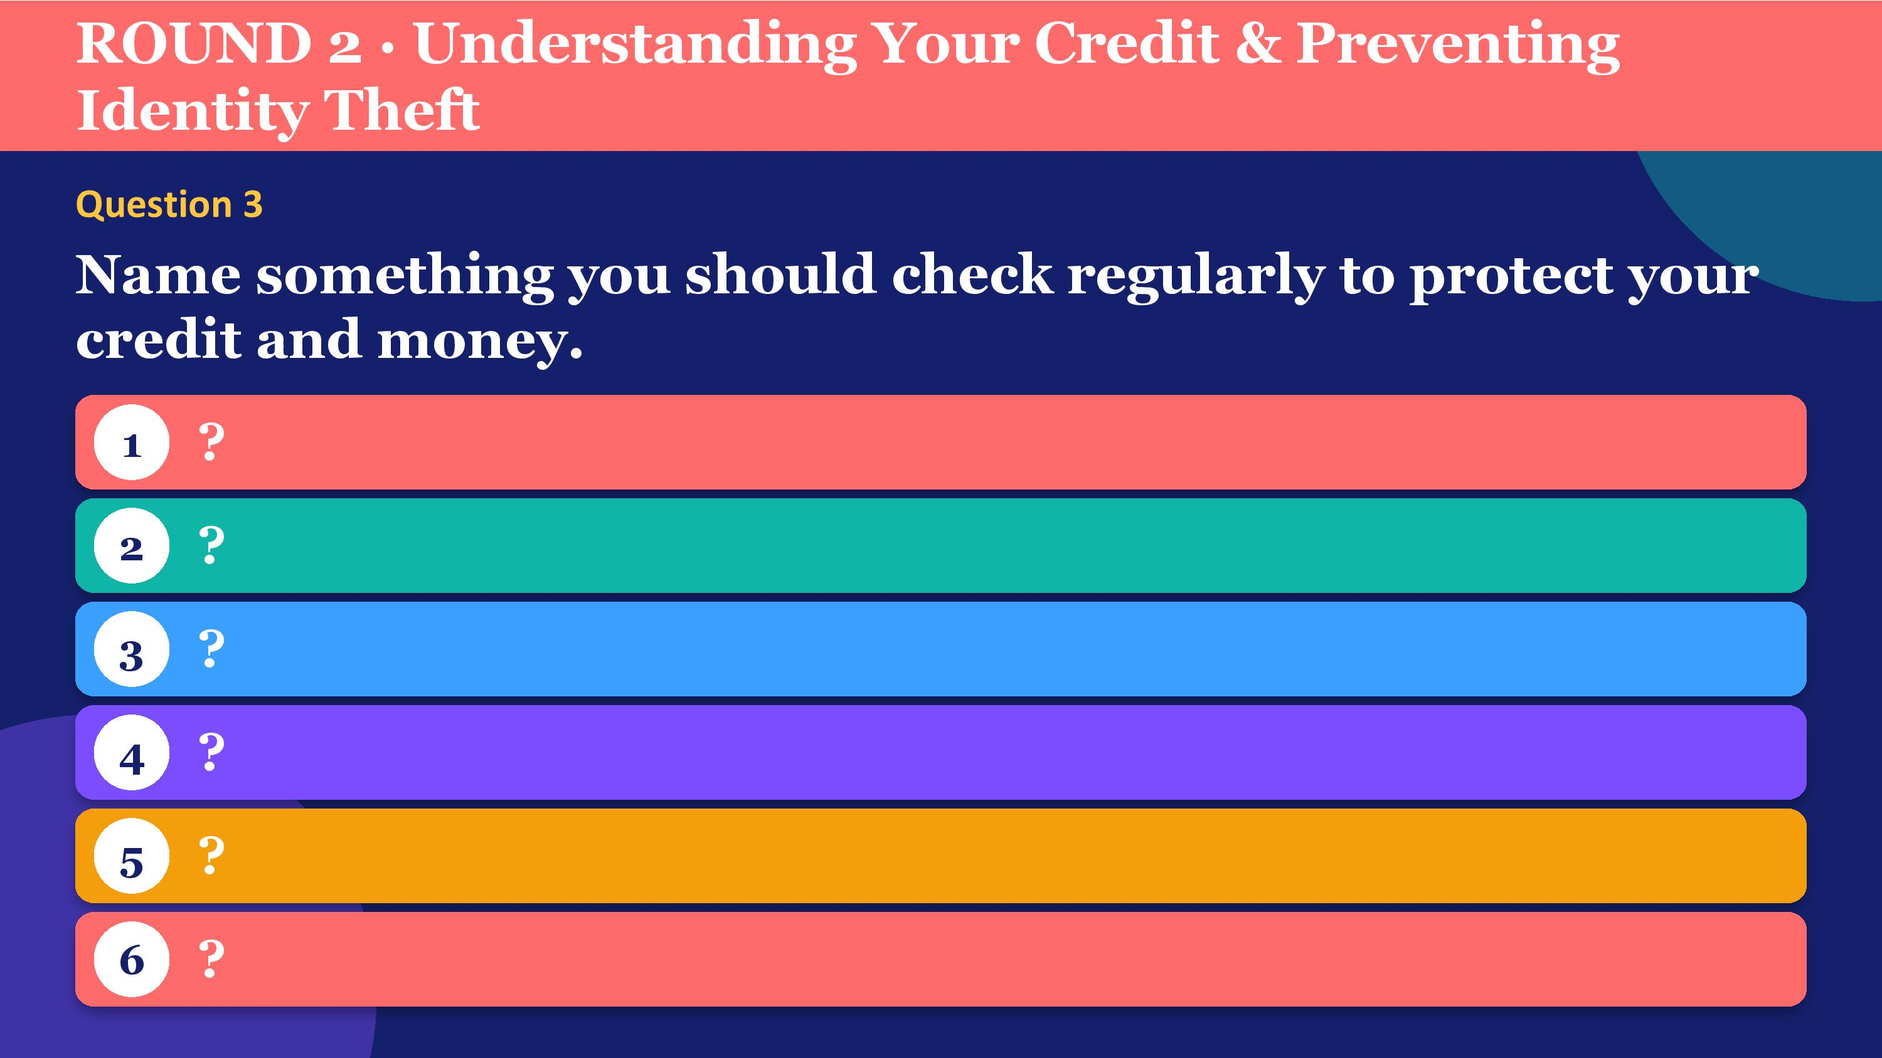

Slide 34
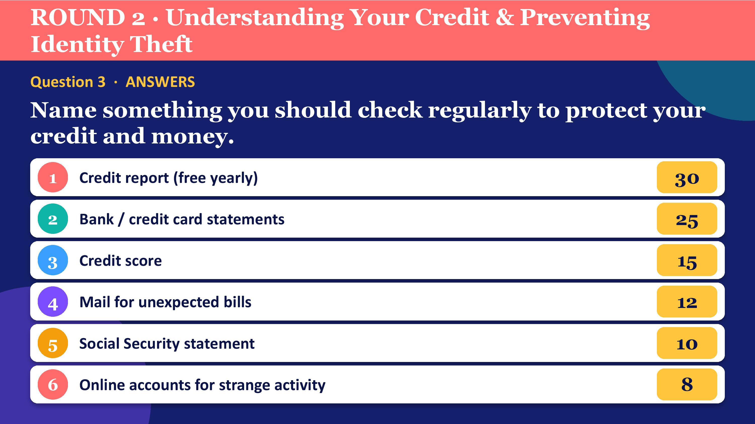

Slide 35
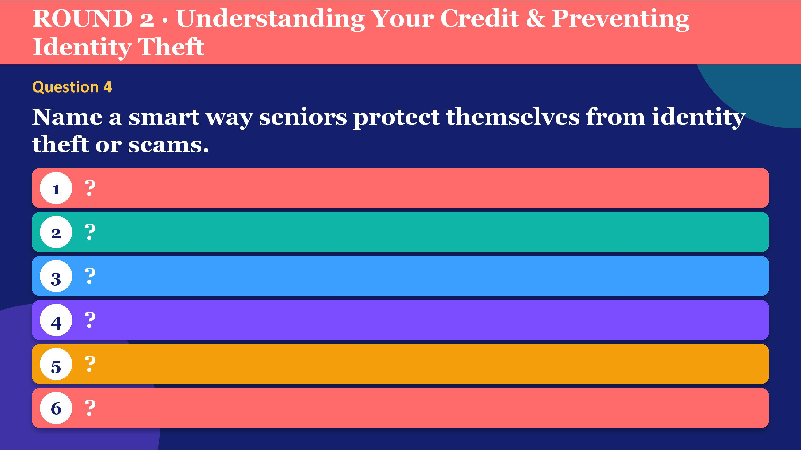

Slide 36
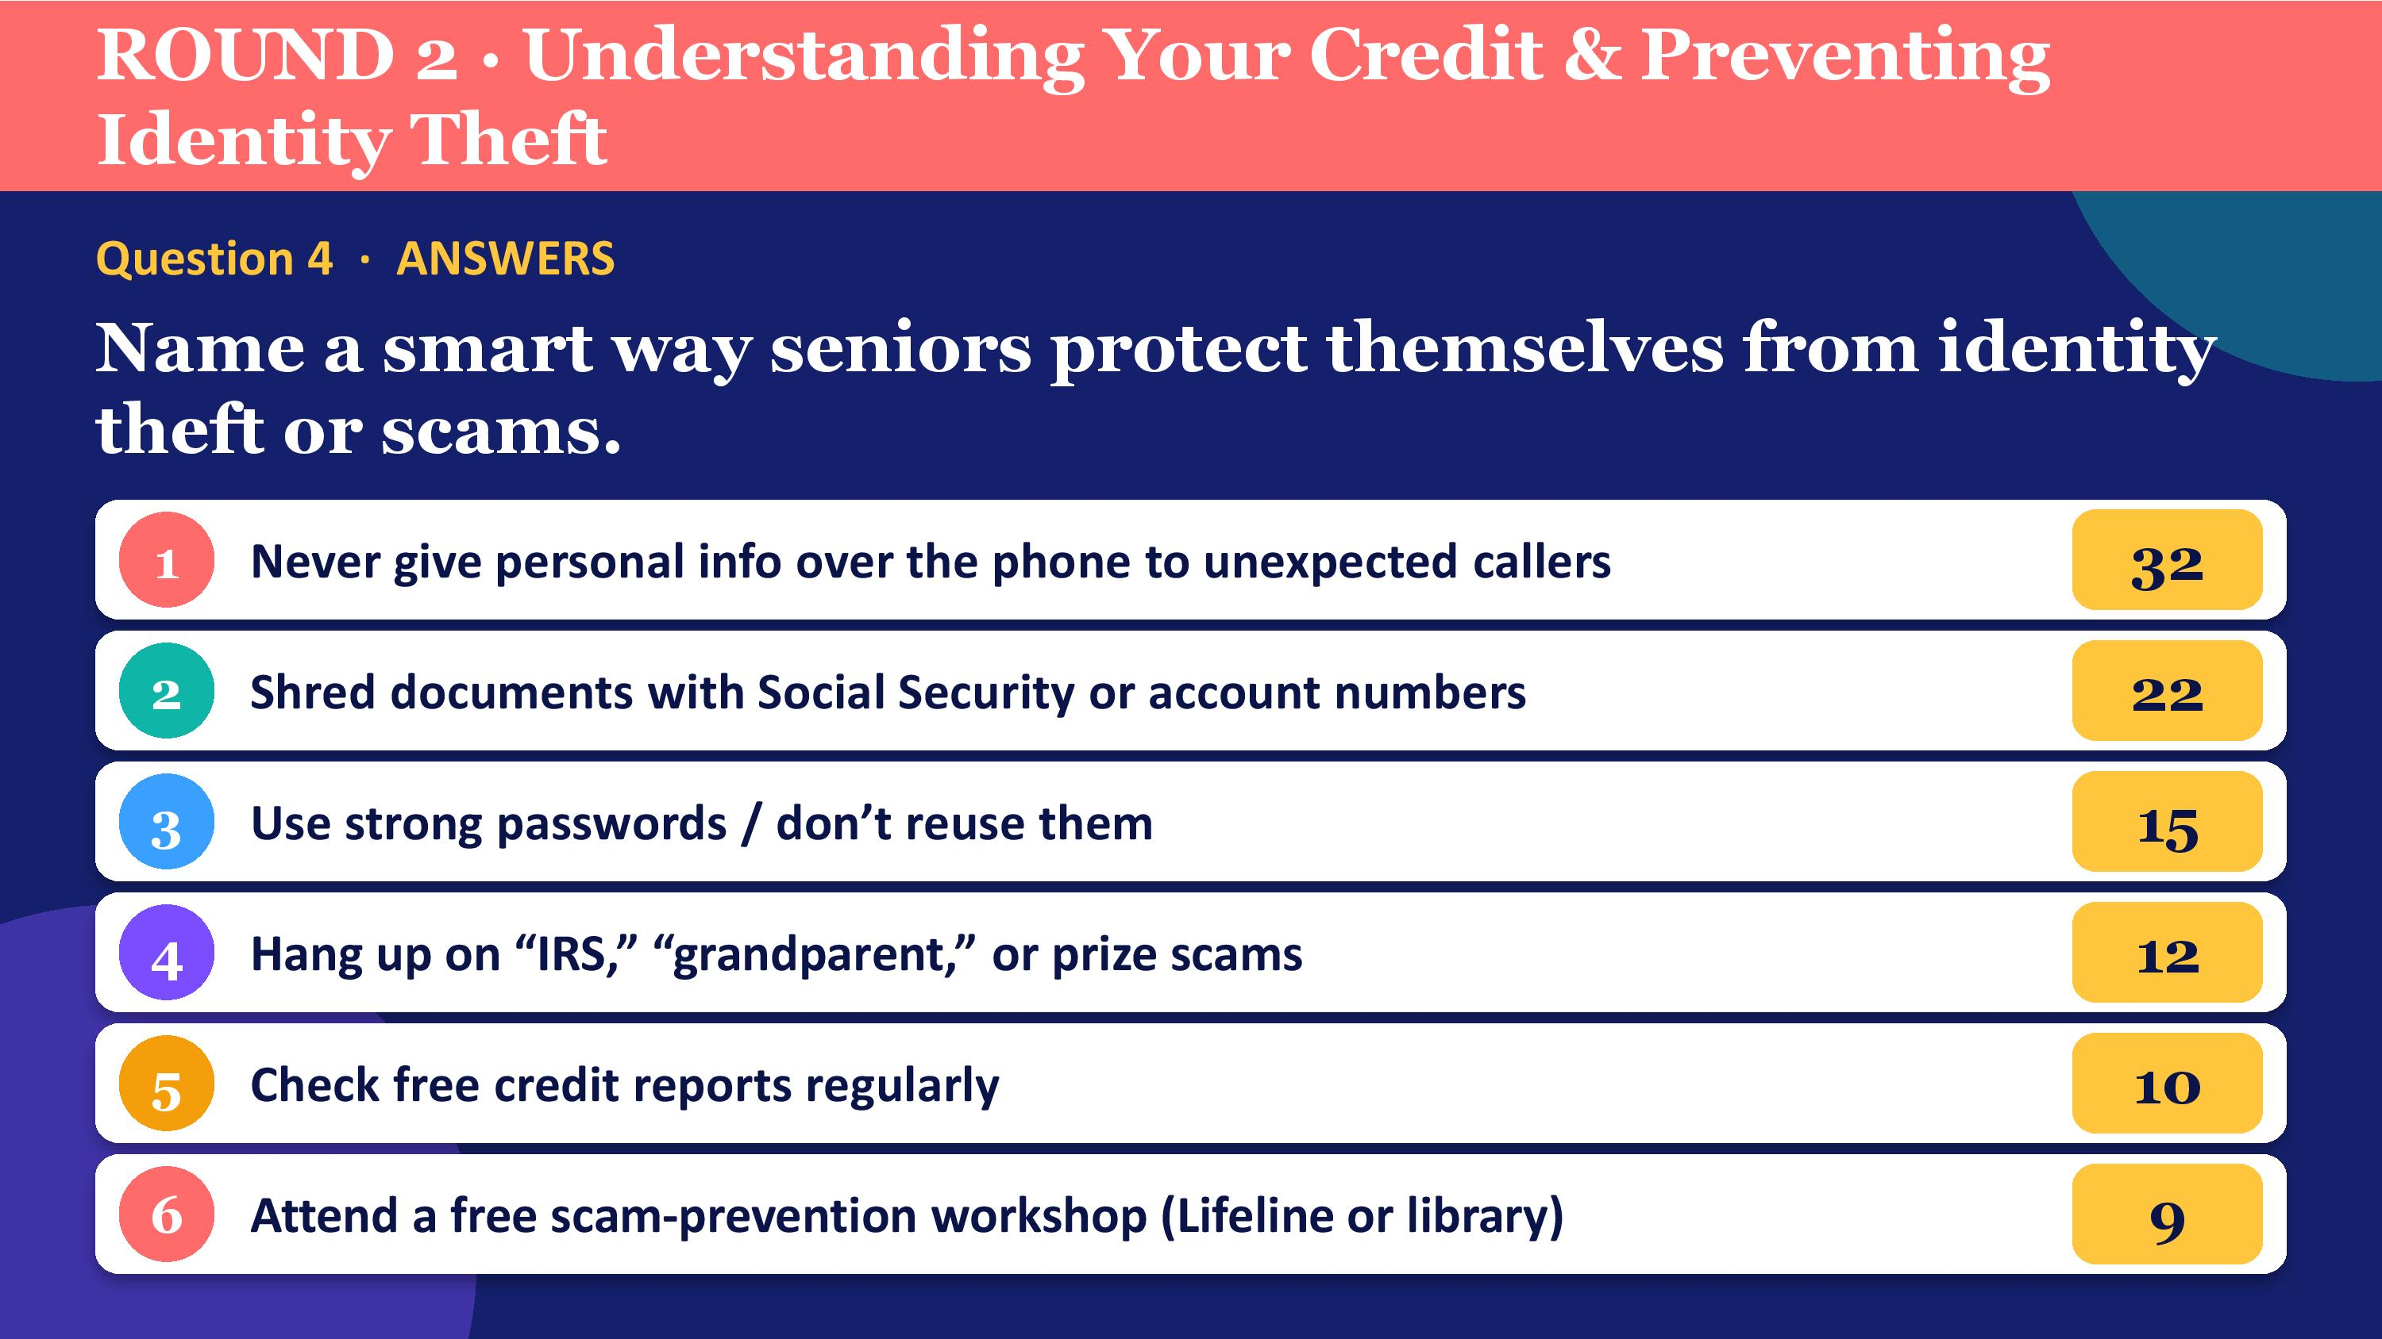

Slide 37


Slide 38
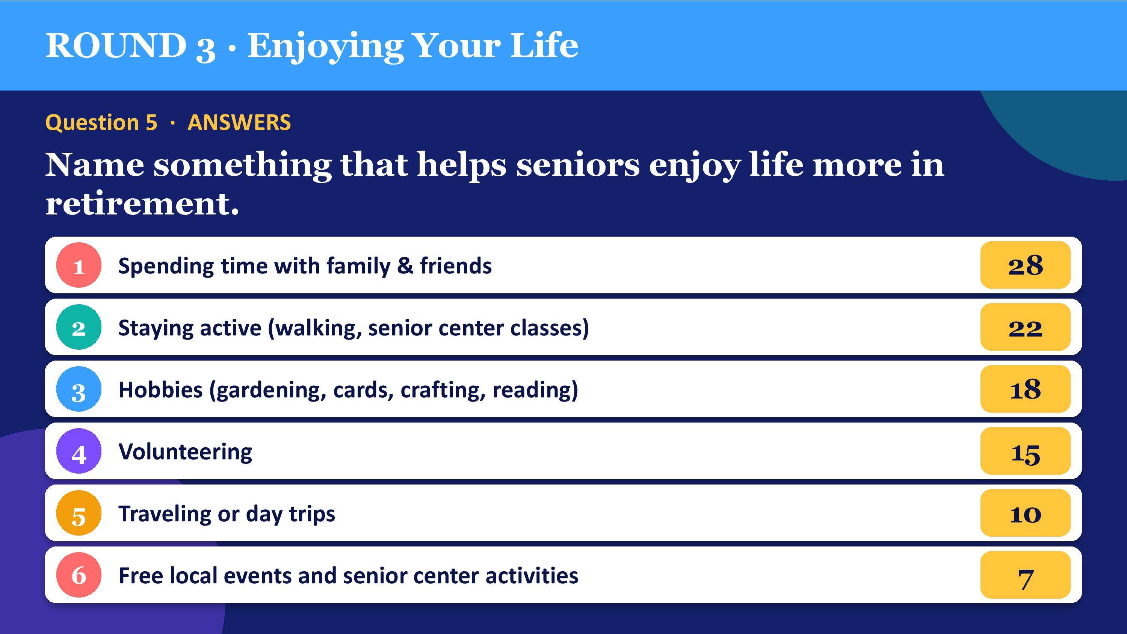

Slide 39
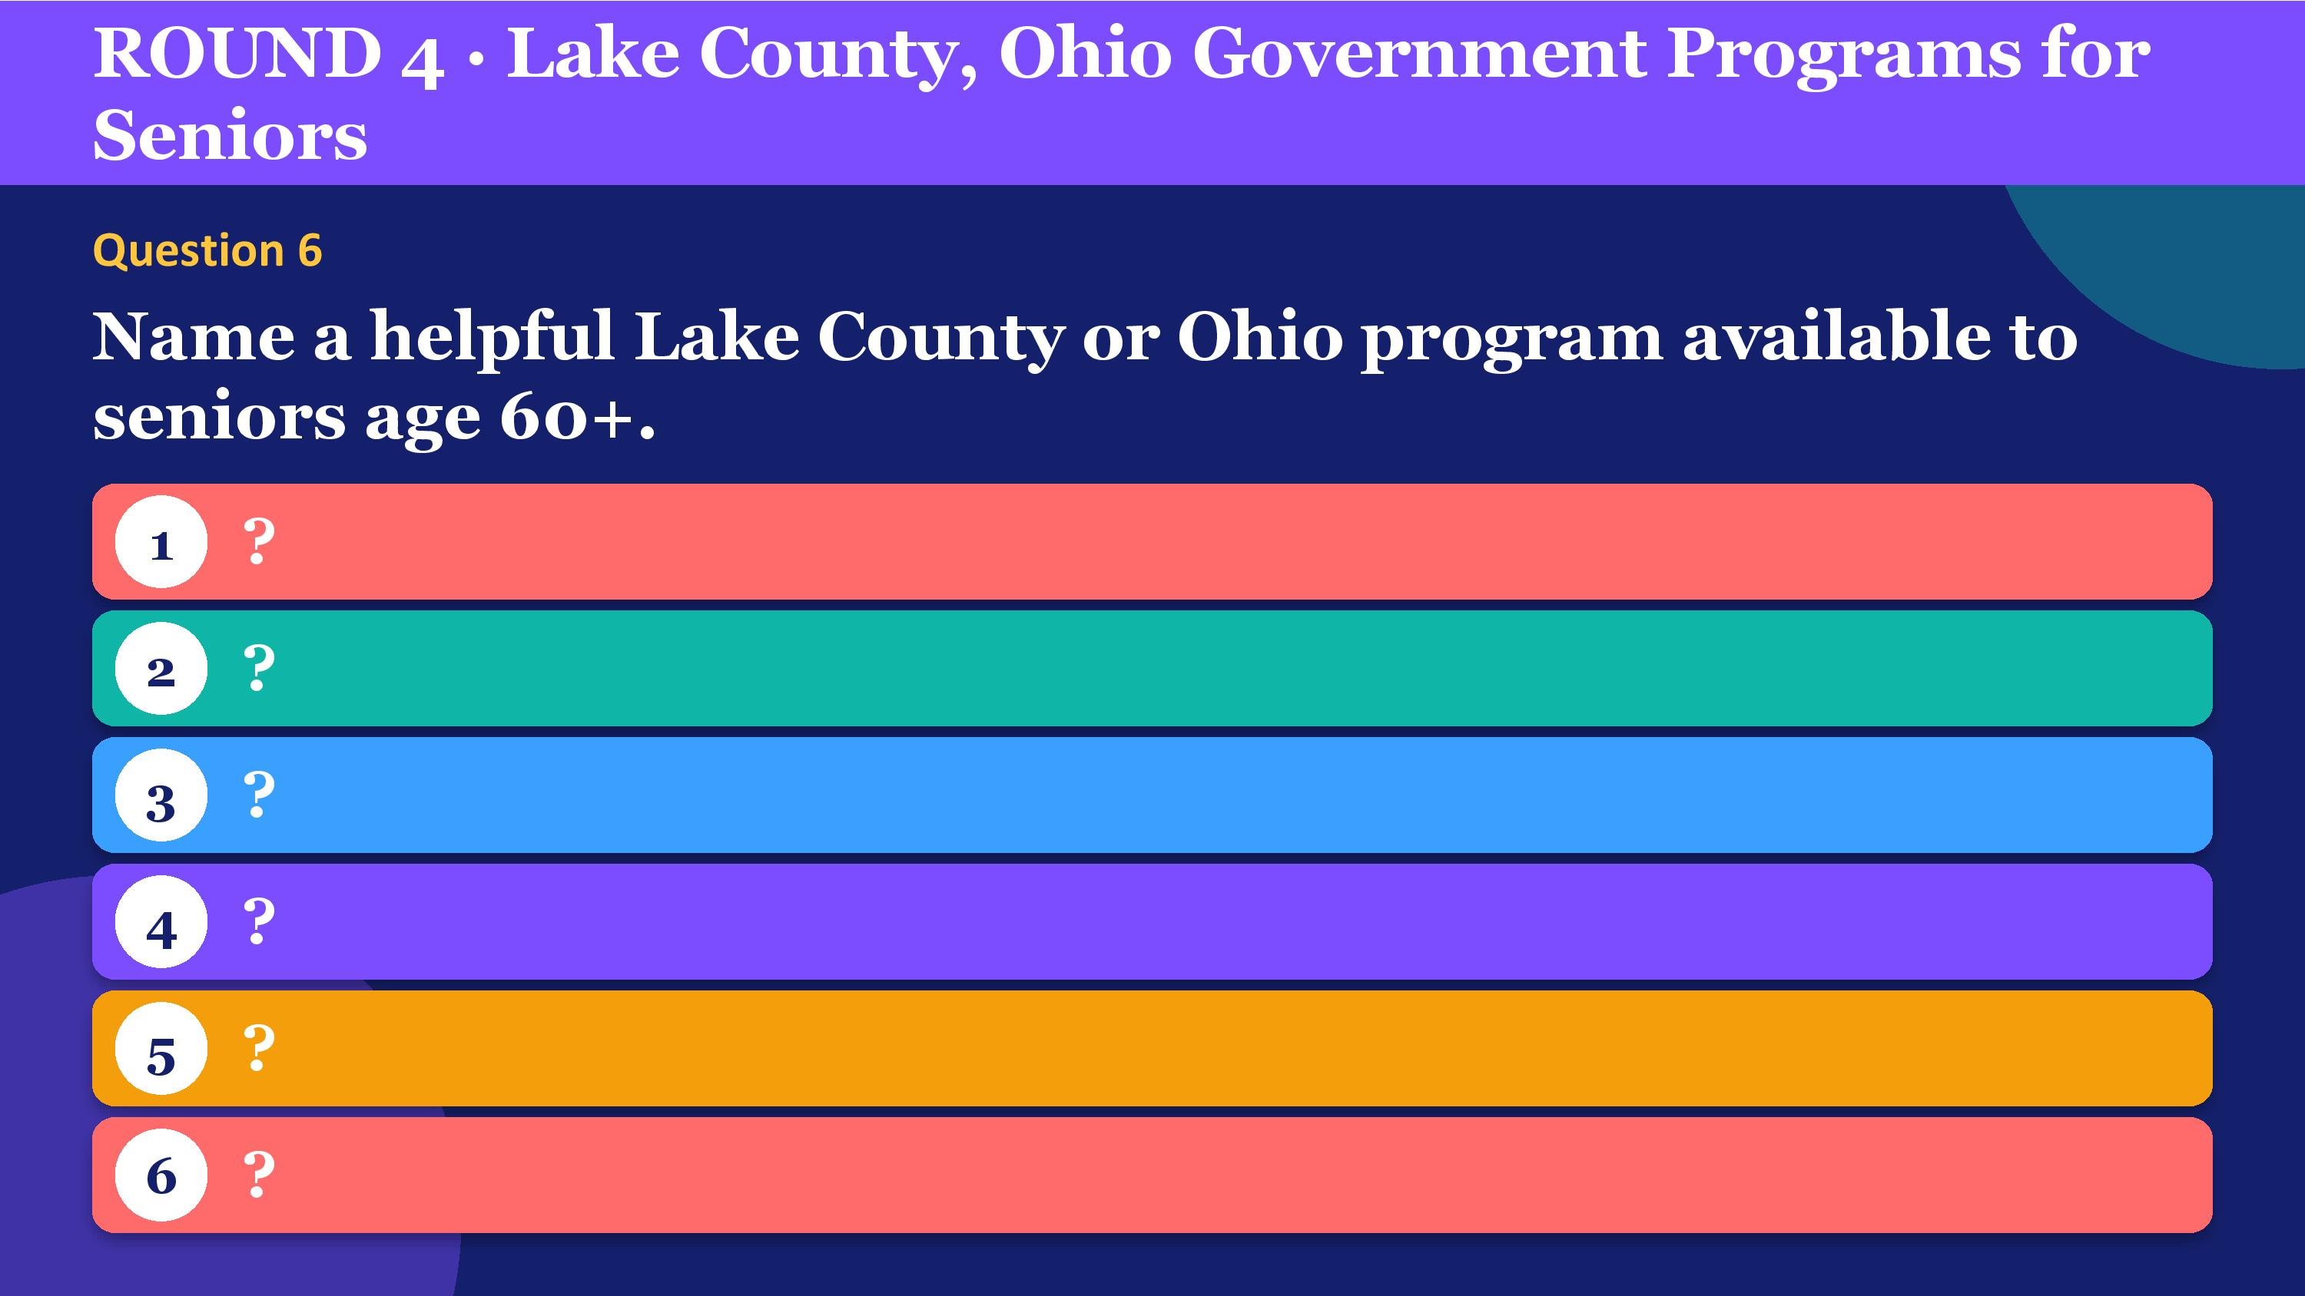

Slide 40
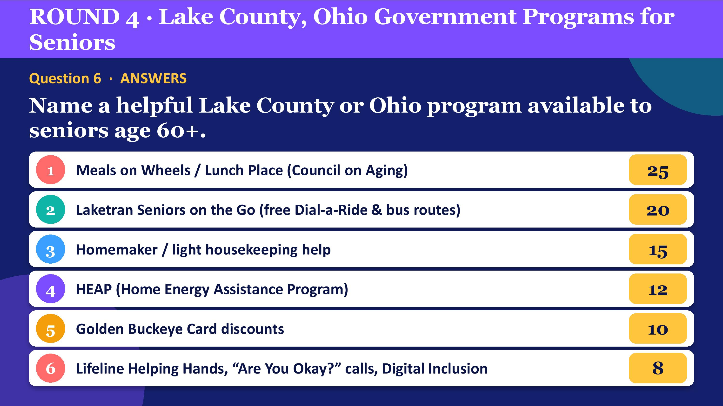

Slide 41
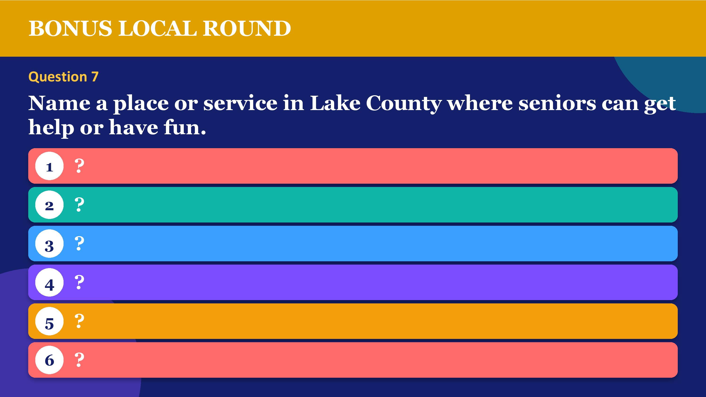

Slide 42
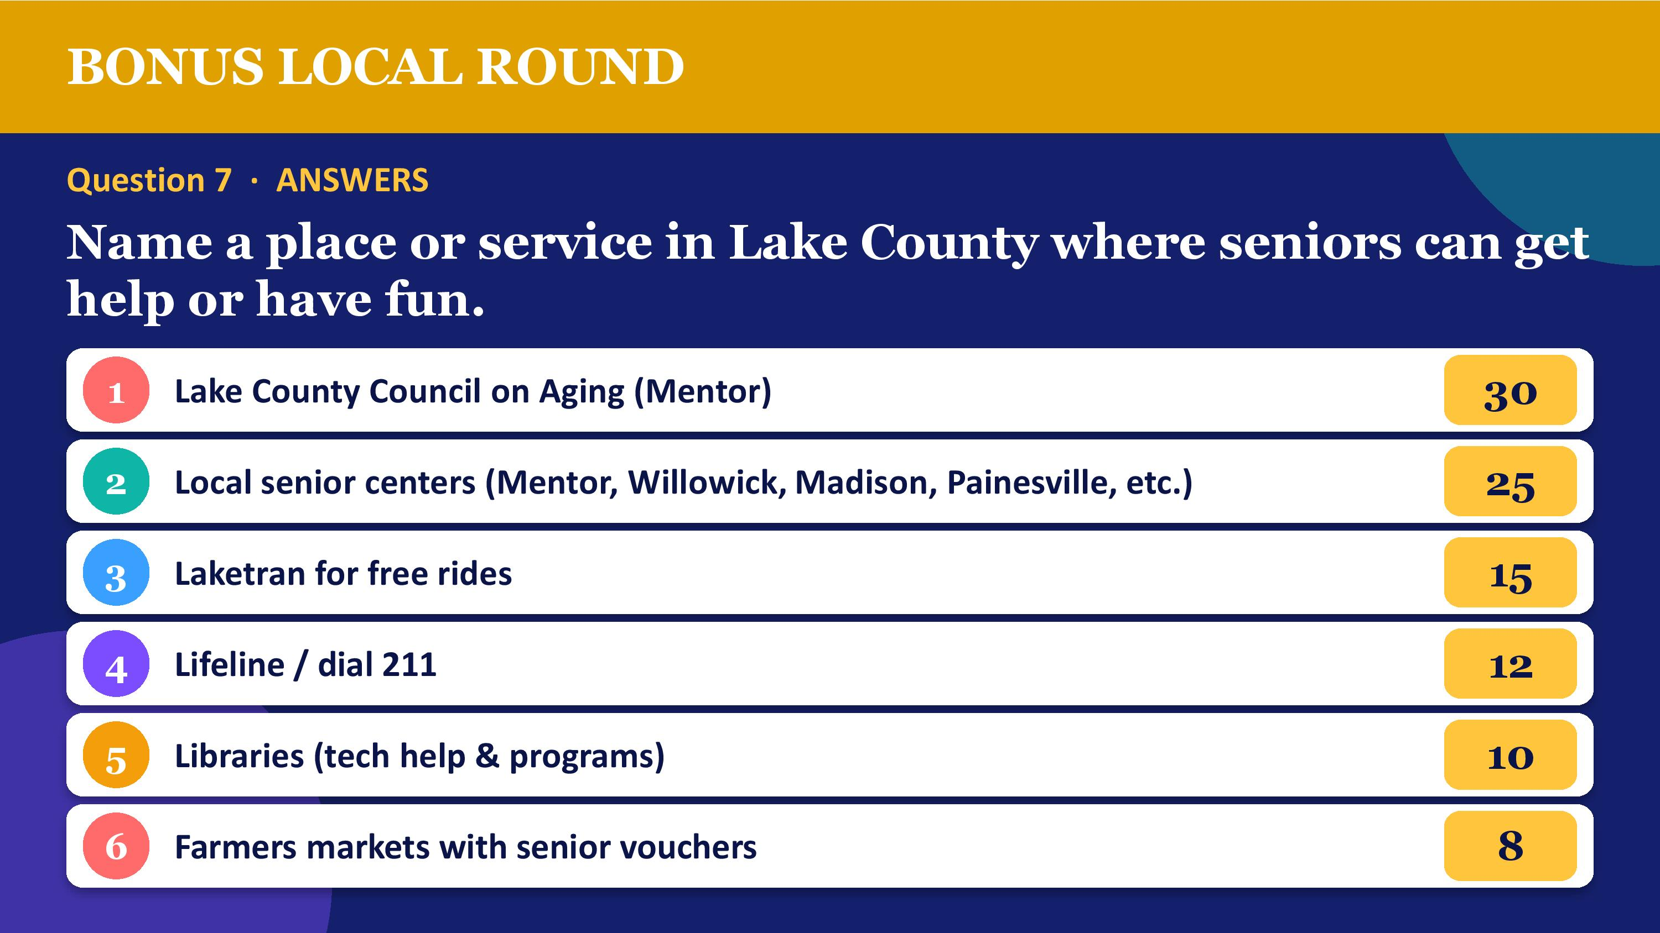

Slide 43
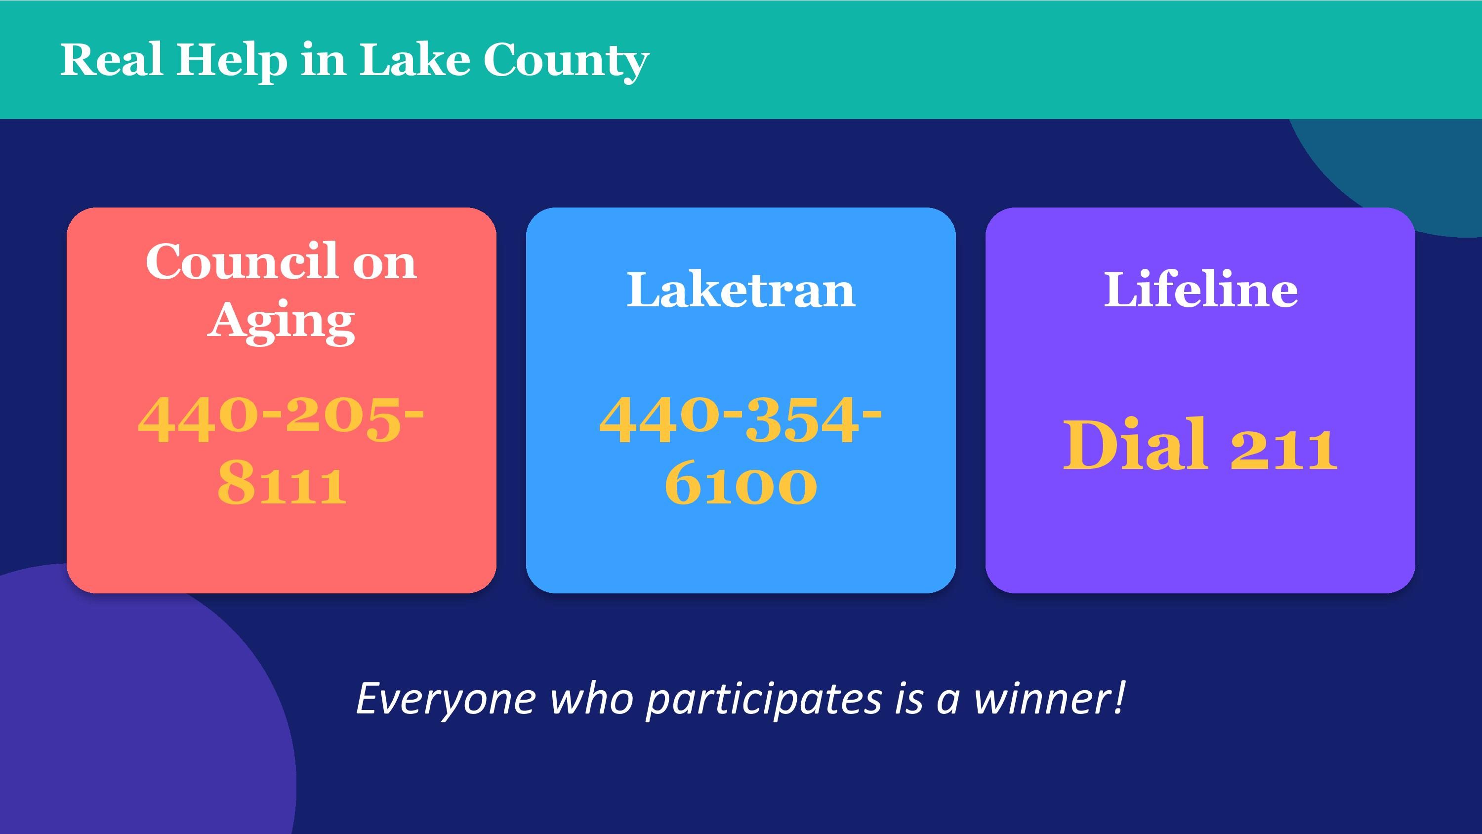

Slide 44


Michael Zuren, PhD
440-251-5381
mikezuren@att.net

